Slide 1


15th European Conference of Electoral Management Bodies
“Security in Elections”, Oslo, Norway, 19-20 April 2018
Cybercrime in the election process:
the role of the Budapest Convention
Alexander Seger
Executive Secretary
Cybercrime Convention Committee
Council of Europe
Strasbourg, France
alexander.seger@coe.int
www.coe.int/cybercrime

Slide 2
Cybercrime in the election process: threats
Elections rely on computer systems at all stages.
Types of interference:
Attacks against the confidentiality, integrity and availability of election computers and data
  Compromising voter databases or registration systems (e.g. hacking systems, deleting, changing, adding data)
  Tampering with voting machines to manipulate results
  Interference with the function of systems on election day (e.g. distributed denial of service attacks)
  Illegal access to computers to steal, modify, disseminate sensitive data (e.g. related to election campaigns) for information operations
Information operations with violations of rules to ensure free, fair and clean elections
  Data protection rules
  Rules on political finances
  Rules on media coverage of electoral campaigns
  Rules on broadcasting and political advertising
2

Slide 3
Budapest Convention on Cybercrime: scope
Criminalising conduct
Illegal access
Illegal interception
Data interference
System interference
Misuse of devices
Fraud and forgery
Child pornography
IPR-offences
+
Procedural tools
Expedited preservation
Production orders
Search and seizure
Interception
Limited by safeguards (article 15)
+
International cooperation
Extradition
MLA
Spontaneous information
Expedited preservation
MLA for accessing computer data
MLA for interception
24/7 points of contact
Procedural powers and international cooperation for ANY CRIME entailing evidence on a computer system!
Note: work on Protocol to Budapest Convention underway
www.coe.int/cybercrime
3

Slide 4
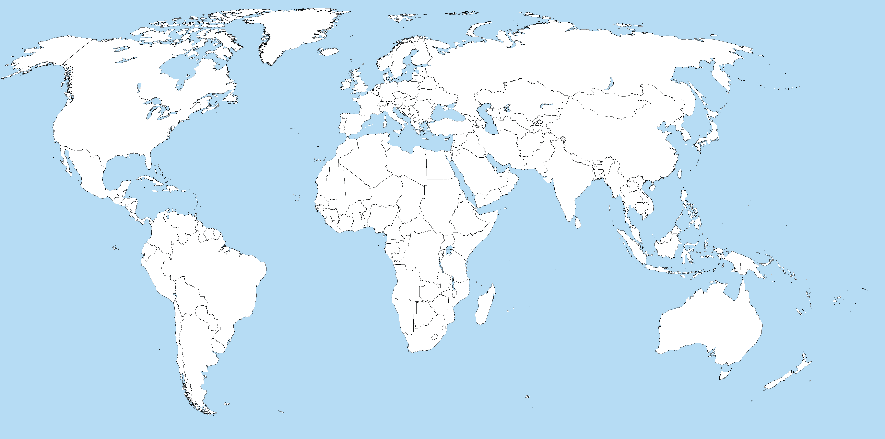
Budapest Convention: Reach
140+
Budapest Convention
Ratified/acceded: 57
Indicative map only
Other States with laws/draft laws largely in line with Budapest Convention = 20+
Signed: 4
Invited to accede: 10
= 71
Further States drawing on Budapest Convention for legislation = 50+

Slide 5
Cybercrime and other offences in the election process: the role of the Budapest Convention
Attacks against the confidentiality, integrity and availability of election computers and data
Compromising voter databases or registration systems
Tampering with voting machines to manipulate results
Interference with the function of systems
Illegal access to computers to steal, modify, disseminate sensitive data for information operations
Budapest Convention
Substantive criminal law provisions
Article 2 Illegal access
Article 3 Illegal interception
Article 4 Data interference
Article 5 System interference
Article 6 Misuse of devices
Article 7 Forgery
Article 8 Fraud
Article 11 Attempt, aiding, abetting
Procedural powers and international cooperation to secure electronic evidence and prosecute offenders
Articles 16, 17, 29 and 30 for data preservation
Article 18 Production orders
Article 19 Search and seizure
Etc. (incl. cooperation with service providers
Information operations with violations of rules to ensure free, fair and clean elections
Data protection rules
Rules on political finances
Rules on media coverage of electoral campaigns
Rules on broadcasting and political advertising

Slide 6
Cybercrime and other offences in the election process: the role of the Budapest Convention
Conclusions
Interference with elections involves cybercrime and/or electronic evidence
Institutions responsible for elections need to understand risks and measures to be taken
Invest in cybersecurity measures to protect systems used for elections and election campaigns
Prosecute cybercrime related to elections (chapter I Budapest Convention)
Secure electronic evidence and cooperate to identify and prosecute offenders (chapters II and III Budapest Convention)
  Apply procedural powers to secure evidence
  Interagency cooperation (involve specialised cybercrime and computer forensic units in investigations)
  International cooperation to secure evidence in other jurisdictions
  Cooperation with service providers (see work on Protocol to Budapest C.)
6

