Slide 1

Social Media and Election Legitimacy
Damian Tambini
OSLO 19/04/18

Slide 2
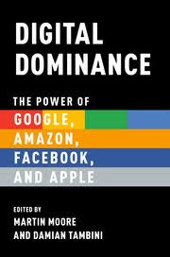

Overview of Presentation
Introduction to the issue of targeted propaganda
The MSI MED feasibility Study
Some general comments on recent events in the UK
and the controversy over Cambridge Analytica
Research: A collaboration with Who Targets Me
NEW Book: DIGITAL DOMINANCE Oxford University Press
MAY 2018

Slide 3
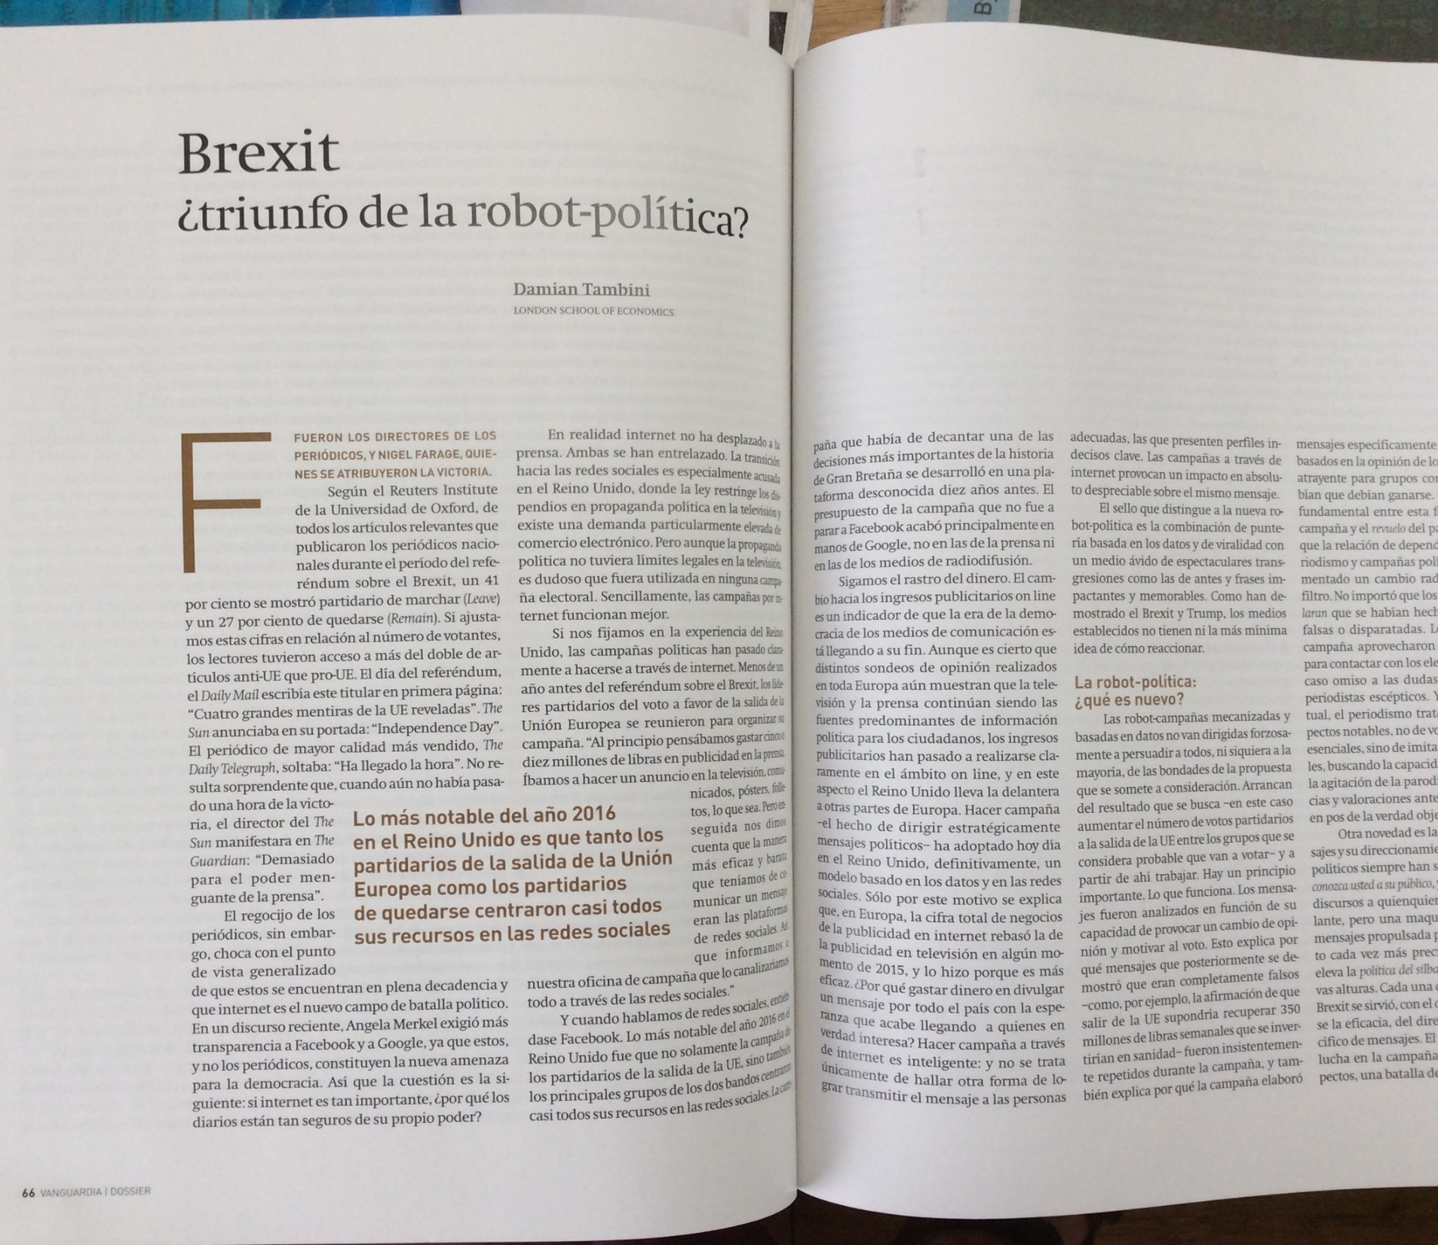
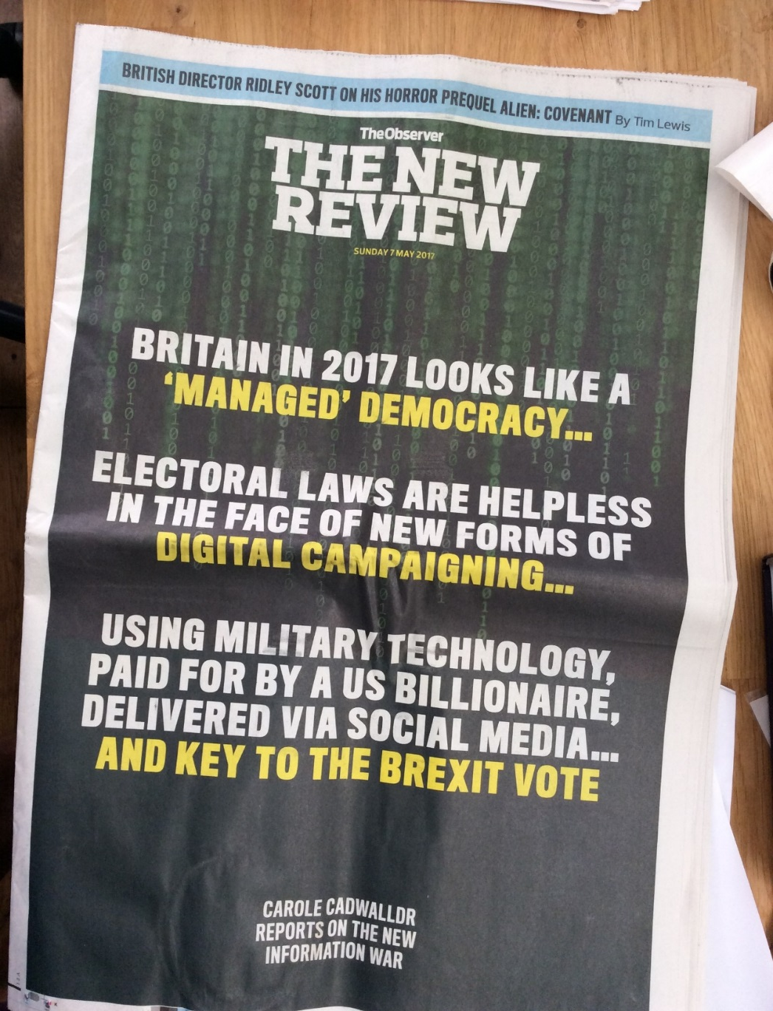

Slide 4
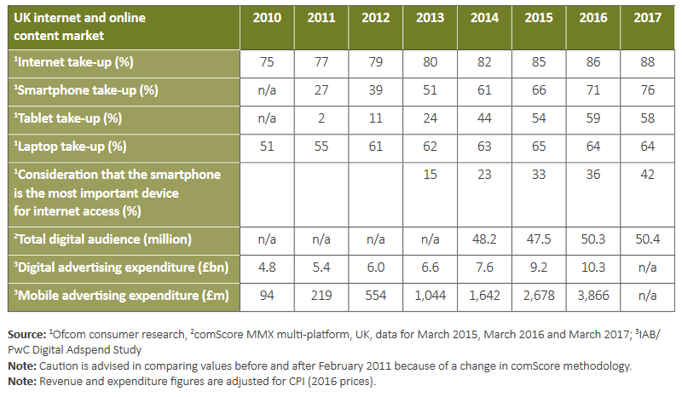
Citizens Move Online – and are increasingly socially active there

Slide 5


Data Driven campaigning
Audience building
Audience segmentation
Message creation
Message Targeting

Slide 6
Potential problems with social media targeting
Transparency
Fairness
Legitimacy
Voter autonomy
Notes:
Under most circumstances this kinda marketing would be fine. It turns out however that this is an inadequate framework for politics.
This is mainly due to the lack of regulation that has been applied to digital advertising.
Unlike Party Political Broadcasts - the ads you see on TV, digital advertising doesn’t have a “special category”. It just fits in under total campaign spending. There are two main problems with this:
Creating expensive databases of voters - not included in spend. And FB advertising - which by the way costs considerably less than maintaining the database of voters does not have a fixed limit on the volume you can

Slide 7
Normative concerns*
Radicalization
‘Fake news’
Redlining
Personalization
Opacity
Misinformation
Negativity
Manipulation
Disenfranchisement
*See Barocas (2012) for a discussion

Slide 8
Regulation of Election Campaigns
OVERALL AIMS: ELECTIONS SHOULD BE FAIR, CLEAN, AND TRANSPARENT
International standards, election monitoring, domestic election law, broadcasting and media law, journalism ethics.
Donation limits
Spending limits
Specific rules on categories of donators
Broadcasting regulation (advertising bans, impartiality, ownership rules).
Transparency obligations
Other issues ‘undue influence’, electoral fraud, ‘false statements of fact’.

Slide 9

Election legitimacy
The point of regulation is NOT to exclude or
disadvantage new political actors or ideas,
only to maintain a level playing field
in the democratic game

Slide 10
Potential problems…
Regulatory failure?
New targeted propaganda is not regulated like TV Party Political Broadcasts, and impartiality. Spending limits have not been updated
  Creating expensive databases of voters - not included in campaign spend
  Relatively cheap FB advertising - counts as total campaign spend
  Data protection and privacy: breaching data consent?
  …Longer term:
  Filter bubbles, truth and accuracy, ‘dog whistle’ politics?
  Transparency and accountability: “Dark Posts”
  Psychometric/ individual profiling

Slide 11

“We are conducting a wide assessment of the data-protection risks arising from the use of data analytics, including for political purposes, and will be contacting a range of organisations,” an ICO spokeswoman confirmed.
March 2017
Notes:
https://www.theguardian.com/technology/2017/mar/04/cambridge-analytics-data-brexit-trump

Slide 12

“The investigation is focused on whether one or more donations – including of services – accepted by Leave.EU was impermissible; and whether Leave.EU’s spending return was complete.
April 2017
Notes:
http://www.independent.co.uk/news/uk/politics/brexit-leave-eu-electoral-commission-investigation-spending-donations-arron-banks-a7695841.html

Slide 13


Slide 14
Potential Recommendations
New transparency requirements:
New political advertising guidance:
accessible repository of targeted messages
Fair access to campaigners at equal pricing
stricter controls on the use of personal data
further guidance on exemptions of third party campaigners and media
Ethical safeguards: Encouraging self-regulation

Slide 15
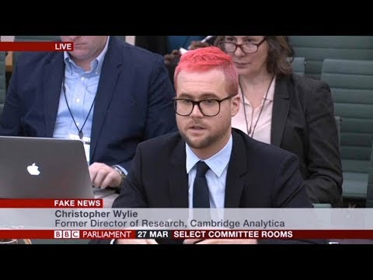
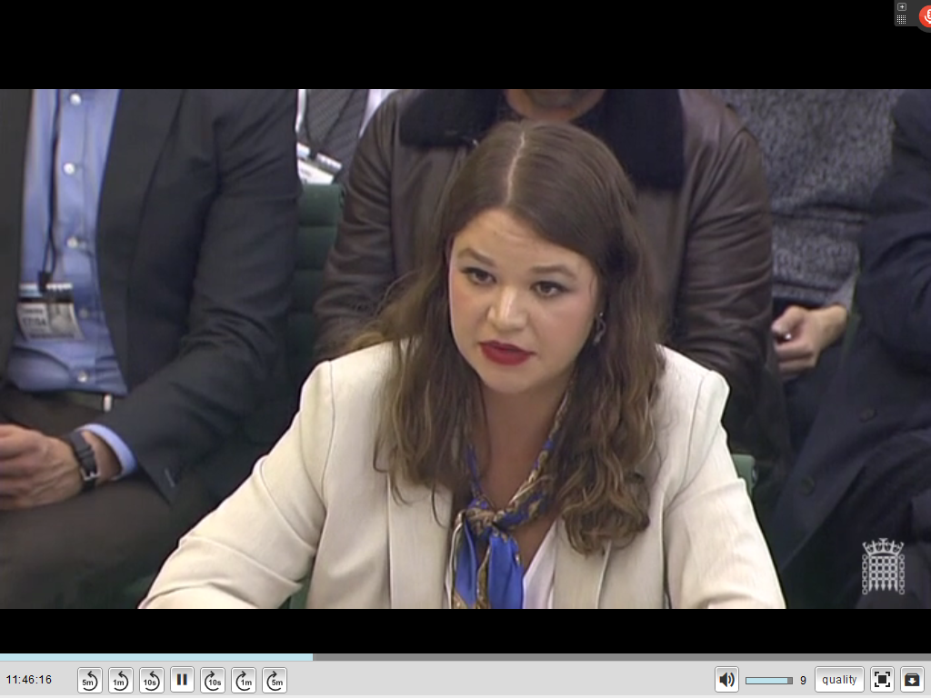
New Whistleblower Allegations: 2018
Breaches of consent for data use for political targeting
Spending breaches – foreign donations; ‘coordination’ of separate campaigns; setting up shell companies in order to breach spending rules.

Slide 16
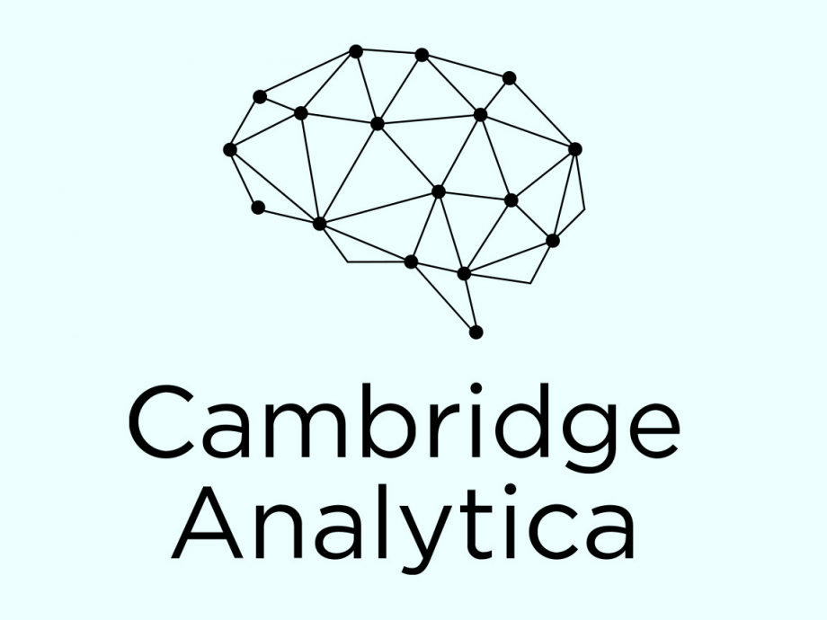
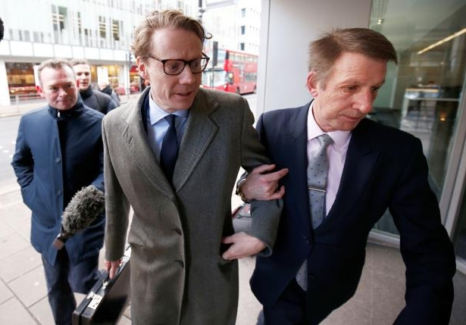
Targeting of fake news?
Cambridge Analytica’s Alexander Nix: ‘It doesn’t matter if it is true or not as long as they believe it’

Slide 17

Findings: moderate topic fragmentation
Notes:
Interesting to see that, while there certainly was fragmentation, topics do not seem to be AS FRAGMENTED as certain accounts of how microtargeting works would predict.

Slide 18
Findings: where’s Corbyn?
Notes:
While Theresa May’s name was used in more than 30% of Tories ads, Corbyn is completely absent.

Slide 19
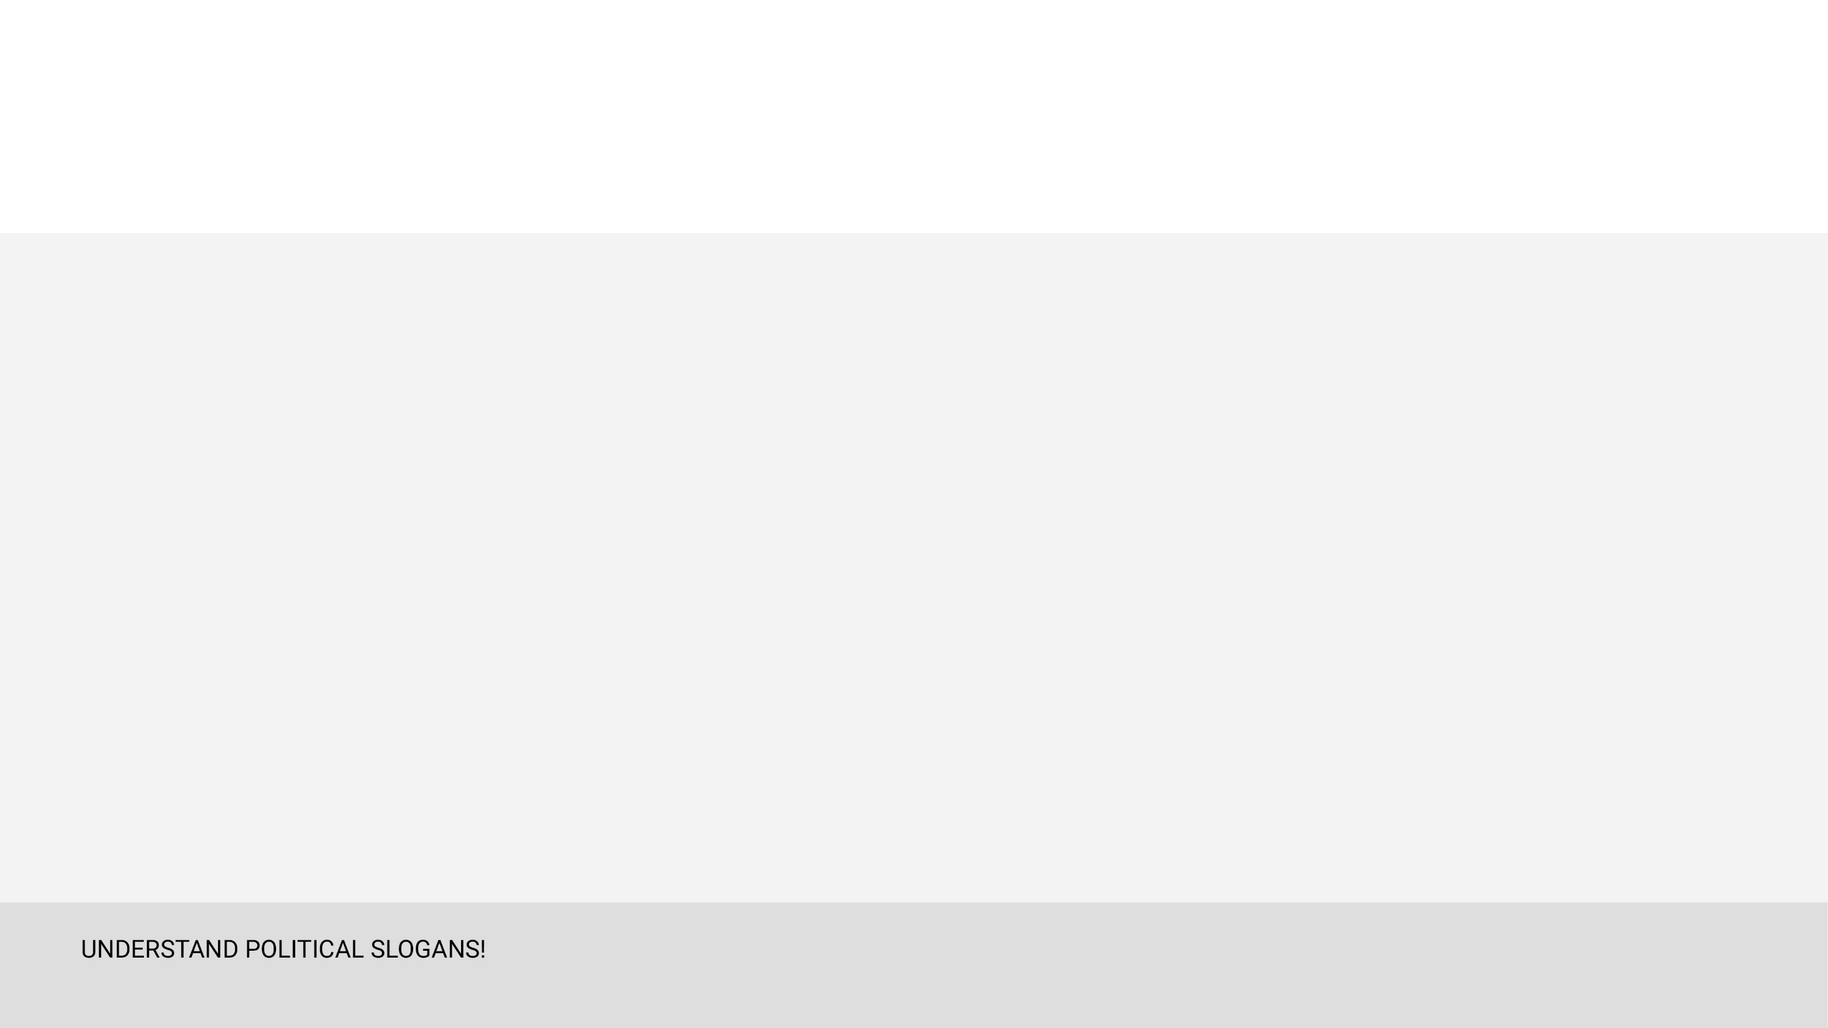
Findings: constituency targeting
Tories: strong correlation between PAD (Political Advert Density) and marginal constituencies
LibDems: weak correlation between PAD and marginal constituencies
Labour: no correlation between PAD and marginal constituencies

Slide 20
Law, policy and targeting
International election monitoring standards
Specific election offences (deliberate misinformation) guidance
Ad transparency (who is paying?): France, the USA
Campaign finance reform?

Slide 21
summary
Campaigns are moving online
Social Media (and particularly Facebook) are a dominant one stop shop
There are problems for the effectiveness and the enforcement of the existing rules
This is undermining legitimacy of electoral processes
These rules must be reviewed

