Slide 2
The usage of ICT in the election process in Bulgaria
Internet sites, registries and e-mails used by CEC, DEC, LEC
Electronic application for voting abroad
Electronic system for approval of the view and the content of the ballot papers, their number and for controlling the printing of the ballot papers
Computerized processing of voting data system (tabulation)
Machine voting and remote e-voting (in the future)

Slide 3
Local Elections and National Referendum October 2015
At the Local Elections and National Referendum in October 2015 an unprecedented for Bulgaria DDoS attack against the infrastructure used by the CEC/LEC was made.
The same attack was made against the web-pages of the President; Ministry of Interior, Directorate General Civil Registration and Administrative Services, National Income Agency and others.

Slide 4
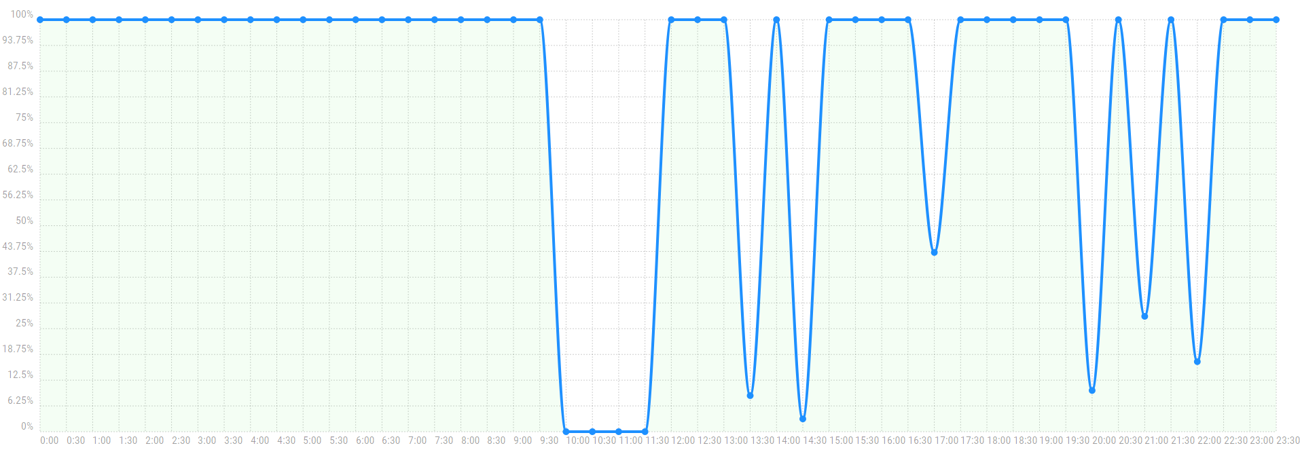
Chronology of the attacks and the steps taken
DDoS against www.cik.bg – partial downtime
Date: October 25th 2015
Website availability by hours

Slide 5
The steps taken by the CEC immediately
Informing the Council of Ministers and the LEC
Dissemination of information and documents to the authorities using alternative means – through the Council of Ministers’ administration - to the District Governors - to the local administration and to the Local Election Commissions; through faxes and mobile phones
Start of informing voters and observers using alternative means – Facebook, twitter, faxes, telephones
Informing the voters through the media for an access problem with the website and e-mails through the media
Informing through intensive briefings given by the CEC

Slide 6
How the attacks affected the election process
Despite the efforts of the teams of the CEC’s system integrator, Information Services JSC, and the experts from government organizations such as SANS and GDBOP (Unit for Combating Organized Crime), during the time of voting and announcement of the results there were interruptions in customer requests servicing.
The CEC used alternative methods to reach the stakeholders, election commissions and voters.
The systems used for computerized processing of voting data are physically isolated from the internet and can not be/were not affected by DDoS or other attacks against the public websites of CEC or any other organization.
The attacks had mostly negative coverage in media

Slide 7
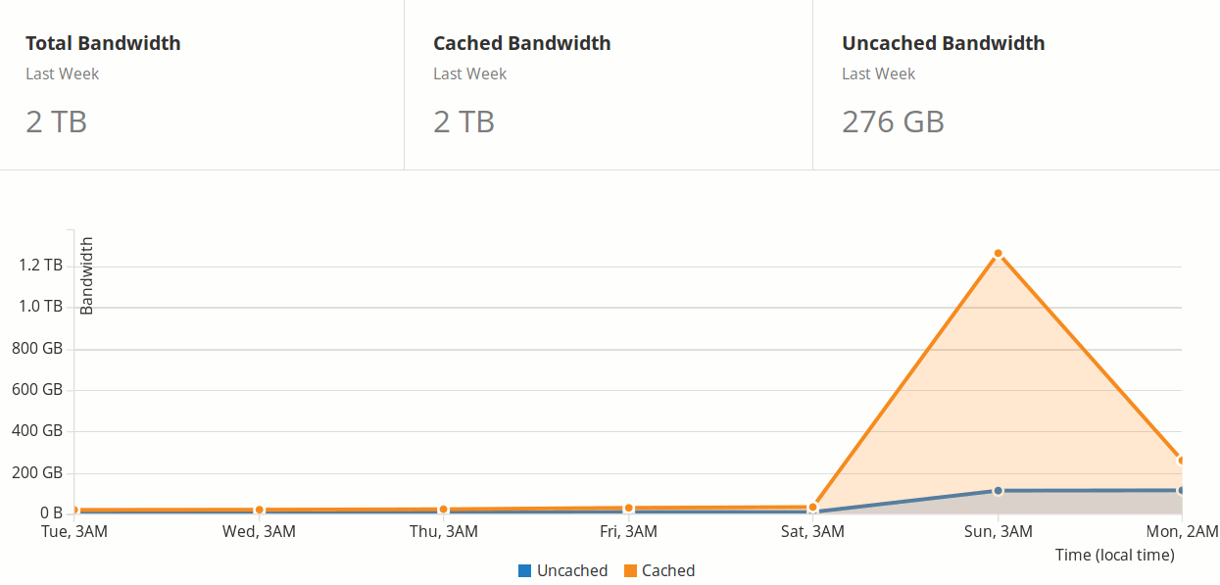
DDoS attack against cik.bg
DDoS against www.cik.bg – partial downtime
Date: October 27th 2015

Slide 8
The steps taken
Assessing the risks of cyber attacks for future elections.
Strategic investments made to upgrade the capacity of the data centers and communication infrastructure.
Good cooperation between the institutions; regular meetings in the pre-election, election and post-election period.
Close cooperation with all big telecoms, government authorities and private companies.
Preventive measures as development of alternative systems for communication and data transfer.

Slide 9
Elections 2016 - 2017
Since 2015 the website of CEC has been constantly exposed to new DDoS attacks, but thanks to the efforts made, they did not result in denial of service.
  Attacks against the public registers and other information
  Attacks against the electronic applications for voting abroad
  Attacks against the entire system
Prevention of cyber attacks against the electoral results.
  No internet connection
  Security check of people
  Double entering of the data
  Publishing original protocols (PDF) and the electronic data
Machine voting and remote e-voting

Slide 10
What allowed this to happen
Strategic documents
Legal provisions
Good coordination
Political willingness
Ideas and proposals based on lessons learned

Slide 11
What is to be done in the future
Constant development of the capacity to deal with cyber attacks including all the involved parties and the scientific society.
Tackling with the cyber attacks is wider than the borders of an individual country.
More intensive information exchange between EMBs.
More intensive cooperation between EMBs and institutions working in the field of cyber security.
A lot of efforts and good luck.

Slide 12
THANK YOU FOR YOUR ATTENTION!
Ivilina Aleksieva-Robinson
Chairperson of the Central Election Commission of Bulgaria

