Slide 1
The use of vote count software
J.G.C. (Jan-Kees) Wiebenga,
Chairman of the Electoral Council of the Netherlands
15th EMB Conference, Oslo, Norway
19-20th April 2018

Slide 2
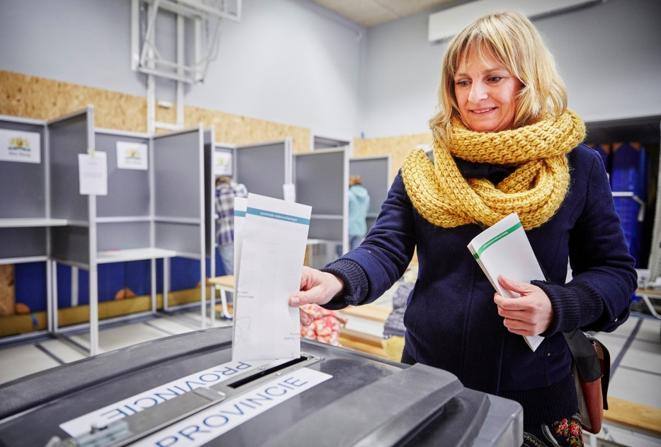
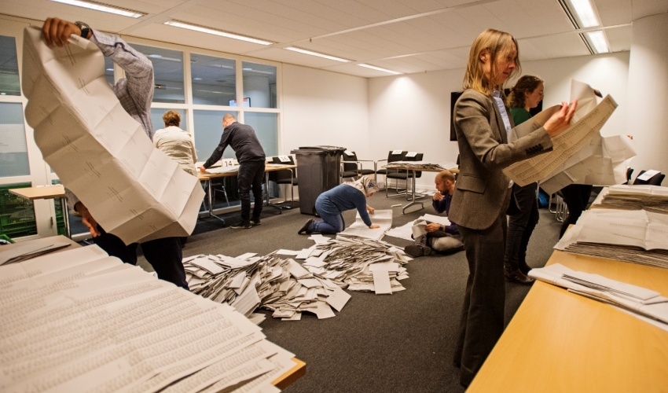
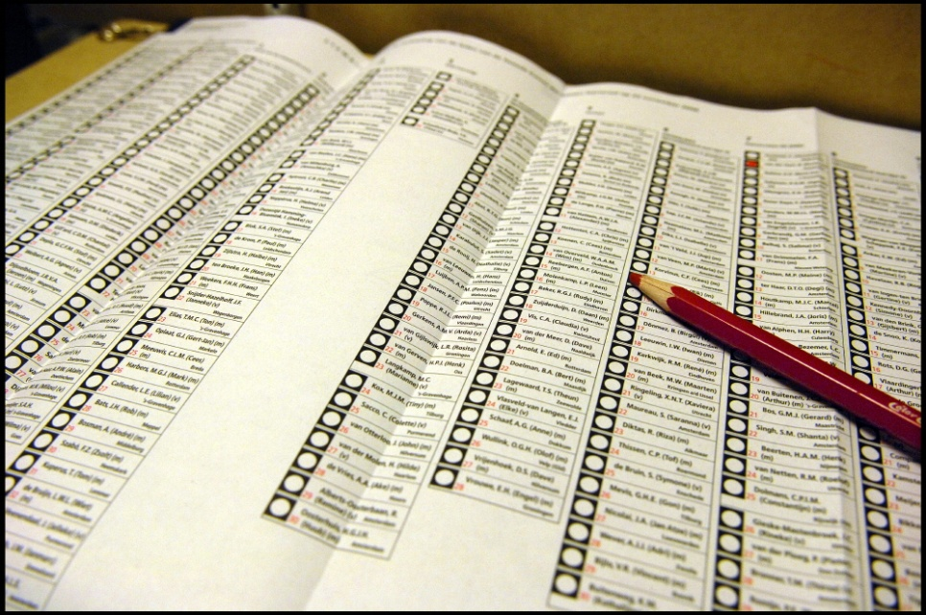
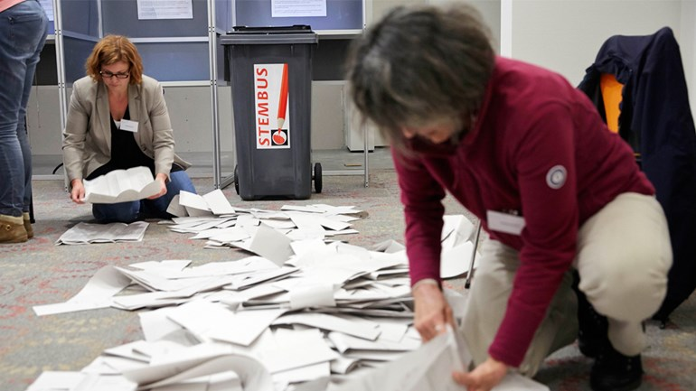
Elections in the Netherlands

Slide 3
Elections in the Netherlands
Kiesraad
Principal electoral committees (20)
Municipalities (388)
Polling stations (ca. 9500)

Slide 4
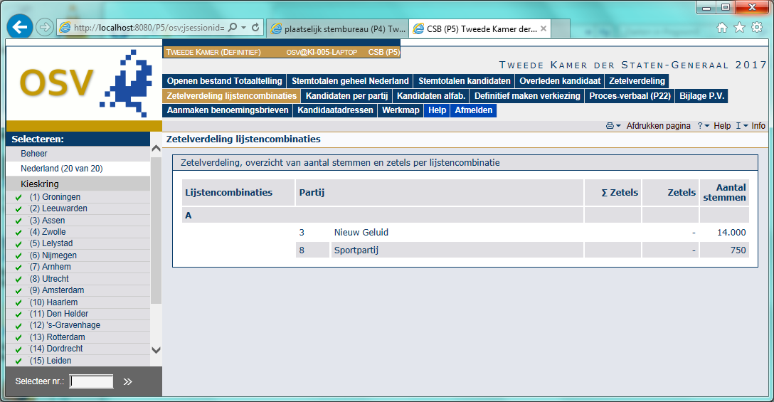
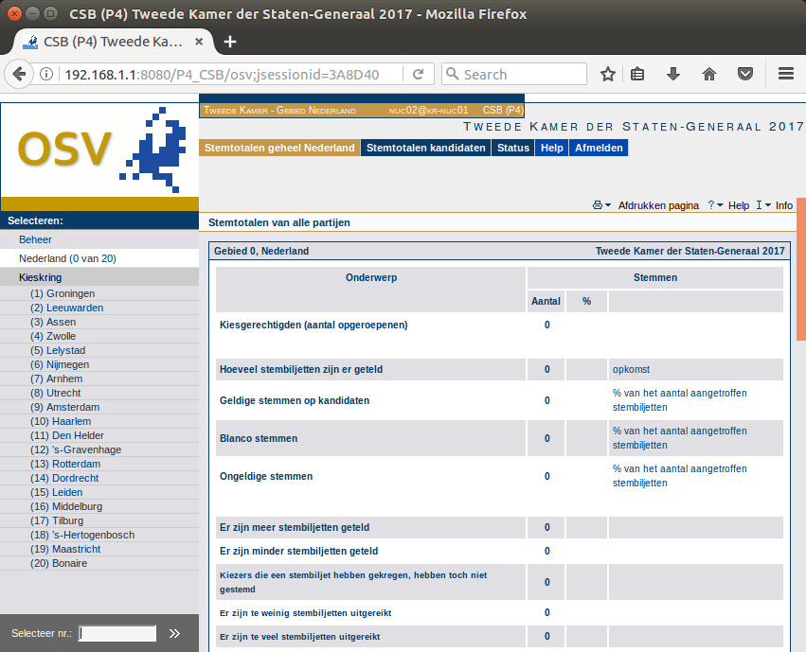
The software of the Dutch Electoral Council

Slide 5
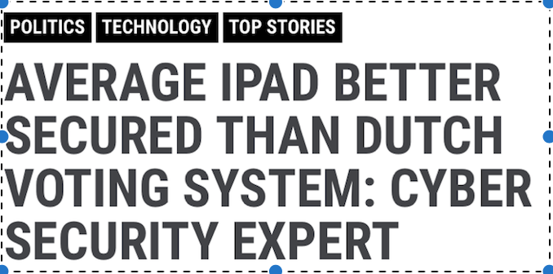
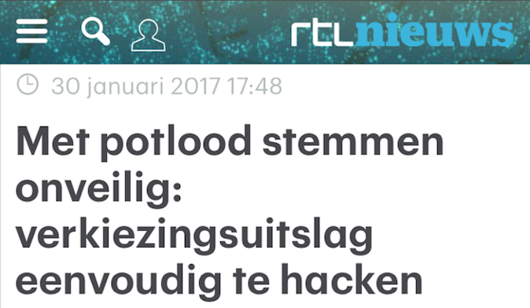
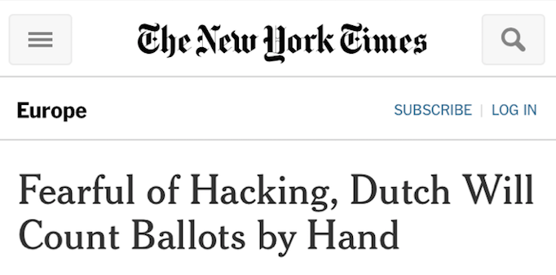
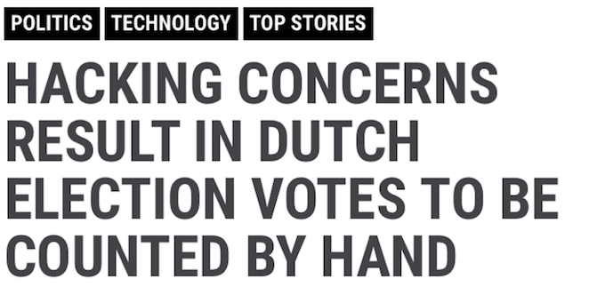
What happened?
- On nomination day a main news channel (RTLnieuws) broadcast that the election software was vulnerable

Slide 6
Coverage not all correct
Some misunderstandigs due to limited knowledge of electoral regulations and process;
They thought the system was connected to internet, while the requirements state that the system has to be stand-alone.

Slide 7
Not all misunderstandings
The used Java system was indeed old;
The human factor did form a vulnerability
Officials don’t always follow guidelines
Was software supporting or leading?

Slide 8
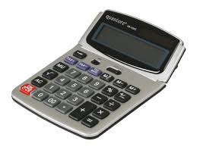
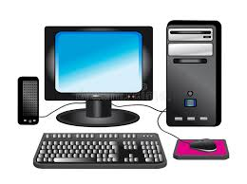
The consequences

Slide 9
Municipal elections 2018
Limited time but various improvements in software;
Discussion and media coverage about parallel manual count at all levels.

Slide 10
The future
Short term: OSV will be further updated and used for elections in 2019.
Long term: development new software based on new regulations.

Slide 11
Future answers needed...
Is it the digital process or the paper process on which the result is based?
Do we need both to have a reliable count?
Who is responsible for the software and systems?
Is it naive to think an EMB can prevent hacks?
What roll can full transparancy of the results play in finding hacks?

