Slide 1
IMPROVING THE ORGANISATION OF ELECTIONS: RESULTS FROM SURVEYS OF ELECTORAL MANAGEMENT BODIES PRESENTATION TO THE 15TH CONFERENCE OF EUROPEAN ELECTORAL MANAGEMENT BOARDS, 19-20 APRIL 2018, OSLO, NORWAY
Notes:
Thanks to the conference organisers and the Venice Commission
Thanks to electoral management boards and their staff who have given their time to contribute towards the collaborative project.
Also the Venice Commission

Slide 2
THE IMPORTANCE OF STAFF, CAPACITY, USE OF TECHNOLOGY, AND INDEPENDENCE
Successfully dealing with security challenges can be dependent on staff, the use/ownership of technology, capacity and independence of an EMB.
While many elections are conducted across the world to very high standards, there is inevitably variation in the quality of electoral management board performance.
In this presentation we present the results of the surveys that we have undertaken in collaboration with EMBs.
Notes:
Successfully dealing with security challenges can be dependent on staff, capacity, use of technology and independence of an EMB.
Yet we know little about these aspects of electoral management bodies.
In this presentation we present the results of the surveys that we have been undertaking in collaboration with EMBs, i.e. with all your support. Thank you! We will send you all a final report of results via snail-mail.

Slide 3
OVERVIEW
Who are we?
What we know about Electoral Management Boards
Response Rates
Conclusions
Capacity
Independence and Autonomy
Use of Information and Communication Technology
Workforce Characteristics
Conclusions
The Future…

Slide 4
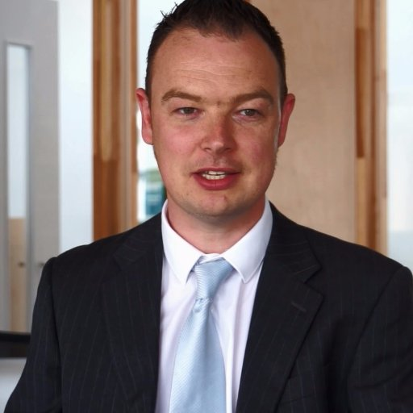
WHO ARE WE?
Dr. Toby James | Senior Lecturer, University of East Anglia, UK
Ms. Leontine Loeber | PhD Candidate, University of East Anglia, UK
Dr. Holly Ann Garnett | Assistant Professor, Royal Military College of Canada
Dr. Carolien van Ham | Lecturer, University New South Wales, Australia
Notes:
Renowned for our work in this area, having authored some of the major work on EMBs outside of America.
Have informed government policy.
Leontine’s legal work
Toby as a permanent Senior Fellow to UK Parliamentary Group
Holly’s work on EMB capacity ADD Holly?
Caro’s work on election integrity worldwide and role of EMBs in ensuring high quality elections
Experienced in surveying and interviewing electoral officials.
Have established the Electoral Management Network and www.electoralmanagement.com to profile leading academic research on the topic.

Slide 5
EXISTING EMB RESEARCH
What works?
Independence (Birch, 2013, Norris, 2015, van Ham and Lindberg, 2015, Birch and van Ham 2017)
Transparency (Garnett, 2017)
Performance monitoring (James, 2013)
Funding (Clark 2014, James 2014; James and Jervier 2017)
New challenges (James, 2014, Loeber 2017)
Limited data on EMBs:
International IDEA classifications
Expert surveys (Perceptions of Electoral Integrity Index, Varieties of Democracy)
Surveys of electoral officials in the UK, Ukraine and USA, but no cross-national comparisons.
Notes:
Limited research on the area
Main starting point has been the idea that independent EMBs are better because they prevent politicians interference. But literature reports mixed findings: mainly due to focus on formal independence rather than de facto independence.
We know that there are some innovative policy tools that can make a difference. In the UK the Electoral Commission set central standards for local officials to comply with and published the results. This provided a mechanism to introduce change and improve electoral management.
The funding of electoral services is usually, but not always, shown to be important
In older democracies, the tools designed decades or centuries ago, may no be longer effective. Challenges of immigration, changing social attitudes, use of ICT (!) and expectations change, make systems such as annual canvasses ineffective.
References for these studies are available at the end of the slides.
Research has been hindered by the lack of comparative data.
International IDEA has developed classification system
There are also some surveys of officials – but limited in geographical reach and no cross-national studies.

Slide 6
FRAMEWORK

Slide 7
EXPLAINING ELECTORAL MANAGEMENT PERFORMANCE
EMB Design
Centralisation
Independence
Capacity
EMB Performance
Service Quality
Service Effectiveness
Outcomes
Electoral integrity
Scope and division of tasks
Relation external actors
Personnel
Efficiency
Equity
Staff Satisfaction
Accountability
Impartiality
Probity
Citizen confidence in elections
Political actors' confidence in elections
Election legitimacy
Technology
The following might be important:
Capacity: What resources do EMBs have? Where are the resources spent?
Technology: What types of technology are used? Who makes these decisions? Who provides support on Election day?
Autonomy: To what extent are EMBs formally independent of government? What factors shape EMB de facto independence?
Personnel and Management: How long have staff been in their post? What qualifications and training do they have? Management practices? Job satisfaction?
Notes:
The project sought to identify the variation in the design of EMBs worldwide
We are then interested in how these variations can affect the quality of elections
We began by thinking that four areas might be important:
Capacity. What resources do EMBs have? Where are the resources spent?
Technology: What types of technology are used? Who makes these decisions? Who provides support on Election day?
Autonomy. To what extent are EMBs formally independent of government? What factors shape EMB de facto independence?
Personnel and Management. Management practices? Employee experiences such as job satisfaction, stress or workload?

Slide 8
OUR SURVEYS
A structural survey of one senior official in each EMB:
The organisational design of the EMB
The volume of staff
The tasks and responsibilities of the EMB
The decision making process within the EMB
The budget and resources of the EMB
The EMBs involvement with the international community
Use of ICT in the electoral process
An online survey of all personnel, to identify:
Role within the EMB
Perceptions of the quality of elections in their own country
Perceptions of the human resource practices and their workplace
Training and professional development
Demographic information
Collaboration with the Electoral Integrity Project
Notes:
- We developed two surveys which were translated and circulated to all European EMBs at the 13th Conference of EMBs in Burcharest.
- The first was a survey asking each EMB about the structure of their organisation.
- The second was designed to be circulated to all personnel within the EMBs
Key principles were confidentiality and mutual trust with EMBs
Information from the structural survey was designed to be eventually made publically available, but we allowed EMBs the option of selecting which information could not be published.
Information from the personnel survey would not be published and individual countries would not be identifiable in the results and analysis. Instead, we would analyse all data together.

Slide 9
RESPONSE RATES

Slide 10
78 ORGANISATIONS FROM 72 COUNTRIES
(35 PROVIDED BY ELECT)
2,032 INDIVIDUALS FROM 52 COUNTRIES
(800 PROVIDED BY ELECT)

Slide 11
LARGEST EVER SURVEY OF EMBs?

Slide 12
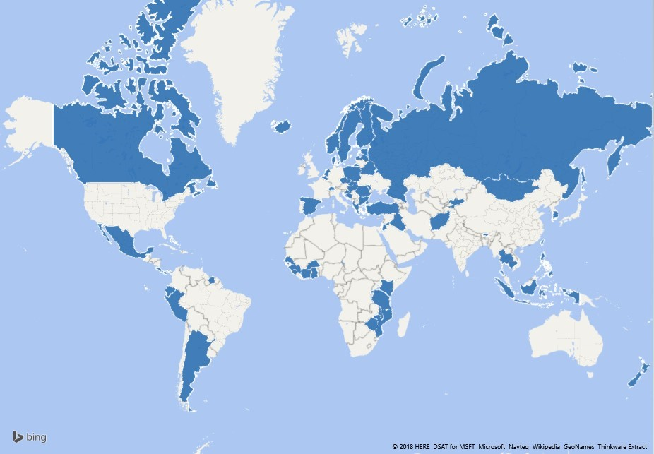
COUNTRY COVERAGE (EMS + ELECT)

Slide 13
RESULTS

Slide 14
INDEPENDENCE: Four Components
Four Components of Independence:
Institutional
Personnel
Financial
Functional
Notes:
We identified four components of EMB formal / de jure independence:
1) Institutional independence
EMB independence from politics formally stated in electoral laws or constitution?
2) Personnel independence
Who selects EMB Chair & Members? Terms? Appointment etc.
3) Financial independence
How are budgets allocated, who has control?
4) Functional independence
Scope of competences delegated to EMB? Monitoring and relationship with other organizations.
Chart: example of findings – we find that in bivariate relationships, oversight by partisan actors (which can include legislative and executive branch) can undermine EMB independence.

Slide 15
INDEPENDENCE: Institutional design alone is not enough
Key Take-Aways:
De facto EMB independence is crucial for election integrity
EMB de jure independence affects de facto EMB independence:
Political party involvement in EMB oversight, appointment of EMB chairs and members by partisan actors (including the executive and the legislature), less secure terms of chairs and members, and rules allowing for party membership of EMB chairs, significantly undermine de facto EMB independence.
More research needed on sources of EMB funding
However, effects relatively weak: EMB de jure independence is only one component of promoting actual, de facto EMB independence
EMB de jure independence
EMB de facto independence
Electoral Integrity
Notes:
We then analysed how these 4 dimensions of de jure EMB independence affect de facto EMB independence.
Does institutional design make a difference?
The results of these tests suggest that political party involvement in EMB oversight, appointment of EMB chairs and members by partisan actors (including the executive and the legislature), less secure terms of chairs and members, and rules allowing for party membership of EMB chairs, significantly undermine de facto EMB independence. In addition, a surprising finding was the importance of sources of EMB funding for de facto EMB independence.
The negative effects of private donor and international organization funding to EMBs, as well as the presence of foreign governments in the funding of EMBs, calls for further research into how electoral management autonomy is affected by influence from external actors. However, despite these interesting bivariate findings, most of these effects are no longer significant when all four dimensions of institutional, personnel, financial and functional independence are included in a joint model, or when control variables are included. This suggests that de jure independence is only weakly related to de facto independence.

Slide 16
CAPACITY : Budgets and Personnel
Budgets: Range from <$0.01 to $40 (per capita, PPP USD)
Personnel: Range from <1 (per 100 000) to 70
Key Take-Aways:
Variations in tasks
Centralization/Decentralization
International assistance
Sharing of resources
Notes:
There are two major components to measuring EMB capacity:
Budgets – Range from less than 1 cent per person, to $40 per person (all adjusted for PPP USD)
Personnel – Range from less than 1 per 100 000 population to 70 per 100 000 population
Key Take-Aways:
Budgets and personnel are not clear metrics of capacity
Variations in tasks – some EMBs are doing all functions, some have more narrowly defined functions
Variations in centralization (ie. some have local offices that are not captured)
Variations in international assistance (ie. some have a high amount of foreign assistance) – nearly 50% of EMBs reported some form of foreign assistance
Sharing of resources between departments, and secondment of personnel: 63% of EMBs that responded to this question noted that they received some additional personnel from other departments, particular during election periods

Slide 17
INFORMATION AND COMMUNICATIONS TECHNOLOGY
Notes:
Differs a lot between countries, but also regions. Biometrics used in Africa, Asia and Latin America, but not Europe. Phillipines and republic of Korea use 7 of the mentioned technologies.

Slide 18
ICT and EMB
65% EMB decisive role, 22% advisory, 6% mixed and 6% no role at all.
Ownership: 64% EMB, 11% central government, 5% local government, 12% private company and 8% other.
Support on Election day: 48% EMB, 10% central government, 6% local government, 29% private company and 8% other.

Slide 19
PERSONNEL: Characteristics of Employees
Generally small permanent national workforce teams – some outliers e.g. Mexico and Iraq
Gender imbalances. Men make up more of the workforce in Africa, Asia-Pacific and Latin America and Caribbean - women in Europe. However, women always less likely to be employed at senior levels.
Motivations for working in elections is civic mindedness
The work force is very well educated with 78.9 per cent educated to university undergraduate degree level.
Average job tenure varies between countries.
The surveys measured human resource practices and employee outcomes
Team working widely encouraged, performance related pay is rare.
Employees have a strong sense of belonging to their organisations, are satisfied with their job, and generally do not intend to leave in the immediate future. Stress and high workloads can be a problem.
Notes:
The surveys give us information, for the first time, about the structure of workforces around the world and their characteristics:
There are generally small permanent national workforce teams – some outliers e.g. Mexico and Iraq
There are gender imbalances. Men make up more of the workforce in Africa, Asia-Pacific and Latin America and Caribbean - women in Europe. However, women always less likely to be employed at senior levels.
Motivations for working in elections is civic mindedness rather than material factors like pay.
The work force is very well educated with 78.9 per cent educated to university undergraduate degree level.
Average job tenure varies between countries – suggesting huge variation in levels of experience
The surveys measured human resource practices and employee outcomes
Team working widely encouraged, performance related pay is rare.
Employees of EMBs seem to have a strong sense of belonging to their organisations, be satisfied with their job, and generally do not intend to leave in the immediate future. There is some evidence that the workload can be high and that levels of stress can be considerable, however.

Slide 20
PERSONNEL: Improving EMB Performance
Human resource management practices
Recruitment processes based on ability, opportunities for involvement in decision-making, policies to promote motivation, opportunities for regular staff appraisals
Employee outcomes
Job satisfaction, propensity to quit, lower levels of stress
Better EMB Performance
Key finding:
Including workers in decision making improves performance
Notes:
We can also use the data to work out which policies help EMBs to deliver better run elections. Data is available from expert surveys about how well run elections were.
Using statistical analysis, the effects of different human resource practices and employee outcomes were identified.
A variety of factors can affect EMB performance. However, the most important practices are:
Enabling employees to be involved in decision-making processes. This suggests that the practices of consulting with employees will bring about better decisions and allow problems to be prevented.
Stress was also important. EMBs should therefore consider ensuring that stress-management courses are provided to employees and workloads do not become too great.

Slide 21
CONCLUSIONS

Slide 22
MAIN CONCLUSIONS
There is variation in EMB organizational structure, capacity, use of ICT and personnel that can be measured through institutional and personnel surveys
For EMB Independence, the promotion of:
De facto autonomy of the EMB in relationship to political actors, Impact of sources of EMB funding (national and international) on EMB independence needs more research
For EMB capacity, the promotion of:
Clear reporting of resources, personnel, and assistance for maximum transparency
For use of ICT, the promotion of:
Involvement of EMB in decision-making process, consideration of questions of ownership and ability to provide technical assistance on election day.
For EMB personnel, the promotion of:
Workforce gender balances through recruitment and promotion practices, Employee involvement/consultation in decision making, Stress management/prevention courses and policies for staff, Ensuring that recruitment is by merit through a rigorous process
A commitment to working with academics to evaluate EMB institutional design and practices
Future wave of the surveys are endorsed to chart change and the effects of reform
Notes:
On the basis of the findings we have the following suggested conference conclusions.
There is variation in EMB organizational structure, capacity, use of ICT and personnel that can be measured through institutional and personnel surveys
For EMB personnel, the promotion of:
Workforce gender balances through recruitment and promotion
Employee involvement/consultation in decision making
Stress management/prevention courses and policies for staff
Ensuring that recruitment by merit through a rigorous process
A commitment to working with academics to evaluate EMB institutional design and practices
Future wave of the surveys are endorsed to chart change and the effects of reform

Slide 23
NEXT STEPS

Slide 24
NEXT STEPS
Full report will be circulated to all Electoral Management Boards
Sign-up to http://www.electoralmanagement.com/electoral-management-network/newsletter-sign-up/ for new research findings as they emerge
Delighted to provide bespoke advice / information on request.
Would like to rerun in the future to map change and improve the survey design
Comments and feedback about your research needs are very welcome!

Slide 25
THANK YOU!
Notes:
Thank you for listening to the presentation and for your kind assistance. Without the support of the EMBS and the Venice Commission this project would have been possible.
You can find more information about us on the electoralmanagement.com website or feel free to approach us at the conference or via email.
We are happy to make these slides available to you and they include a statistical appendix.

Slide 26
Select References
Birch, Sarah. 2011. Electoral Malpractice. Oxford: Oxford University Press.
Birch S; Van Ham C, 2017, 'Getting away with foul play? The importance of formal and informal oversight institutions for electoral integrity', European Journal of Political Research, http://dx.doi.org/10.1111/1475-6765.12189
Clark, Alistair. 2014. "Investing in Electoral Integrity." In Advancing Electoral Integrity, edited by Pippa Norris, Richard Frank and Ferran Matinez I Coma. New York: Oxford University Press.
Holly Ann Garnett. 2017. “Election Management Bodies.” Election Watchdogs: Transparency, Accountability, Compliance and Integrity. Eds. Pippa Norris and Alessandro Nai. New York: Oxford University Press.
James, Toby S. 2013. "Fixing failures of U.K. electoral management." Electoral Studies, 32, (4), p. 597-608.
James, Toby S. 2014. "Electoral Management in Britain." In Advancing Electoral Integrity, edited by Pippa Norris, Richard Frank and Ferran Matinez I Coma. New York: Oxford University Press.
James, Toby S. forthcoming. Comparative Electoral Management: Performance, Networks and Instruments. London and New York: Routledge.
James, Toby S. and Jervier, Tyrone. 2017. ‘The cost of running elections: funding electoral services during austerity in England and Wales’, Public Money and Management, 37(7), p. 461-468.
Loeber, Leontine. 2017 “Legislating for e-enabled elections” In E-voting, edited by Robert Krimmer et al. Springer.
Norris, Pippa. 2015. Why Elections Fail. New York: Cambridge University Press.
van Ham, Carolien, and Staffan Lindberg. 2015. "When Guardians Matter Most: Exploring the Conditions Under Which Electoral Management Body Institutional Design Affects Election Integrity." Irish Political Studies, 30, (4), p. 454-81.
Notes:
Should we add the Special Issue here??

