Slide 1
Cybersecurity of election technology: what can states do
Liisa Past, CRO
”Security in Elections” conference
Oslo, April 20, 2018
Notes:
Auxilliary systems –
Doubt and confusion
3 levels
Adversarial thinking
Not only paper

Slide 2
“There’s been a lot of claims that our election system is unhackable. That's BS.
Only a fool or liar would try to claim that their database or machine was unhackable.”
Jake Braun, DefCon 2017 hacker voting village
Notes:
Planning assumption
PAPER as well

Slide 3
1. Accept risks are related to paper and digital

Slide 4
Technology does not matter
Elections uniform, general, direct
Voting free and secret
Notes:
Election tech cannot tamper with these and cannot come at the expense of these
Baseline of
Integrity
Identification
Legal framework and political will
Security

Slide 5
2. Innovation cannot come at cost of legal requirements (including security)
Notes:
Start small

Slide 6
Cyber-related attack vectors
Internet voting
Election technology
Attacks on auxiliary systems, facilitators and vendors
Integrated information operations
Notes:
Regardless of the adversary/ attacker

Slide 7
3. Understand your risk profile

Slide 8
Politically motivated attackers
Objective: delegitimization, not necessarily fraud
Well-resourced and patient
Strategic and opportunistic
Plausible deniability replaced with attribution
MO very different from criminals
Notes:
Adversary opportunistic and reactive
Attack surface wider
Includes nations, political players, hactivists

Slide 9
5. Understand the likely attacker’s likely motivation and capabilities

Slide 10
6. Comprehensive risk assessment and mitigation

Slide 11
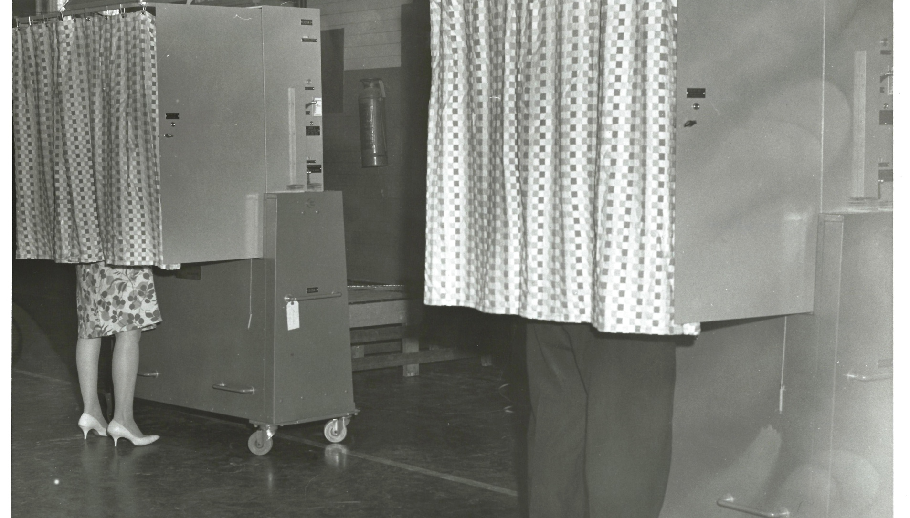
6.1 Technical measures
Voting Booths 1966, Photo CC: Josie Barnett, Oregon City Enterprise Courier

Slide 12
Secure (election) technology
Documentation, procedural controls
Back-up, revert and recovery
Testing, audit, transparency
Access control and procedures
Monitoring and logging
Incident handling
Technical tools for specific threats (DDoS protection etc.)
Constant feedback and improvement

Slide 13

6.2 Management and communication
Notes:
Clarity of roles

Slide 14

6.3 Stakeholderism, including candidates
Notes:
Clarity fof roles
I-voting task force

Slide 15
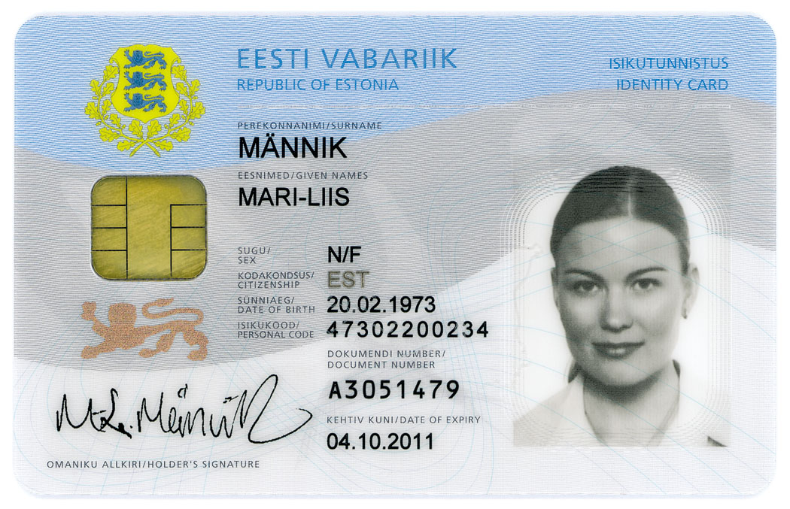
6.4 Dependencies and supply chain
Notes:
Additional tokens
Mobile-ID: SIM-card-based token
Digi-ID: additional card for digital use only
E-Residency card
Diplo-ID
This is how the key to our digital universe looks like. Contains only 3 things:
Personal data file (which is not part of the eID but is to help physical identification of the person in a machine readable way), all other data about the person is not on the chip but in the services. Card is just the key to services. And you have a very wide choice of services. The only 3 things that you cannot do over the Internet using your eID – getting married, getting divorced and buy a property – 3 most important decisions in your life.
Certificate for authentication
Certificate for digital signature – digital signature cryptographically computes a hash of the document and encrypted that is legally aquivalent to physical signature
When we speak about use cases, then in addition to digital authentication and a legally binding digital signature (which is equivalent to the physical one), Estonian national eID card also offers the functionality to encrypt and decrypt files using the authentication certificate. Since 2002 Estonians have had the ability to safely send sensitive files over the Internet. This is supported by national legislation (Digital Signatures Act, 2000).
An ID card comes with a official email address that the card owner can redirect to another email address. That address works as an official channel in state-citizen communications.
1st IDcard was issued in JAN2002, in 2006 1mln-th card was issued. 2007 – mID
Regarding eID management, the cornerstone of our system is that every person is uniquely identifiable through the PIC and the state has the responsibility to indentify a person, confirm the identity and issue cetificates.
A person (in relation with the state) has only one identity. .
The PKI used in Estonia is the national PKI. This means that the state undertakes to assure the existence and functioning of a public key infrastructure even though a large part of the services related to the PKI is purchased from the private sector, e.g. the certification, the infrastructure for making enquiries about the validity of the certificate, the infrastructure for distributing the public key (LDAP service), the key creation environment (e.g. ID card chip).
Price for smart card readers: in 2003 – 20 eur, in 2007 – 5 eur.
Traffic penalties – depending on speed, the system generates automatic file and sends it to your official mailbox, encrypted (sent over regular mail but only the person who receives it can see).
Eesti.ee is the central government e-service portal of Estonia exposing over 800 services from a wide range of service providers.

Slide 16
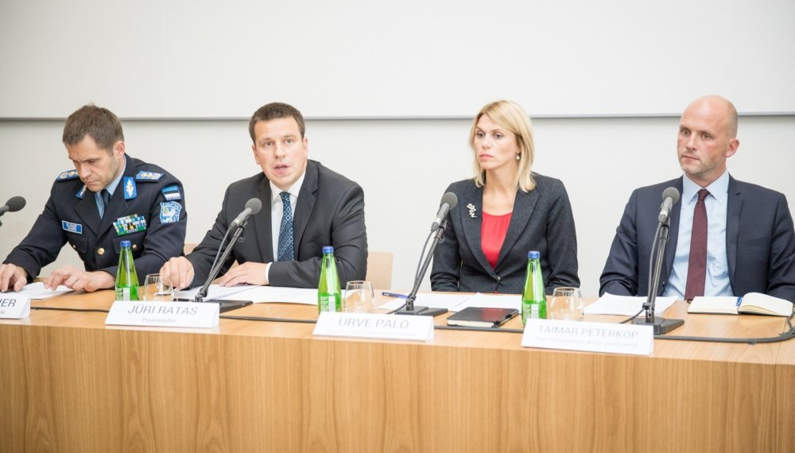
Agressively open vulnerability management (Estonia, 2017)

Slide 17
Aggressively open vulnerability management (Estonia, 2017)
Case of firmware flaw in ID-card
Impact: 800 000 ID cards (55%)
Need to ensure credibility, cooperation
Avoided tsunami of crisis communication
Allowed to focus on solution

Slide 18
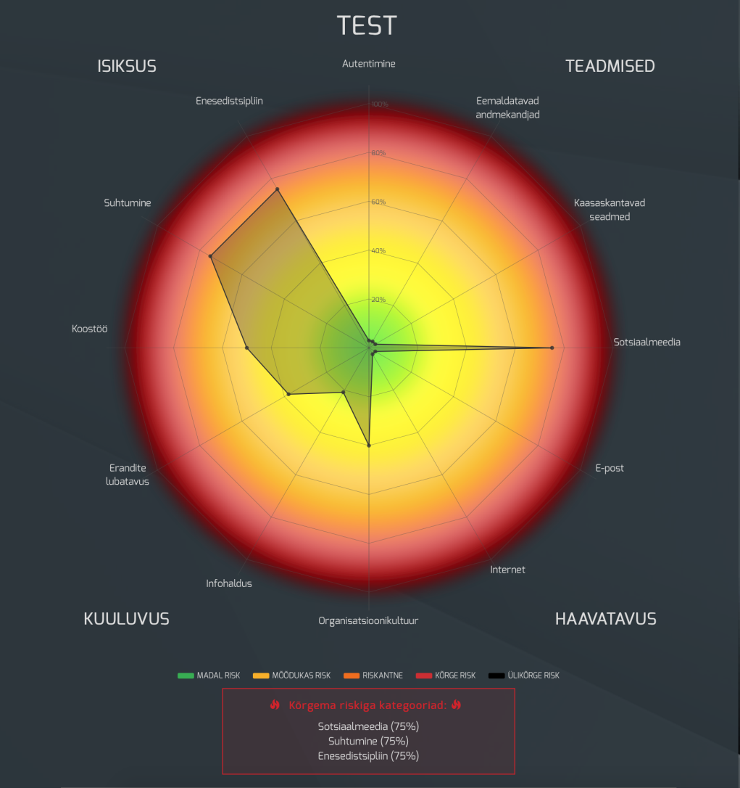
6.5 Rely on ecosystem, security/risk level
Example of Estonian DigiTest Risk Profile

Slide 19
Start small
1/3 of Estonians vote online
About 500 m digital signatures given
Robust data exchange layer
Digital Population registry
1/3 of votes cast online
Notes:
95% of taxes declared online
1 in 50 medical prescriptions on paper
Let’s see how it has held up
No way back
Services are available offline
But digital Estonia is a recognized necessity
Resilience and security by design
“We’ve burnt the ships“
Rationale for digital society: benefit for economy, transparency and efficiency for governance, individual liberties
Digital Estonia as a recognised necessity
Demographic and geographic constraints
Technological constraints
High awareness and systematic capacity building
Trust and cooperation
No legacy or proprietary solutions
Open by law
Open specifications, protocols, documentation
Open procedures, public observers
Open source code
References
www.valimised.ee – EN – e-voting – documentation
https://github.com/vvk-ehk/ivxv - real source code

Slide 20
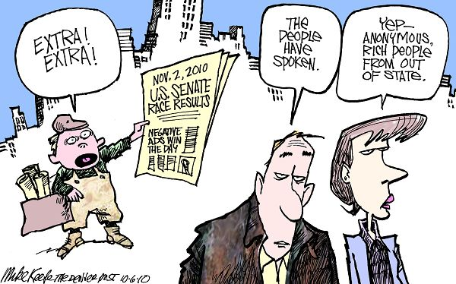
6.7 Prepare for political and hybrid
Mike Keefe 2010, from http://www.intoon.com/cartoons.cfm/id/91364

Slide 21
7. Prepare for the likely (make meddling ineffective) and the detrimental (keep elections running)

Slide 22
Cyber security of election technology
  Voter and candidate registration and voter databases including eligibility checks;
  voter identification;
  electronic tools used to gather process and count votes;
  systems to display, broadcast or communicate election results;
  supply chain security of systems and tools;
  relevant auxiliary systems and services.
Notes:
: digital components are used to assist in organizing elections. These can include:
voter registration and voter databases including eligibility checks;
candidate registration and candidate databases;
voter identification;
electronic tools used to gather votes, be it remote voting, computer-aided-voting or kiosk technology;
systems to process and count votes;
systems to display, broadcast or communicate election results;
supply chain security of systems and tools.
i-Voting: the process of recording votes remotely using internet-connected computers. While not universally introduced across Europe, the existing i-Voting model offers insight in terms of development of election technology with security-by-design in mind.
In the face of opportunistic attacks against all systems involved in campaigns and elections, attention has to be given also to affiliated actors, for example on the IT used by candidates and political parties or infrastructure used by for public broadcasting and media. Additionally, Member States might want to, if it is not addressed elsewhere, look at the technical elements of mass communication (including social media) in the context of elections.
NOT SOCIAL MEDIA

Slide 23
Need for international cooperation
Election organization is a national issue
Attack vectors and adversary often similar
Most elections rely on some technology
Attacks undermine legitimacy
Notes:
Attacks undermine a representative democracy that relies on the integrity and trustworthiness of regular elections that are to be universal, free, fair and based on secret ballot.
Adversarial strategy and actions – NOT CRIME; longterm

Slide 24
No 100% security 100% of time
Liisa Past, liisa.past@ria.ee, @LiisaPast

