Slide 1

Cyber attacks on
Democratic processes
Dr. Marnix Dekker, ENISA

Slide 2
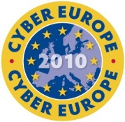
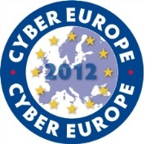
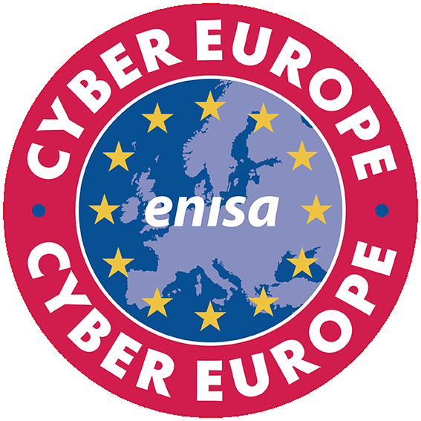

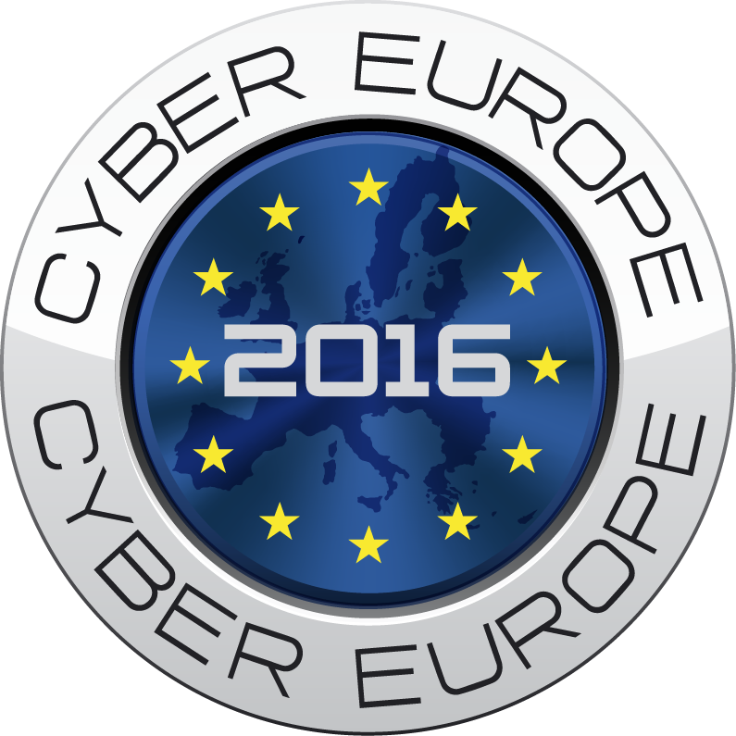
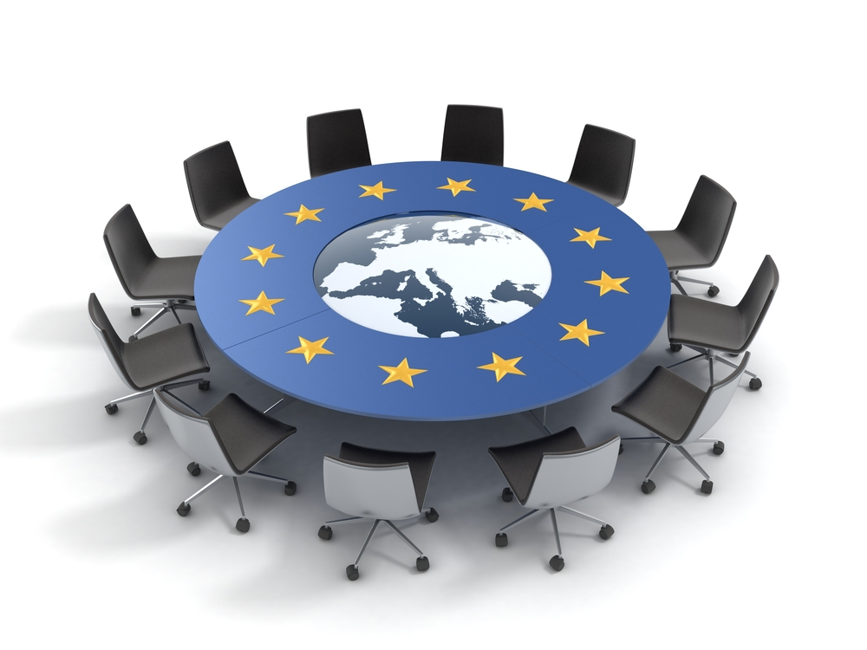
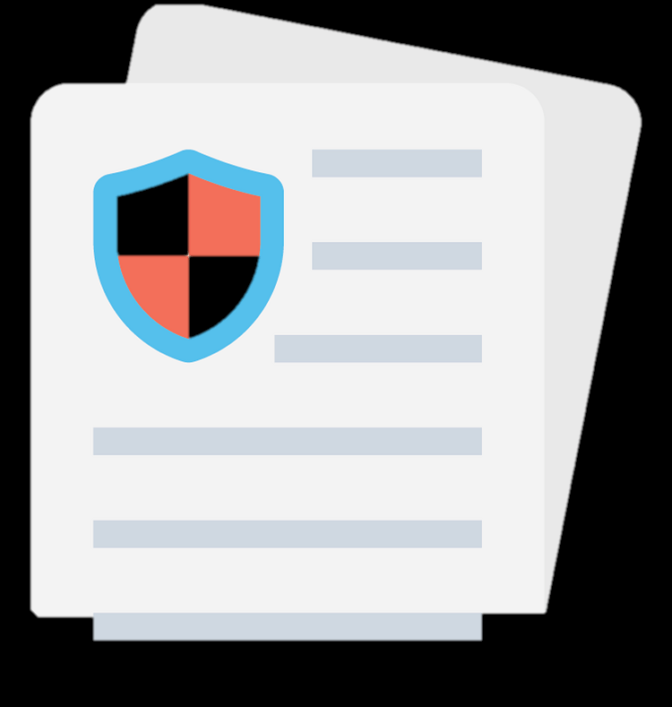

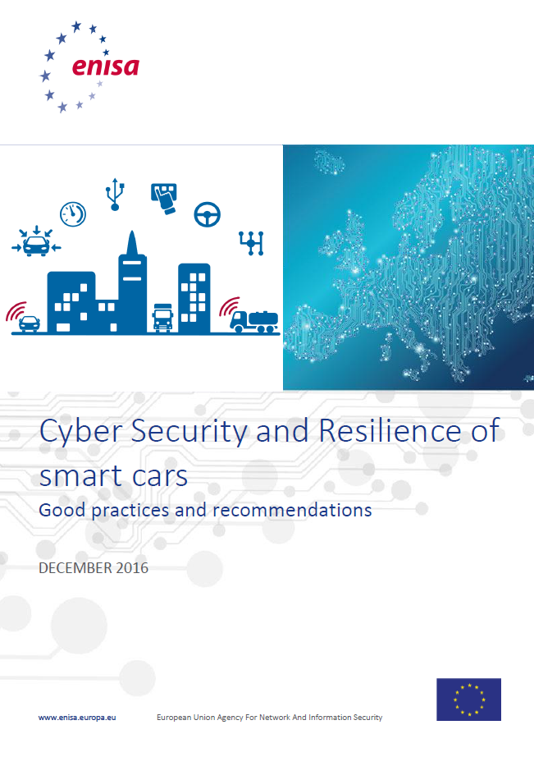
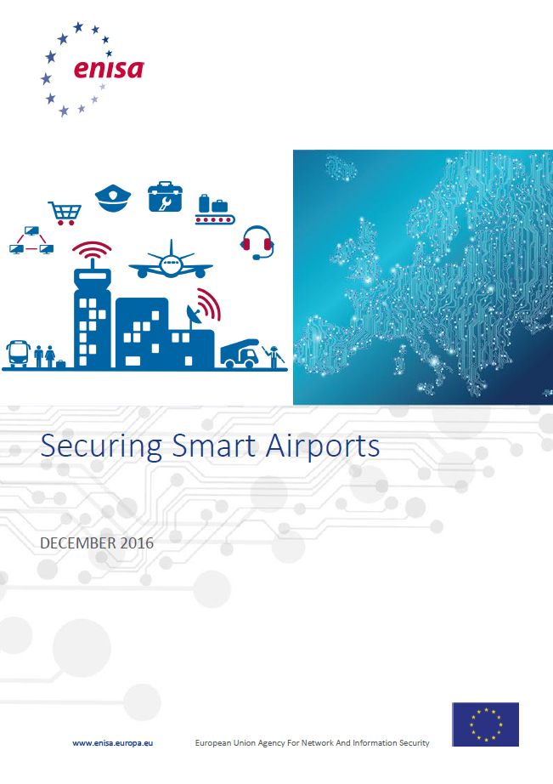
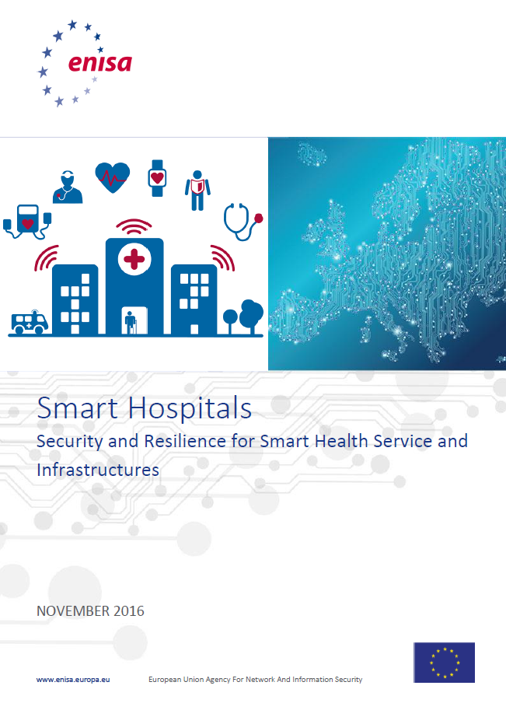
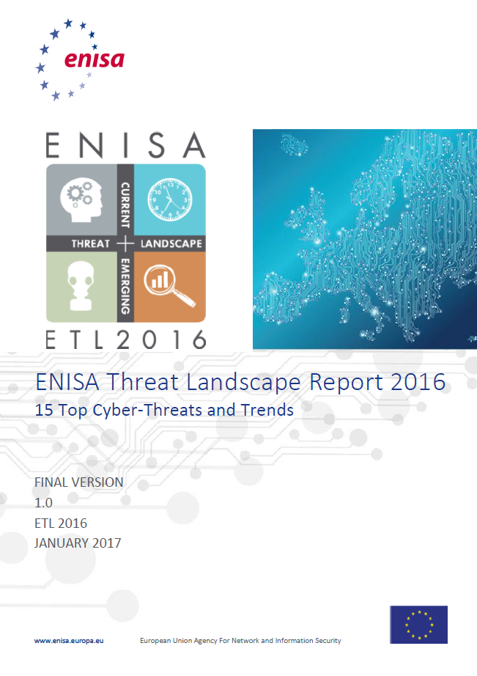
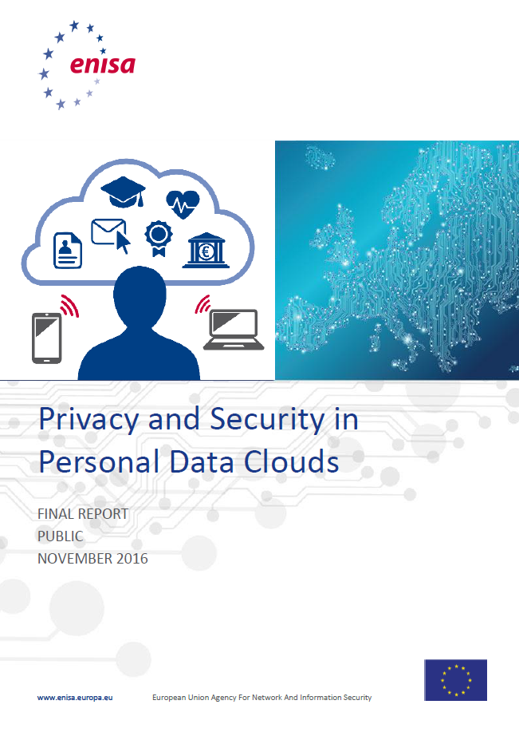
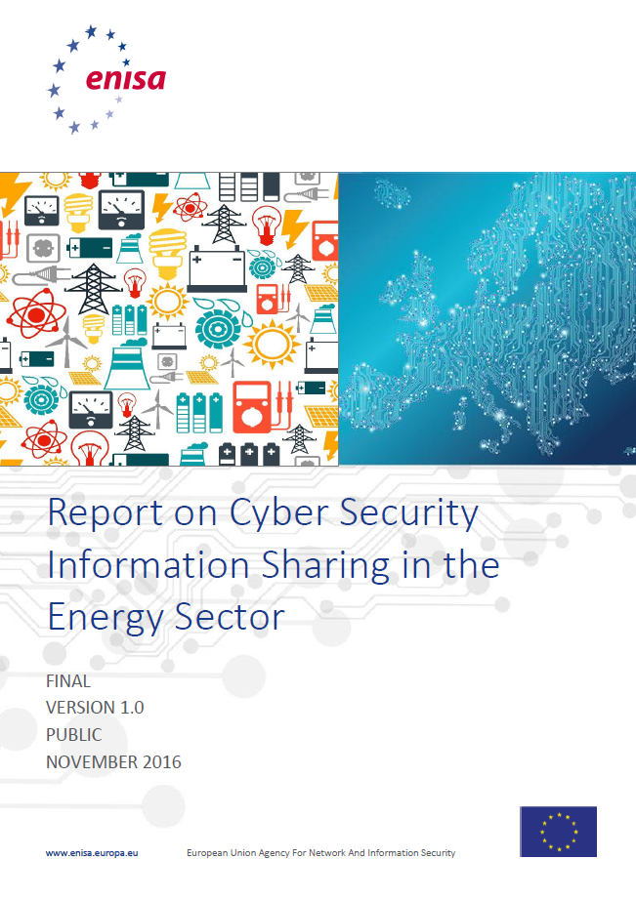
ENISA, the EU Cybersecurity agency
CAPACITY
Hands on activities
POLICY
Support MS & COM in Policy implementation
Harmonisation across EU
Mobilizing EU communities
COMMUNITY
EXPERTISE
Recommendations
Independent Advice

Slide 3
Security of Network and Information systems
Many ‘unfair’ actions can influence an election or a referendum.
  Vote buying, fake news, false promises, etc.
Cybersecurity experts have a limited focus
  Cybersecurity experts can help to secure IT systems
Practical scope definition: If it started with a ‘cyber security incident’ and could impact an election or referendum
  Actual outcome,
  Voter privacy,
  Verifiability, transparency
  The trust in the process and the outcome
Cyber security incident: Incident with a (negative) impact on the security of a network or information system.
  Not only attacks: Bug causing downtime of voting systems.
  Not only central systems: Personal email account of politician is hacked.

Slide 4
Brief history of cyber security
In the 90s and 2000s security was largely a compliance exercise
  Fire-and-forget viruses and computer worms
Security was compliance checklists focussed on prevention
  Antivirus software
  Firewalls
  Passwords
Logging, monitoring, detection and response in name only
Since 2010 the game changed:
  ‘Advanced persistent threats’ (evading antivirus software, stealthy)
  Very hard to detect (keep looking)
  Still a lot of ‘vintage’ PCs and software (from the 90s)
  Lots of ‘vintage’ security advice

Slide 5
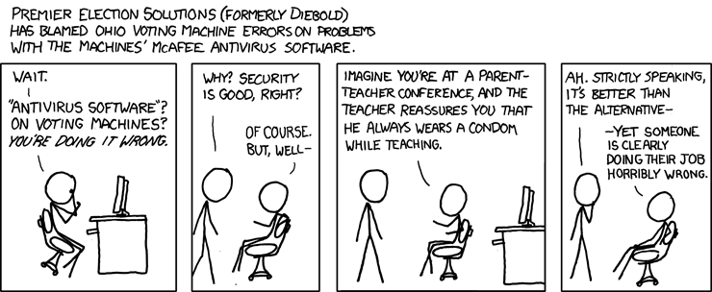

Slide 6
Technology in the election lifecycle
Setup of the referendum or election
  Electoral roll (sponsors/signatures)
  Voter lists and voter registration
Campaigning
  Campaign organizations, political parties, government
  Media (traditional media, social media)
Voting
  Casting ballot (e.g. physical, mail, online)
  Counting (e.g. physical, automated)
  Transmission and publication of results (e.g. phone, electronic)

Slide 7
Cyber attacks on democratic processes
Step | Assets | Attacks
1. Setup | Electoral roll | Tampering with the electoral roll DoS party/campaign registration Fake signatures
 | Voter lists | Leak voter lists Identity fraud DoS voter registration
2. Campaign | Campaign IT | Hacking PCs or email accounts Hacking campaign websites (deface, DDoS)
 | Government IT | Hacking government PCs Hacking government websites
3. Voting | Election technology | Tampering or DoS of voting/counting Tampering with logs/journals Blocking monitoring (jamming surveillance cameras) DoS counting or results publication Breaching voter privacy
 | Media/press | Hacking, DoS, defacement

Slide 8
Securing election technology for EMBs
You are on your own: this is not normal (no market, strange tech, high stakes)
IT Security: Preventive measures and reactive measures
  Prevention is very important, but expect it to fail.
Preventive measures
  Industry good practices, cyber hygiene and then some more.
  Audit individual systems (penetration testing, code auditing, load testing)
  Audit also the general organization and the IT suppliers
Reactive measures (last line of defence)
  Monitor, detect, respond (round the clock during the elections).
  Anomaly detection (statistics?).
  Know how to get help from a CERT or CSIRT.
  Playbooks for all scenarios, failover plans, backup plans.
  Prepare communication with public and press.

Slide 9
IT managed by others
EMB knows what is at stake but does not control all IT systems
Government IT is a target also (but usually well-managed, secured)
Easy target is the IT outside government/EMB, used by politicians, campaigns, parties.
Awareness raising about cyber attacks
  User-friendly devices (smartphones and tablets, secure out of the box)
  IT of family and friends
  Phishing emails (with links or malware)
  Get DDoS protection for the websites (https://projectshield.withgoogle.com/)
  Secure social media accounts
  Make sure they can reach a CERT for support (https://www.accessnow.org/)
Trust is an issue.
  EMB can act as a neutral intermediary
  Don’t expect political parties to openly discuss their security issues.
  Maybe proactively audit everyone

Slide 10

Thank you

