Slide 1
Risk management and elections: the Estonian experience
Priit Vinkel – Head of State Electoral Office of Estonia

Slide 2
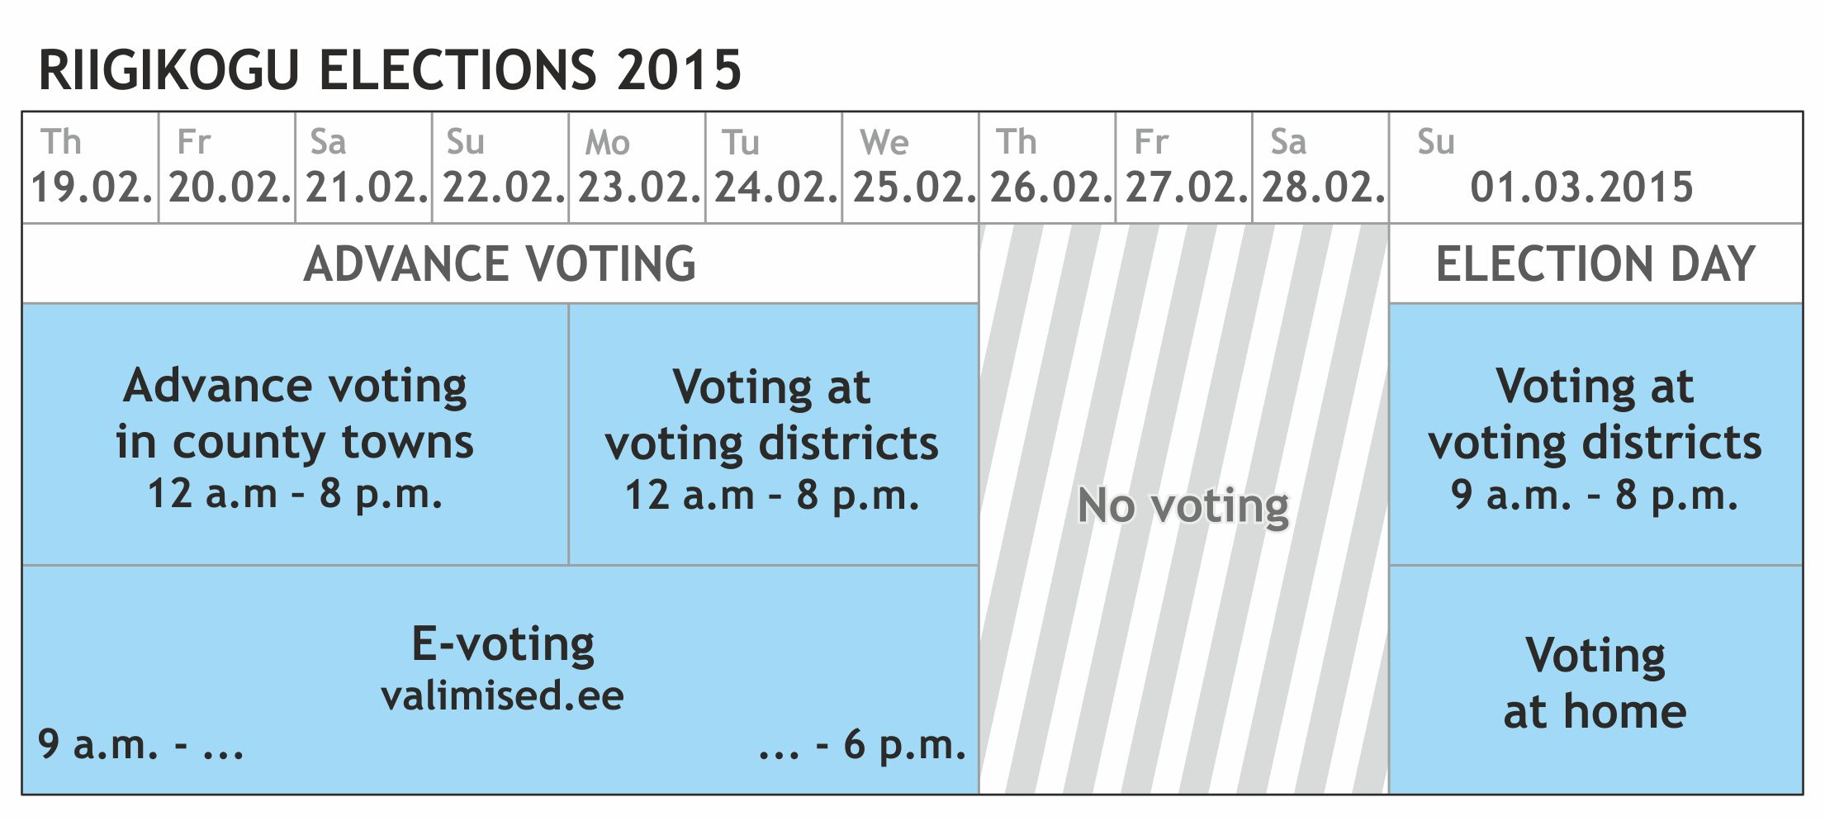
Voting Period
Voting abroad
(by post or in embassies)

Slide 3
Estonian Elections and IT
Internet Voting Infosystem
Election Management Infosystem (from 2021 electronic voters’ rolls)
Election Webpage
Auxilliary Systems (Population Register, ID card infrastructure etc)
Party Webpages, e-mails etc

Slide 4
Risk Management Categories
Technical
Political
Managerial
Communicational

Slide 5
Recommendations
Plan ahead, threat management is necessary
The key is cooperation between all actors (incl local CERT and others)
Verification, publication, transparency
Election security in NOT just the duty of the EMB but of the government in general
Politically motivated (Hybrid) threats are real and should be addressed (PR!)
Never underestimate a motivated actor (both internal and international)

Slide 6
In conclusion
Technology must not mistrusted!
Technology and the risk of using it must be understood
Risks are not linear
Election security is an issue of that concerns the state/government/public sector not only EMB

Slide 7
Thank you!

