Slide 1

Organization of
Arab Electoral Management Bodies
(ArabEMBs)
15th Conference of Electoral Management Bodies
Security In Elections
Presented by
Dr. Zuhair Abu Fares /
Head of ArabEMBs Executive Board
April 2018

Slide 2
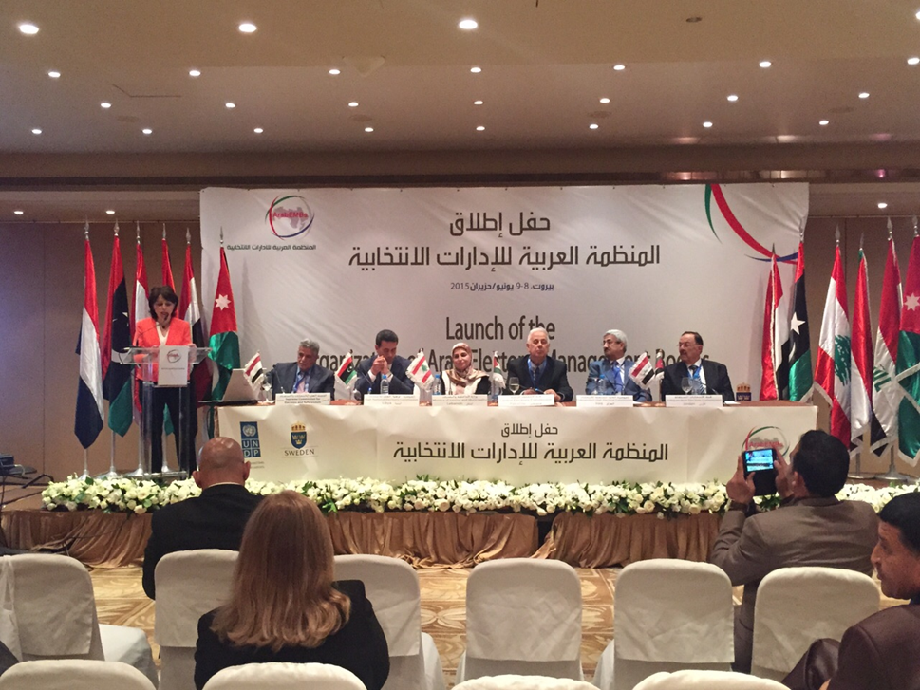
What is ArabEMBs
ArabEMBs was Officially Launched in June 2015 in Lebanon
  Six EMB Founding member (Jordan, Iraq, Palestine, Lebanon, Libya, Yemen)
First Cooperation and Coordination Mechanism in the Field of Elections in the Arab world
Fostering Regional Coordination Among Arab Electoral management bodies
Creating and developing platforms for networking and knowledge exchange between its members
Launching Ceremony 2015

Slide 3
Characteristics of ArabEMBs
  Created by Electoral Management Bodies in Arab States
  Targeting EMBs in Arab World as Beneficiary Group
ARAB
INDEPENDENT
Non- political
  Working at the level of EMBs
  Away from the Influence of National Governments and Political Parties
  Technical Activities
REGIONAL
PROFESSIONAL ENTITY
  Regional Nature of Functions and Activities
  Aiming at improving the technical aspects of Electoral Fields in Arab world
Seeking to enhance institutional and professional electoral practices of EMBs

Slide 4

Why Do We Need ArabEMBs ?
Supporting Electoral Processes as Part of Democracy Development in the Region
EMBs in Arab world sharing common objectives in terms of the needs to enhance the credibility of the electoral process and to regain citizen’s confidence in its results.
Similarities in the scope and nature of challenges facing EMBs in the region
Informative variety in electoral experiences and EMBs Models in Arab states.

Slide 5

Objectives
2
Enhance cooperation among Arab EMBs through membership in regional and international peer organizations
4
Enhance independence and neutrality of electoral management bodies
5
Enable members to promote successful Arab experiences internationally
1
3
Support members to implement fair and transparent elections
Strengthen the capacity of Arab EMBs and improve their performance

Slide 6
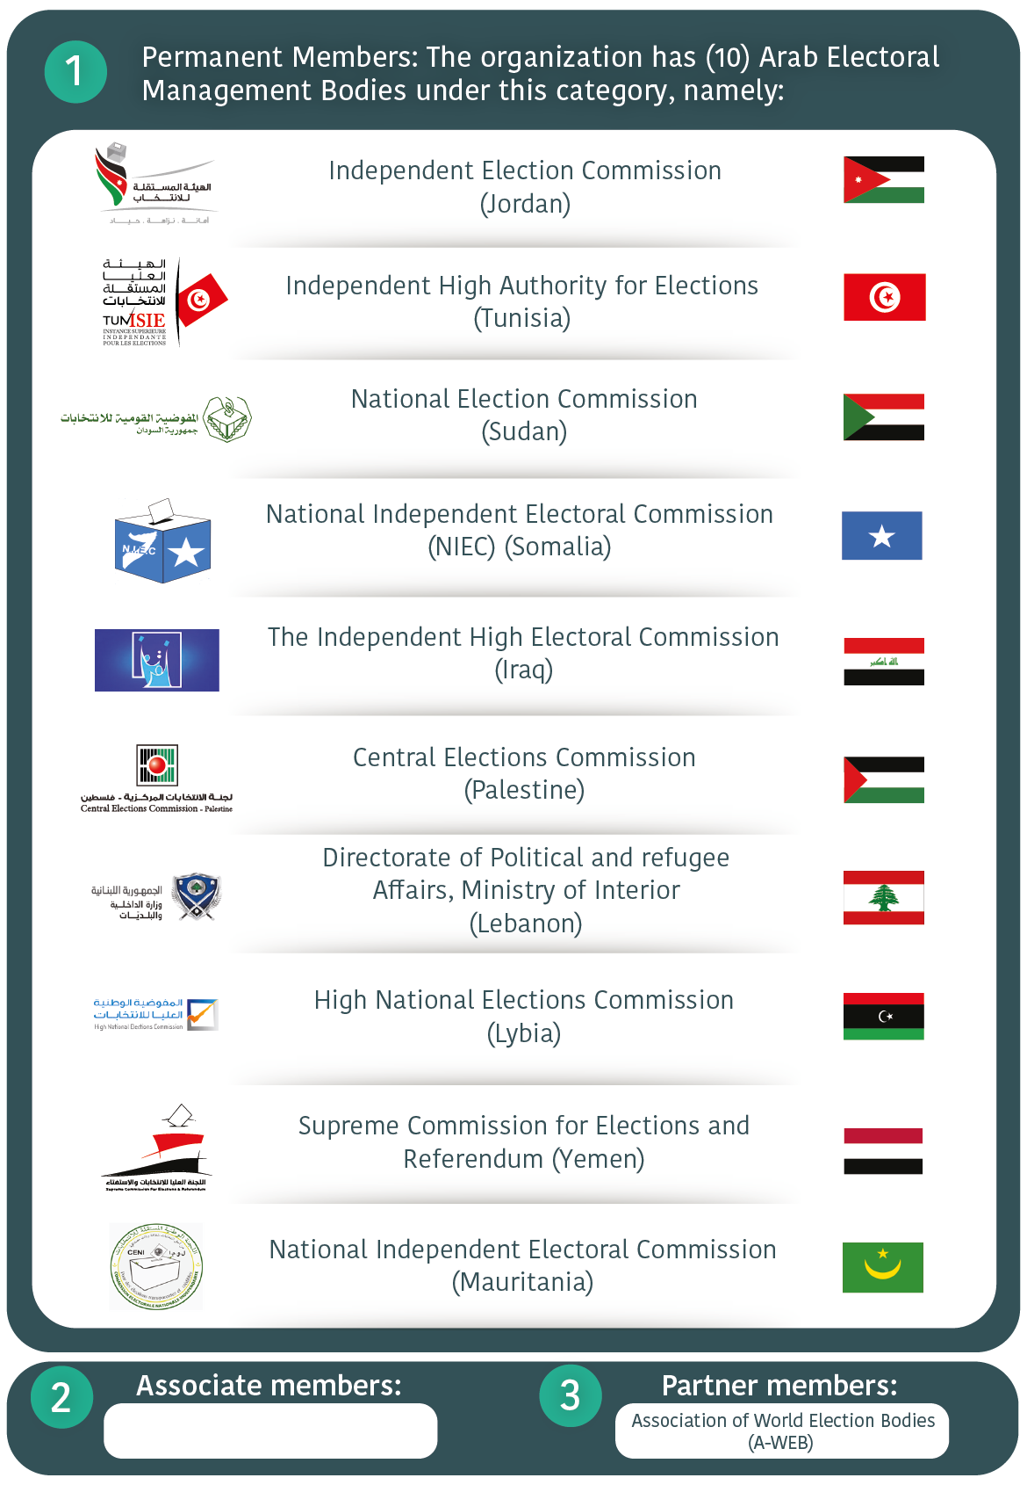
Membership Category
Permanent Member
Embs conducting National Elections in Arab States (having the right to vote)
Affiliated Member
EMBs conducting National Elections in Arab states who do not wish to be a permanent member
EMBs conducting Local Election at Arab state who are represented by a permanent member at the organization
Partners
Regional or International Organizations wishing to become members of the organization and fulfill conditions

Slide 7
Organs of ArabEMBs
General
Assembly
(GA)
Secretariat
Executive Board
The highest monitoring and supervisor authority in the Organization, includes representatives of all members accepted in accordance with the Charter
In charge of executing and following up GS decisions. Consist of a president and two members elected by the General Assembly for a term of 2 years, in addition to the Secretary-General (who has no voting rights)
The administrative body of the organization. It is headed by the Secretary-General who shall be appointed by the General Assembly for a 4-year term, renewable once

Slide 8
Regional and International Networking
Signing MOUs
Promoting ArabEMBs at Regional and International Events
MOU with
CEC Russia
MOU with
A-WEB
MOU with
Venice Commission
MOU with
ACEEEO

Slide 9
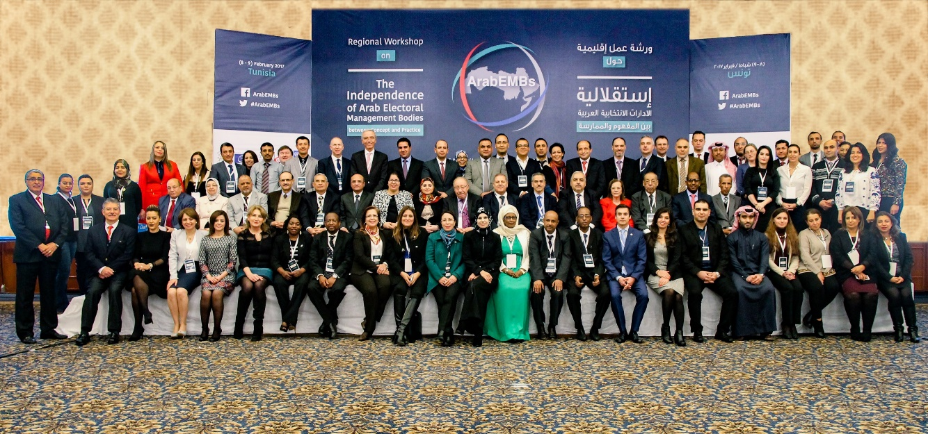
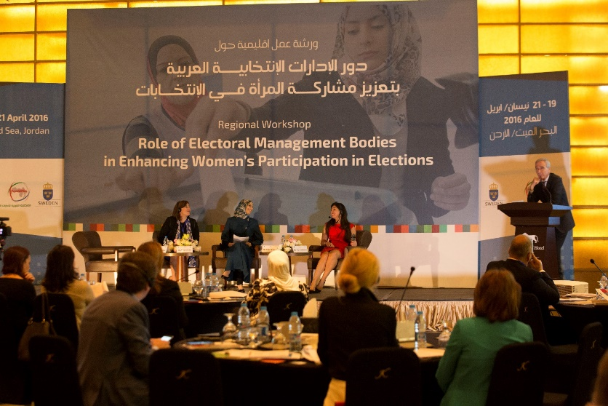
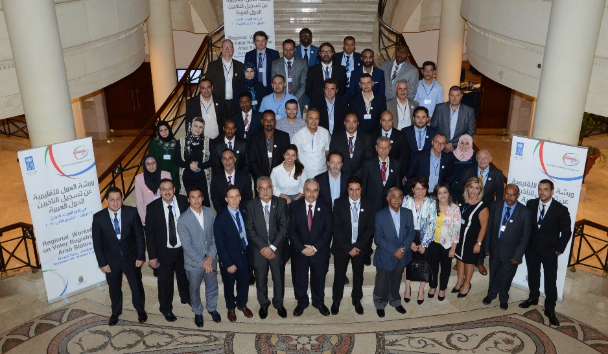
Thematic Workshops
Voters Registration in the Arab World: Methodologies and Tools
Role of ArabEMBs in Enhancing the Participation of Women in Elections
The Independence of Electoral Management Bodies : Concept and Practice" Between

Slide 10
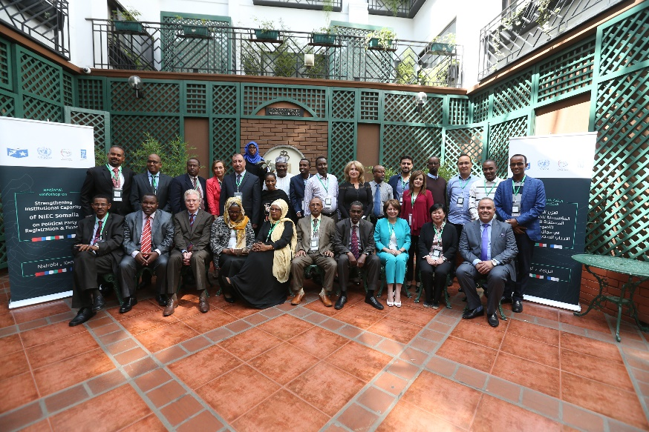
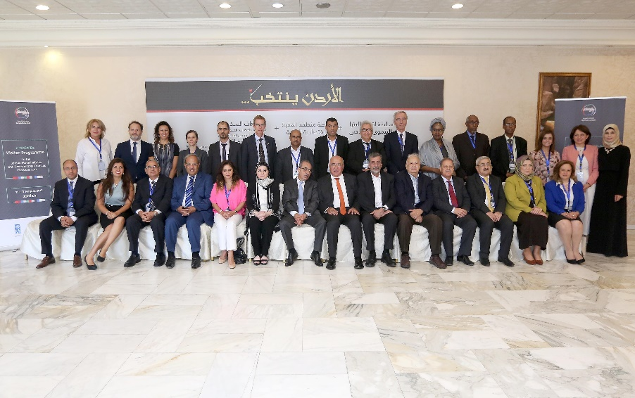
Activities and Programs
Technical support Program
Specialized workshop to support the independent National Electoral Commission in Somalia in the area of registration and funding of political parties
Visitor Program to the Local Elections in Jordan
Regional Election Visitor Program

Slide 11
Thank you

