Slide 1
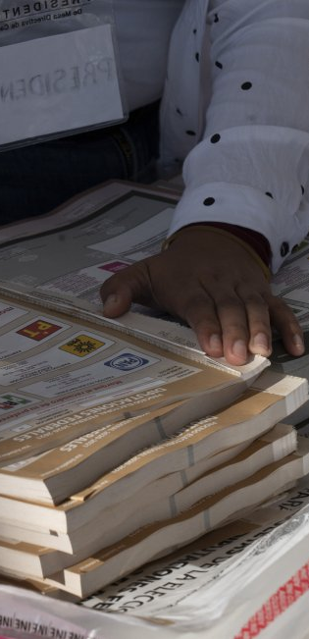
Elections in times of pandemic
A Balance
Lorenzo Córdova Vianello
President Councilor / National Electoral Institute
October 2021

Slide 2
Challenges to democracies (as Mx) towards the future
Democracy is not in its best momento. Mala tempora currunt.
  Social discontent (disengagement) with democracy given the lack of results regarding “the great problems of our time”
  Oceanic inequality running across all aspects of social lives
  Persistent Poverty
  Institutional dismantling and credibility crisis of key institutions on which the democratic processes rests: parties and parliaments.
  Disruptive capabilities of dis/misinformation given the penetration and speed dissemination facilitated by social media.
  Increasingly polarized societies.

Slide 3
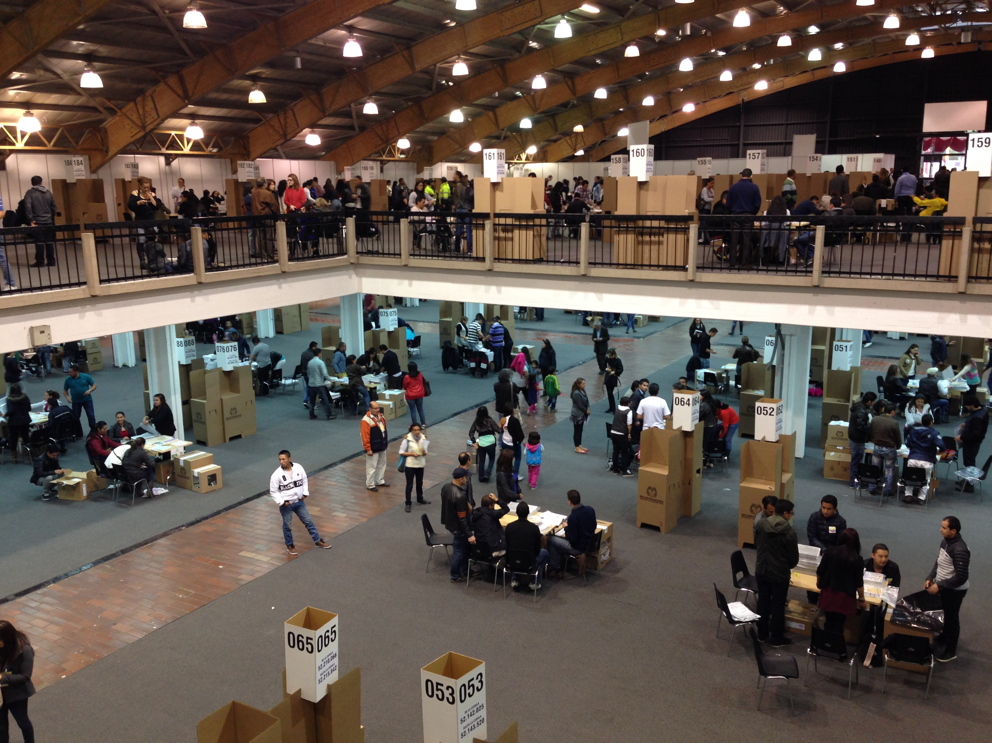
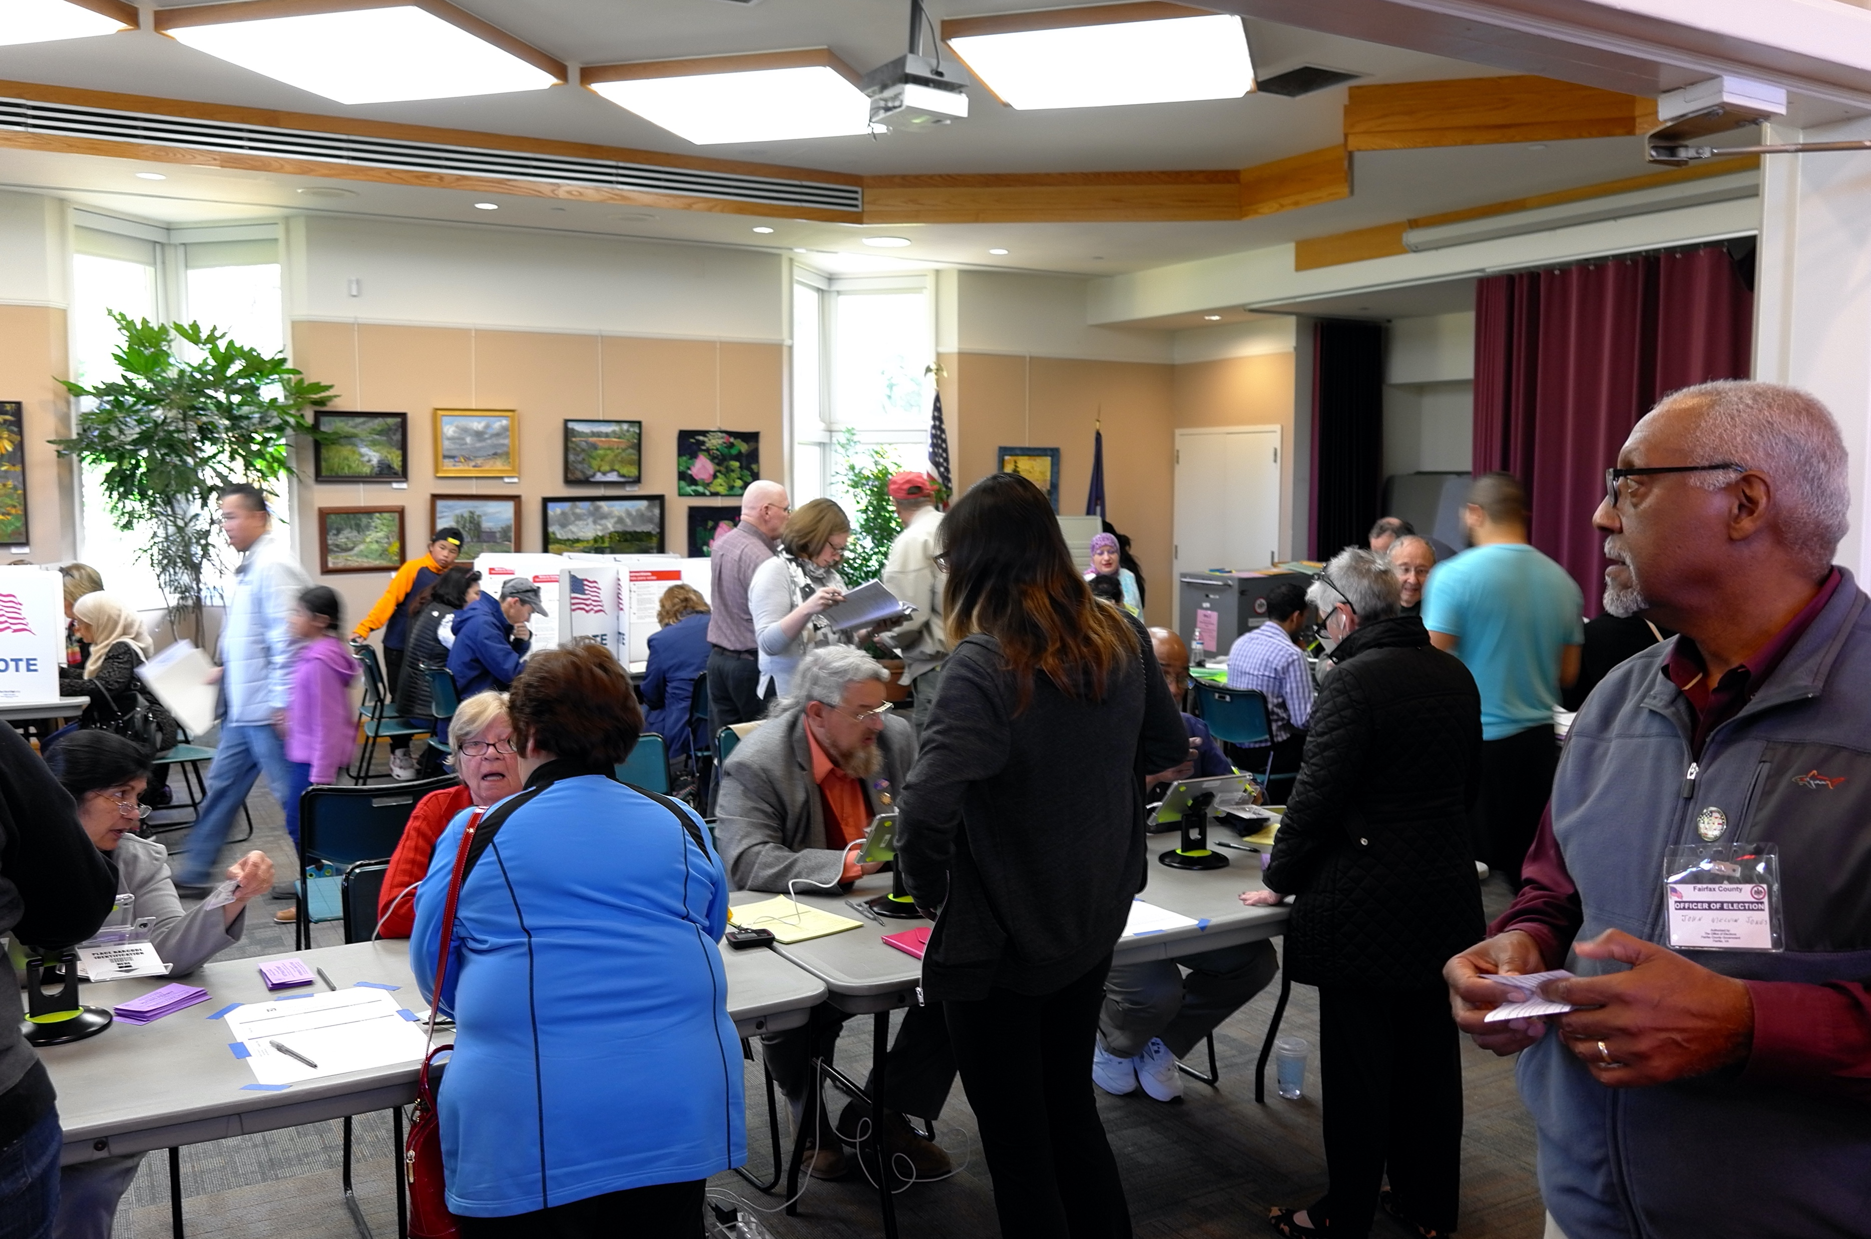
Covid-19 pandemic is an additional challenge
1. Health Dimension
Democratic processes and elections need a large mobilization of citizens:
For the organization of elections themselves – training of citizens, participation in election posts, electoral overseeing, casting of votes, among many others.

Slide 4
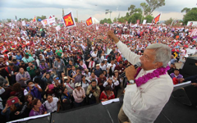
1. Health Dimension
Political Campaigns
    Elections in a pandemic also requiere to take special measures such as sanitizing voting centers and materials (we already had a natural relationship and coordination with the Security Forces, but now the relationship with the sanitary authorities is fundamental).

Slide 5
2. Economic Dimension
An economic crisis – not only a slowdown but a mayor, unseen, economic contraction of every economy in the world.
This would surely:
Accentuate the feeling of discontent and unsatisfaction with governments due to…
…the increasing difficulties to address lasting social demands and the satisfaction of basic needs.
Poverty increased, affecting the integrity of democracy.
“How much inequality and poverty
does democracy is able to resist?”
UNDP, Report on the State of Democracy in LA (2004)

Slide 6
3. Political Dimension
The Sanitary and Health emergency due to the pandemic has placed constitutional democracies in a tension. When rights are restricted (for whatever reason) democracies enter a Risk Zone. In these moments, power controls and protection of rights become crucial.
First Risk.
Concentration of power
→ Autocratization.
The exercise of power is exposed to autocratization forces. This is the moment to reinforce constitutional controls.
5

Slide 7



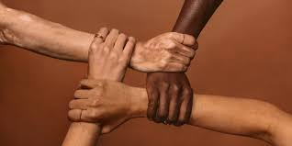
3. Political Dimension
Second Risk.
Polarizing discourses may be accentuated in periods of crisis with respect to the management of the crisis itself (among other issues).
“Normal” democratic confrontation is radicalized when electoral processes coincide with emergency contexts.
Friends vs Enemies type of polarization erodes tolerance, respect and acknowledgement of differences of opinion, basis for the functioning of all democracies.
This is a breeding ground for authoritarian impulses.

Slide 8
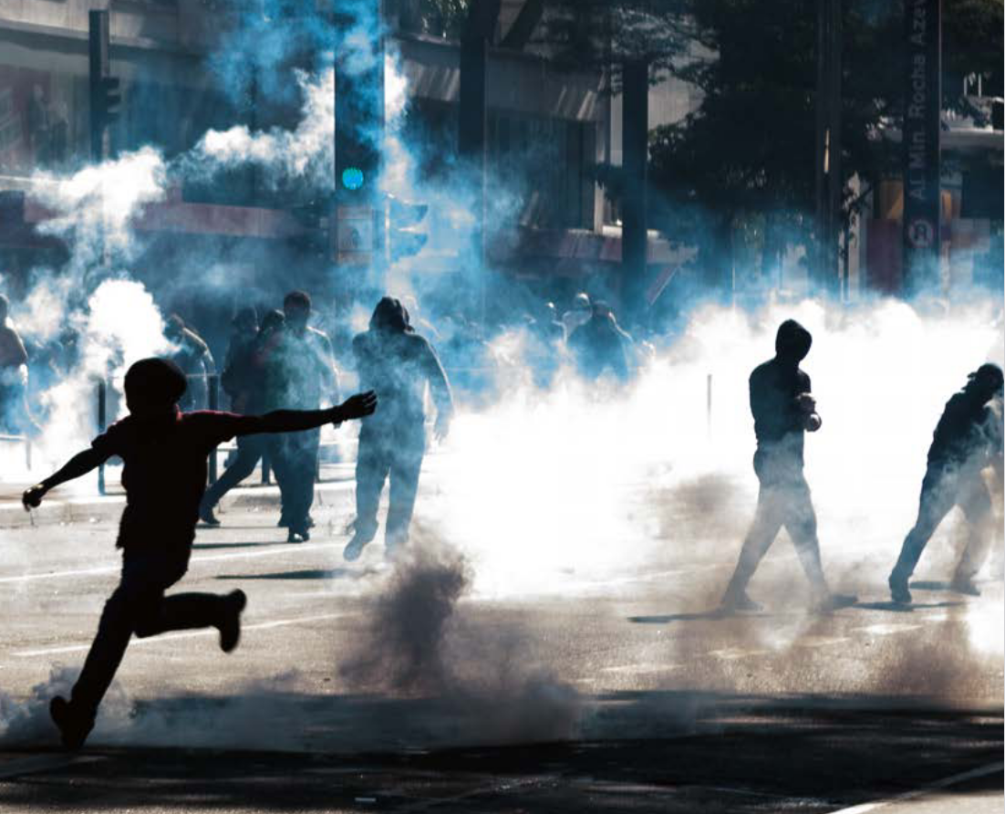
4. Social Dimension
Sanitary, health, economic and political challenges to democracy may eventually give birth to wider and more profound expressions of social discomfort that may overflow institutional channels to addressing those problems.
8

Slide 9
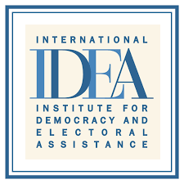





Analysis and recommendations
Compared data analysis
Compilation of comparative experience
Compilation of best sanitary practices
France (Second legislative round), South Corea (Parliamentary elections), Polonand (Parliament), Dominican Republic (general), Surinam (Parliament), et. al.
Elections

Slide 10
2021: The largest election in history
Concept | 2018 | 2021 | Change
National Registry (people) | 89,123,355 | 93,328,771 | +4.72%
Number of States with simultaneous local elections | 30 | 32 | +6.66%
Polling stations installed | 156,808 | 162,570 | +3.67%
Supervisors / Trainning personnel | 45,137 | 48,082 | +6.52%
Citizens to visit | 11,602,897 | 13,331,352 | +14.89%
Polling station citizens required | 1,398,534 | 1,463,130 | +4.62%
Number of posts to be elected | 18,299 | 20,417* | +11.57%
*Two extrarodinary elections are included (2 municipalities in the State of Hidalgo).

Slide 11
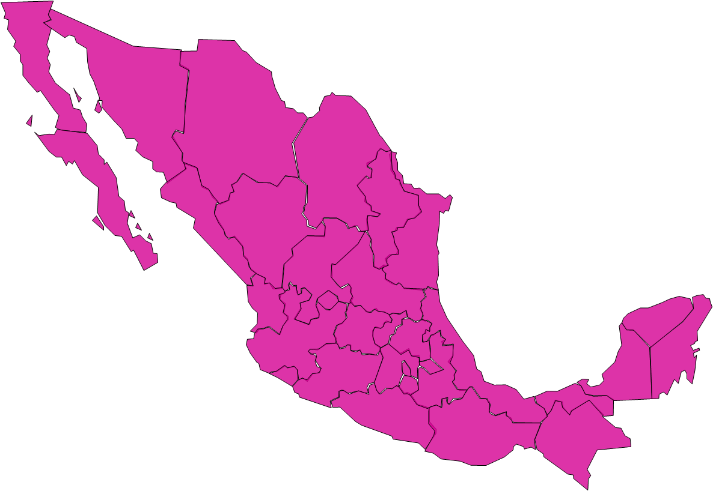
2021: The largest election in history
FEDERAL
Chamber of Deputies
  300 / Majority
  200 / Proportional
  Representation
LOCAL/State
Governorships:15
Local Chambrer of Deputies: 1,063
  642 / Mayority
  421 / Proportional Representation
Municipalities: 1,925*
* Includes 2 extrarodinary elections for presidency of municipalities in the State of Hidalgo.

Slide 12

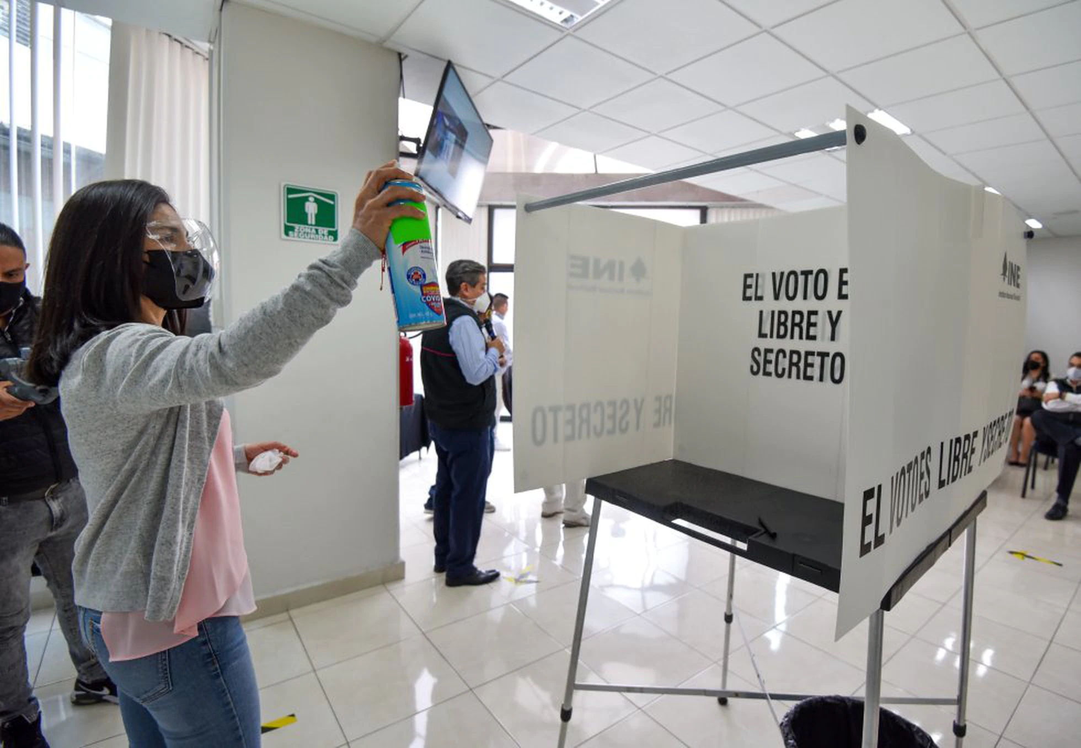
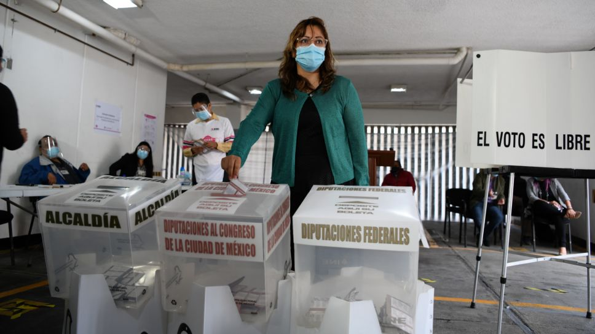
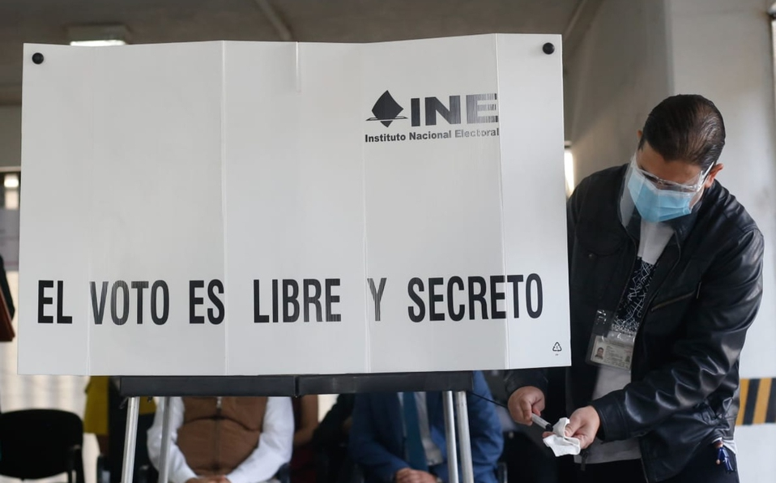
A Challenging Context
The sanitary challenge of the Covid-19 pandemic
In order to guarantee both political rights and the right to health we designed and implemented special measures for field operatives and electoral organisation.
a) International experience
b) Previous experience
in Hidalgo y Coahuila 2020.
c) INE’s approved protocols to implement sanitary measures in different phases
of the electoral process.
  Strategic Group C-19
  Advisory Group formed by specialists in sanitary measures and epidemiology

Slide 13
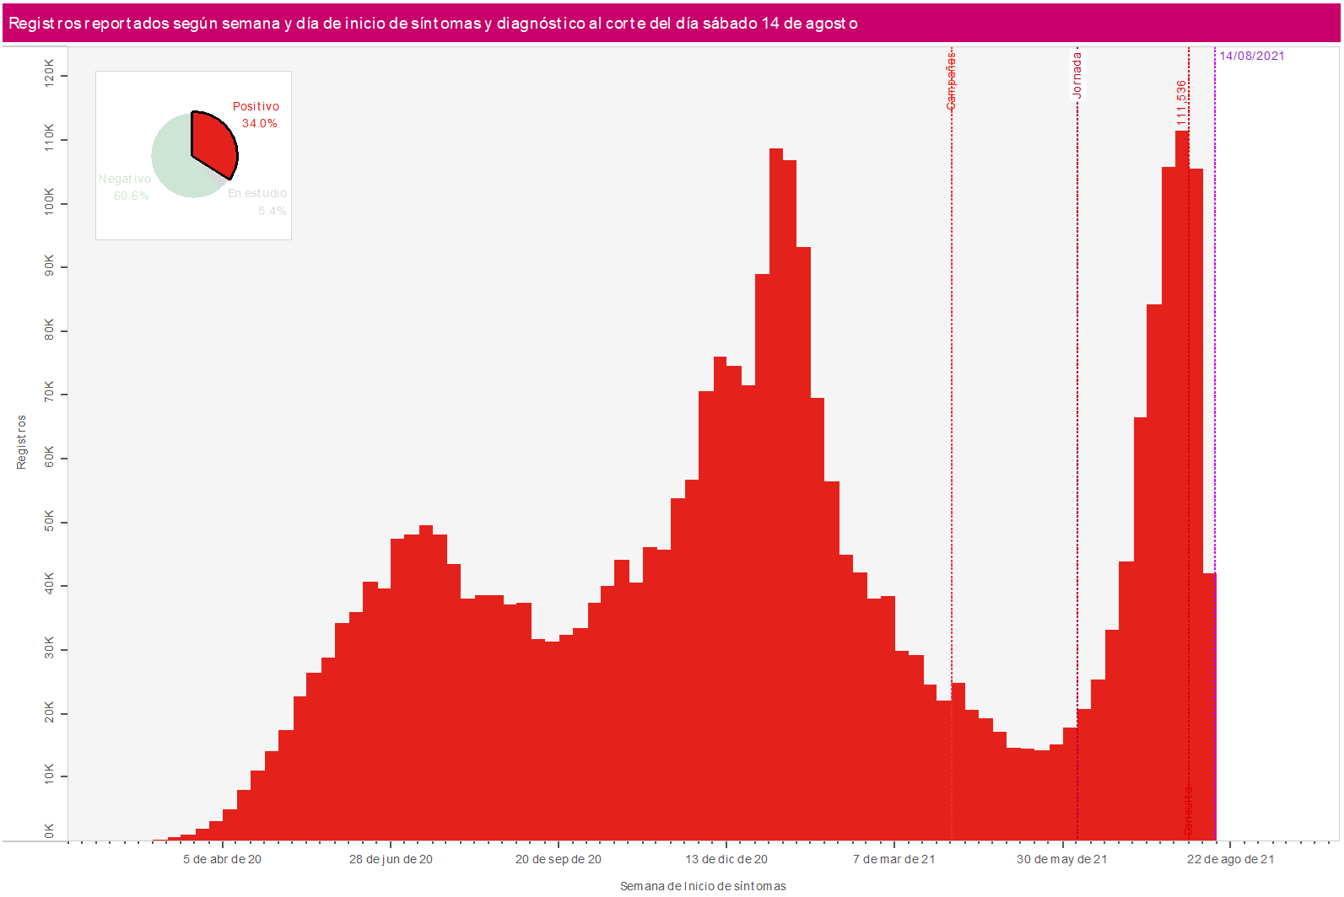
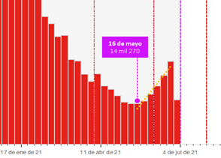
A Challenging Context
The sanitary challenge of the Covid-19 pandemic
Election June 6
May 16, 2021 weekly contegion cases starts and remain constant 3 weeks after elections.
Source: DECEYEC (INE) with data from the government of Mexico.

Slide 14
Election day, June 6
Federal Election: Citizens’ Participation
Year | National Registry | Voters
1991 | 36,676,167 | 24,194,239
1994 | 45,729,057 | 35,285,291
1997 | 52,208,966 | 30,120,221
2000 | 58,782,737 | 37,601,618
2003 | 64,710,596 | 26,738,924
2006 | 71,374,373 | 41,791,322
2009 | 77,470,785 | 34,677,923
2012 | 79,492,286 | 50,143,616
2015 | 83,536,377 | 39,864,082
2018 | 89,250,881 | 56,611,027
2021 | 93,328,771 | 49,151,320
Average participation in middle elections (51.96%)
Source: INE.

Slide 15



International missions evaluations
“[The IIDH states] its satisfaction for the usual high performance of the National Electoral Institute and the Local Elections Organisms in the organization, administration and implementation of the election day, which developed within the INE’s standards, and that citizens and observers of the the mexican electoral regime have gotten used to (…)”.
“The evidence we have is that people voted peacefully, calmly and freely; they had all the voting options available and INE provided them with a way to do so”.
“Their participation [of the citizens in the elections] was a prove of the trust that mexican people has on the INE, the integrity of the vote and of the political parties system, just as it was shown by the plurality of the results (…)”.

Slide 16

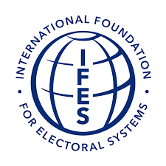
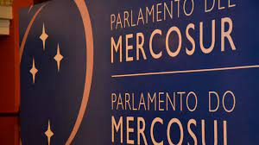
International missions evaluations
“[The citizens’ participation] confirms that it is posible to conduct safe electoral processes in these pandemic times, the mission makes a special recognition of the civic and democratic conviction of the mexican people.”.
“[the result of the election] can be summarized by the fact that it materialized a democratic and civic distribution of power in Mexico”.
“ It is widely known, the goal of the Democracy Observatory of PARLASUR is to contribute to the development of democracy in the region; therefore, we must highlight the importance of the role that INE has been fullfilling in the conduction of the electoral process.
“The mission congratulates all the mexican people for having gone to the polling stations, showing civic duty and for having complied with the preemptive measures stablished in the biosecurity protocols as defined by the INE”.

Slide 17

International missions evaluations
“INE continues to provide the people of Mexico independent and transparent elections that they can trust (…)
“INE has guaranteed the will of the people of Mexico at the ballot box through highly competitive elections at local, state and federal level and has contributed to achieving greater diversity of the members of the Mexican Congress”
“We also recognize the INE for its work in organizing elections that are impartial, transparent and conducted in accordance with internationally recognized standards (…)”.

Slide 18
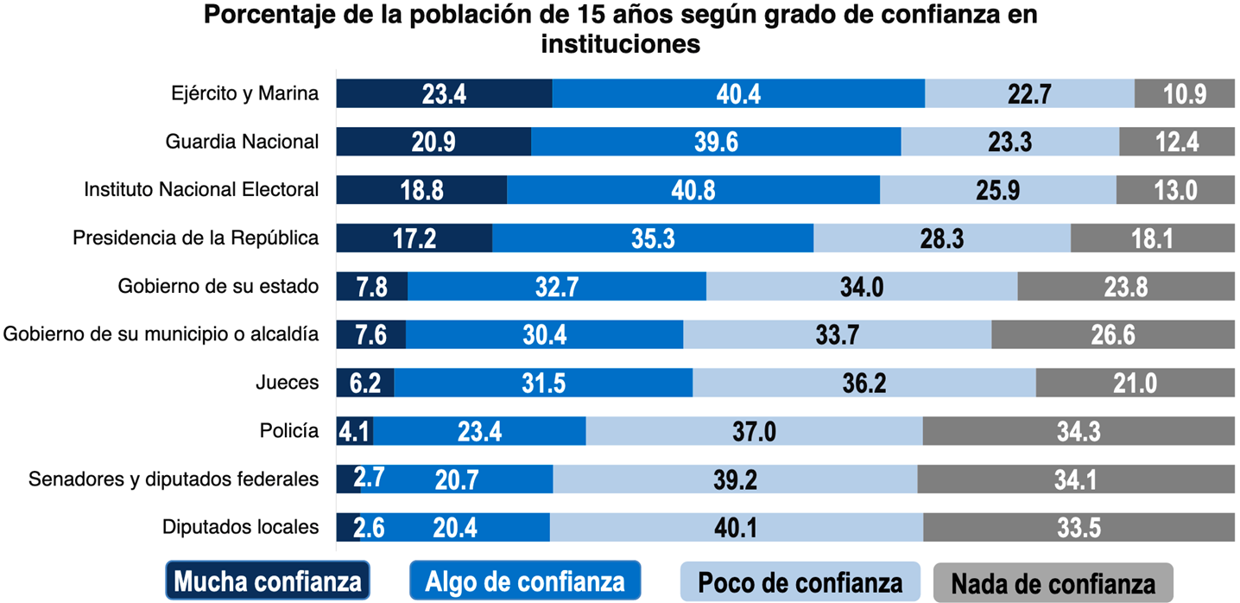
A challenging context
….nevertheless, citizens’ trust on the INE is widespread.
59.6% (3 out of every 5 people) has “a lot of or some trust” on the INE.
Third institution with the highest level of social trust among the citizens.
Source: INEGI (2021) Civic Culture Survey [Encuesta de Cultura Cívica, Encuci] 2020.

Slide 19
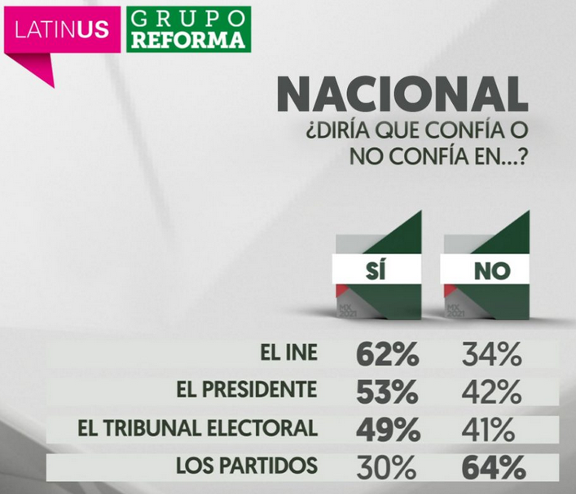
A challenging context
….nevertheless, citizens’ trust on the INE is widespread.
Source: Latinus y Grupo Reforma, June 1 2021, https://bit.ly/3wsszdE

Slide 20
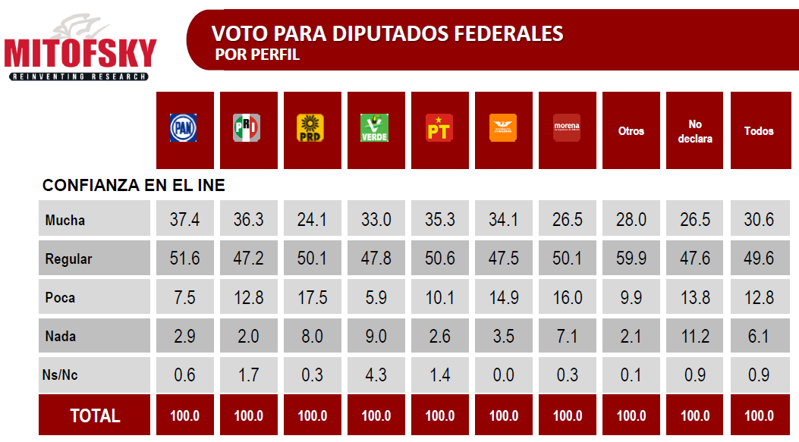
Citizens’ Evaluation of the ine
80.2% has “a lot of or some trust” on the INE.
Among and whitin all political parties trust on the INE (“a lot of” or “some”) is widespread: between 76.6% (Morena) and 89% (PAN).
Fuente: Consulta Mitofsky, June 6, 2021, https://cutt.ly/um9AF1I.

Slide 21

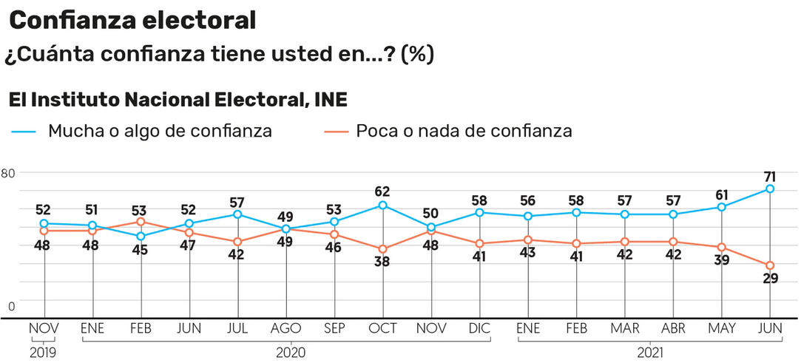
Citizens’ evaluation of the ine
June 14th, 2021
source: El Financiero, june 14th, 2021, https://cutt.ly/RnGXBHK

Slide 22

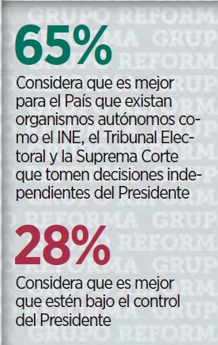
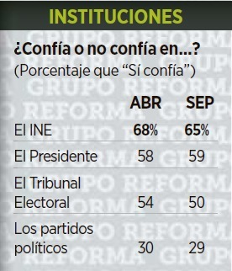
Citizens’ Evaluation of the ine
September 1, 2021

Slide 23
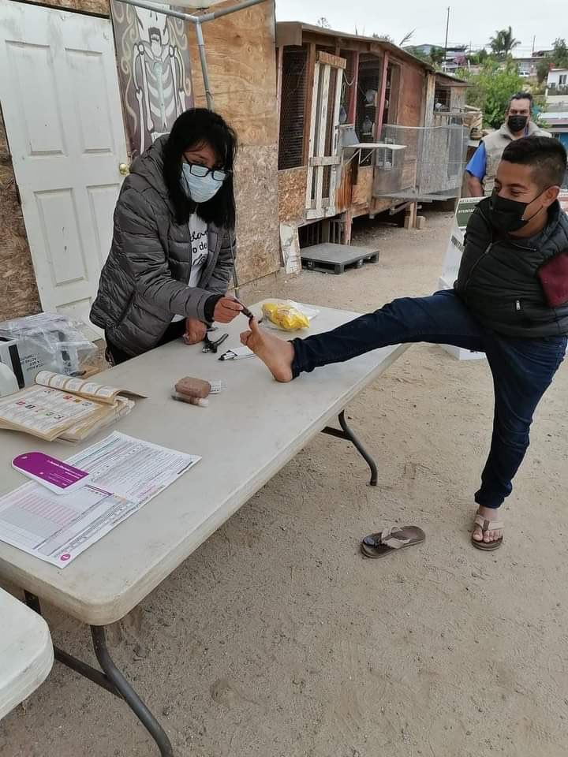
Thank you!

