Slide 1
Committee on Artificial Intelligence (CAI)
19th European Conference of Electoral Management Bodies
14 November 2022
Presentation
Amb. Thomas SCHNEIDER, President of the CAI

Slide 2
Council of Europe’s interest in AI
The use of AI systems has an enormous innovation potential for our economies and societies.
It can help societies and economies to organise themselves more (resource-)efficiently and provide better service to their citizens.
But: inappropriate use of AI systems could take humanity to a dystopic place where:
human rights and fundamental freedoms are no more respected;
democratic processes are manipulated;
the rule of law is replaced by the rule of algorithm.
The Council of Europe’s task is to ensure that AI remains a force for good.

Slide 3
Ad Hoc Committee on Artificial Intelligence (CAHAI), 2019-2021
Key findings:
Existing national and international law also applies to AI
There is no legal vacuum, but…
Substantive and procedural gaps
Uneven protection levels
Uncertainties affect development and implementation
Soft law approach has major limitations
What more is needed for an appropriate legal framework?

Slide 4
Ad Hoc Committee on Artificial Intelligence (CAHAI), 2019-2021
Dec. 2020: Feasibility Study: appropriate legal framework:
combination of binding & non-binding legal instruments complementing each other
transversal binding instrument: set out general common principles applying fundamental principles to the AI environment, using a risk- and impact- based approach
additional binding or non-binding sectoral instruments: address challenges brought by AI in specific sectors
include practical mechanisms to mitigate risks arising from AI systems, as well as appropriate follow-up mechanisms
Dec. 2021: possible elements for binding instrument

Slide 5
Committee on Artificial Intelligence (CAI)
1 January 2022 - 31 December 2024
CAI Mandate:
elaborate an appropriate legal framework on the development, design and application of AI, by November 2023
based on CoE standards on human rights, democracy and the rule of law
conducive to innovation,
Development of an appropriate tool for implementation on national levels
Goal: Instrument with as global a reach as possible (cf. Cybercrime Convention):sufficient scope for implementation in different legal systems.
maintain a transversal approach, also by co-ordinating its work with other intergovernmental committees and Council of Europe’s entities, by providing these committees and entities with guidance in conformity with the legal framework under development and by assisting them in resolving problems (…)

Slide 6
CAI : where we stand…
Multistakeholder participation and great interest: > 100 Institutions as members/observers: 46 member states, 6 other states, 7 IGOs, 4 EU organisations, 22 NGOs, 24 business entities and associations
4-6 April 2022: Inaugural CAI meeting (Rome)
30 June 2022:
CM decision: appropriate instrument should be a [framework] convention
CAI sends out a “zero draft” for comments and feedback
21-23 September 2022: Second CAI Plenary meeting: first discussion on “zero draft”
Jan 2023: HUDERIA and technical provisions
Feb 2023: start of negotiations

Slide 7
Future appropriate instrument
filling-in any legal gaps
ensure both global and regional consistency
particular focus on the public sector
avoid risk of over-regulation and insufficient clarity about consequences (intended as well as unintended) of future AI applications;
prudent approach to regulation – focusing on general principles and basic norms rather than attempting to cover complex issues in great detail

Slide 8
Outline of the instrument
General points :
fundamental principles and rules to safeguard human rights, democracy and the rule of law while being conducive to innovations
ensure complementarity with already existing standards (including CoE reference standards on elections);
due account of relevant initiatives of other international, supranational and regional fora
specific modalities of implementation governed by the domestic law of the Parties.

Slide 9
Outline of the instrument
Fundamental principles of regulating the design, development and application of AI systems:
Respecting and strengthening human rights and fundamental freedoms, democracy and rule of law
Human dignity, equality (incl. gender equality and rights related to persons in vulnerable situations or subject to discrimination)
autonomy (reach informed decisions free from undue influence)
Accountability, responsibility and legal liability for any unlawful harm caused, and the need for appropriate safety, security, data protection, cybersecurity and robustness requirements.
equal and fair access to public debate and inclusive democratic processes
Sustainability, solidarity, and protection of the environment

Slide 10
Outline of the instrument
Proposed specific rights:
The obligation to record and store the usage of artificial intelligence systems and the right to access relevant records,
The right to be informed about the application of an AI system where it substantially informs or takes decision(s) affecting human rights and fundamental freedoms, legal rights and significant legal interests,
The right to know that one is interacting with an AI system, and the right to human review of such decisions.

Slide 11
Outline of the instrument
Risk and impact assessment (so-called “HUDERIA”):
methodology providing clear, concrete and objective criteria for identifying contexts and applications that pose significant dangers
ensure a uniform approach towards the identification, and assessment of risks and impact, while being adaptive to different jurisdictions
assist authorities by specifying the procedural mechanisms needed to ensure that adequate risk analysis, impact assessment and miti-gation, access to remedy and monitoring protocols are put in place
ensure seamless compatibility of this approach with the existing assessment, governance, and compliance practices followed by industry
designed to be as “algorithm neutral” and practice-based as possible, dynamic, in need of regular revision

Slide 12
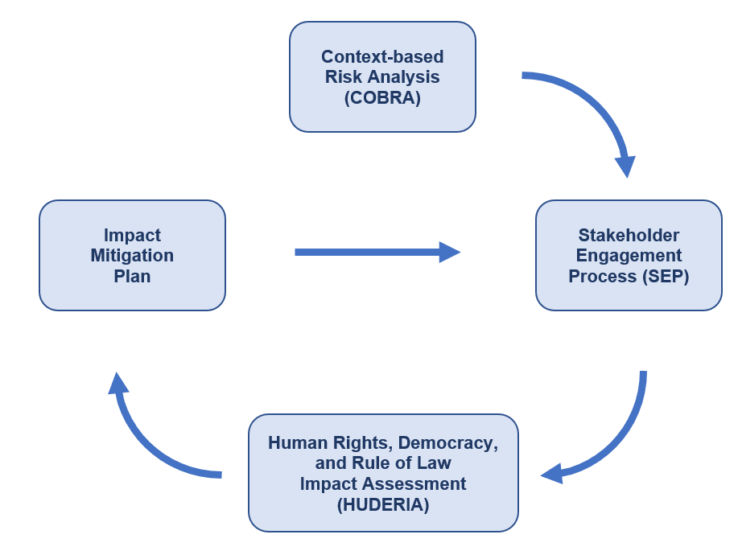
Outline of the instrument
Risk and impact assessment (so-called “HUDERIA”):

Slide 13
Outline of the instrument
Risk and impact assessment (so-called “HUDERIA”):
HUDERIA considers democratic processes as sensitive sector/domain not only for human rights but for democracy and the rule of law
democratic processes include such issues as electoral system, institutions and political processes, freedom of expression, freedom of assembly and association, access to information and media
significant levels of risk if the output of the artificial intelligence system is employed with a view to:
substantially informing the process of establishing or revising laws and policies, or
substantially informing or taking decisions affecting human rights and fundamental freedoms or connected legal rights or interests of individuals or legal persons
substantially informing or influencing decisions, behaviours, or actions taken by proxy through the deployment of such systems (i.e. where such systems carry out cognitive or perceptual functions, in the place of humans, like reasoning, communication, prediction, planning, classification, problem solving, pattern recognition, or kinematic, visual, auditory, or haptic analysis) that affect human rights and fundamental freedoms or connected legal rights or interests of individuals or legal persons.

Slide 14
Outline of the instrument
The issue of “red lines” prohibited applications and practices
the convention could provide definitions of certain potentially prohibited artificial intelligence practices, such as certain emotion recognition and social scoring techniques
the possibility of imposing a full or partial moratorium or ban in respect of other such systems that are deemed to present an unacceptable level of risk
appropriate procedure for reversal of such measures once relevant risks have been sufficiently reduced or appropriate mitigation measures have become available

Slide 15
Conclusions
A State-by-State approach to regulating AI will only lead to legal fragmentation and uncertainty – and even a regional approach is probably not sufficient in tackling the challenges posed by a technology with global reach
We need a global approach and a global legally binding instrument
Therefore, we will involve States from other regions in the negotiations
The new instrument has the potential to become a global standard

Slide 16
www.coe.int/cai
@coe4ai
fb.com/coe4ai

