Slide 1



Good practice and new technologies: the Belgian case
David Van Kerckhoven

Slide 2
Content
The Belgian voting system
Collection of candidates
Polling station
Collection results and publication
Security principles
IT security
Security procedures
Transparency

Slide 3
The Belgian voting system
Candidates
Polling stations
Collection results
Publication

Slide 4

Collection candidates
Candidates
Parties
Candidates
Control

Slide 5
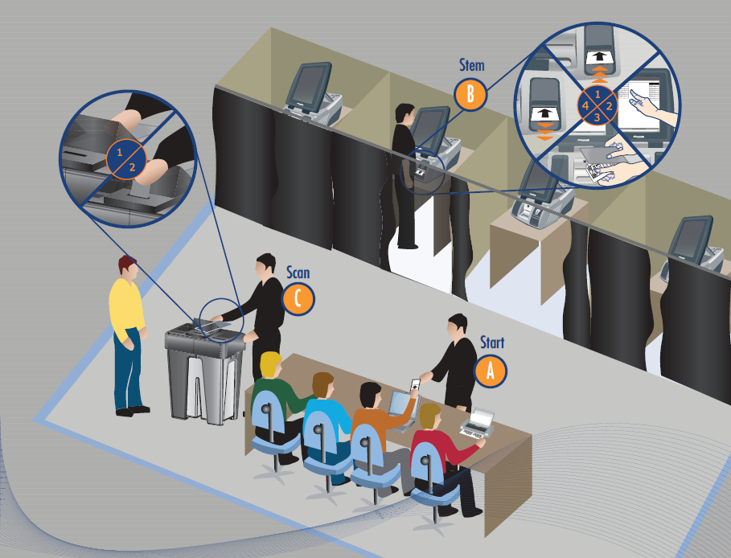
Barcode reader (optional)
Voting computer and alarm box
Computer chairperson, card reader and
usb hub
Ballot box
Printer

Slide 6




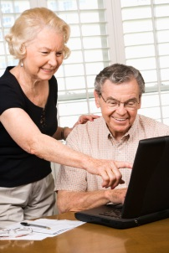



Collection results and publication

Slide 7
Security principles
3 principles
IT security
Procedures
Transparency

Slide 8



IT security
IT security people ←→ Hackers
Encryption
Digital signature
Conscious

Slide 9
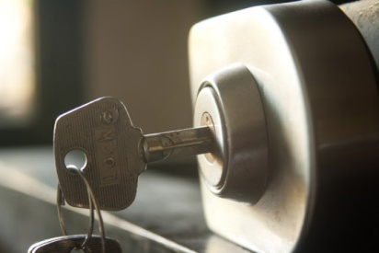
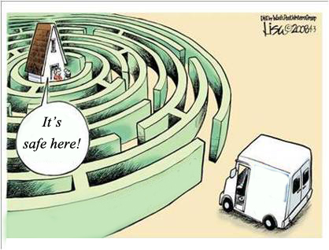
Security procedures
Protection
Security zone
Secured transport
Prevent battle
A battle that doesn’t need to be fought, is always won!

Slide 10
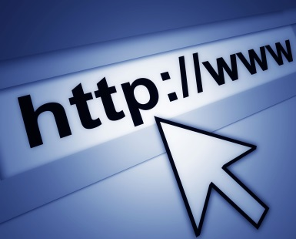


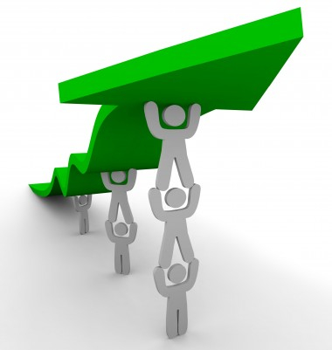

Transparency
Openness towards citizens
Website
Helpdesk
Publication software
Improvement
IT security
Procedures

Slide 11


More info:
DirElec-Verk@rrn.fgov.be
http://www.verkiezingen.fgov.be

