Slide 1
Media Monitoring During Electoral Processes
Rasťo Kužel
Media & Election Analyst
kuzel@memo98.sk

Slide 2

Media Monitoring
Monitoring media conduct – when done impartially, proficiently and based on a credible methodology – establishes whether the key aspect of an election process contributes to or subverts the democratic nature of elections.
Media monitoring can measure the amount of coverage of electoral subjects, the presence of news bias, appropriateness of media access for political competitors and the adequacy of information conveyed to voters through news, direct political messages, public information programming and voter education announcements.
Shortcomings in media conduct can be identified through monitoring in time for corrective action. Abuse of the mass media power to affect voter choices also can be documented, which allows the population and the international community to appropriately characterize the true nature of the electoral process.

Slide 3
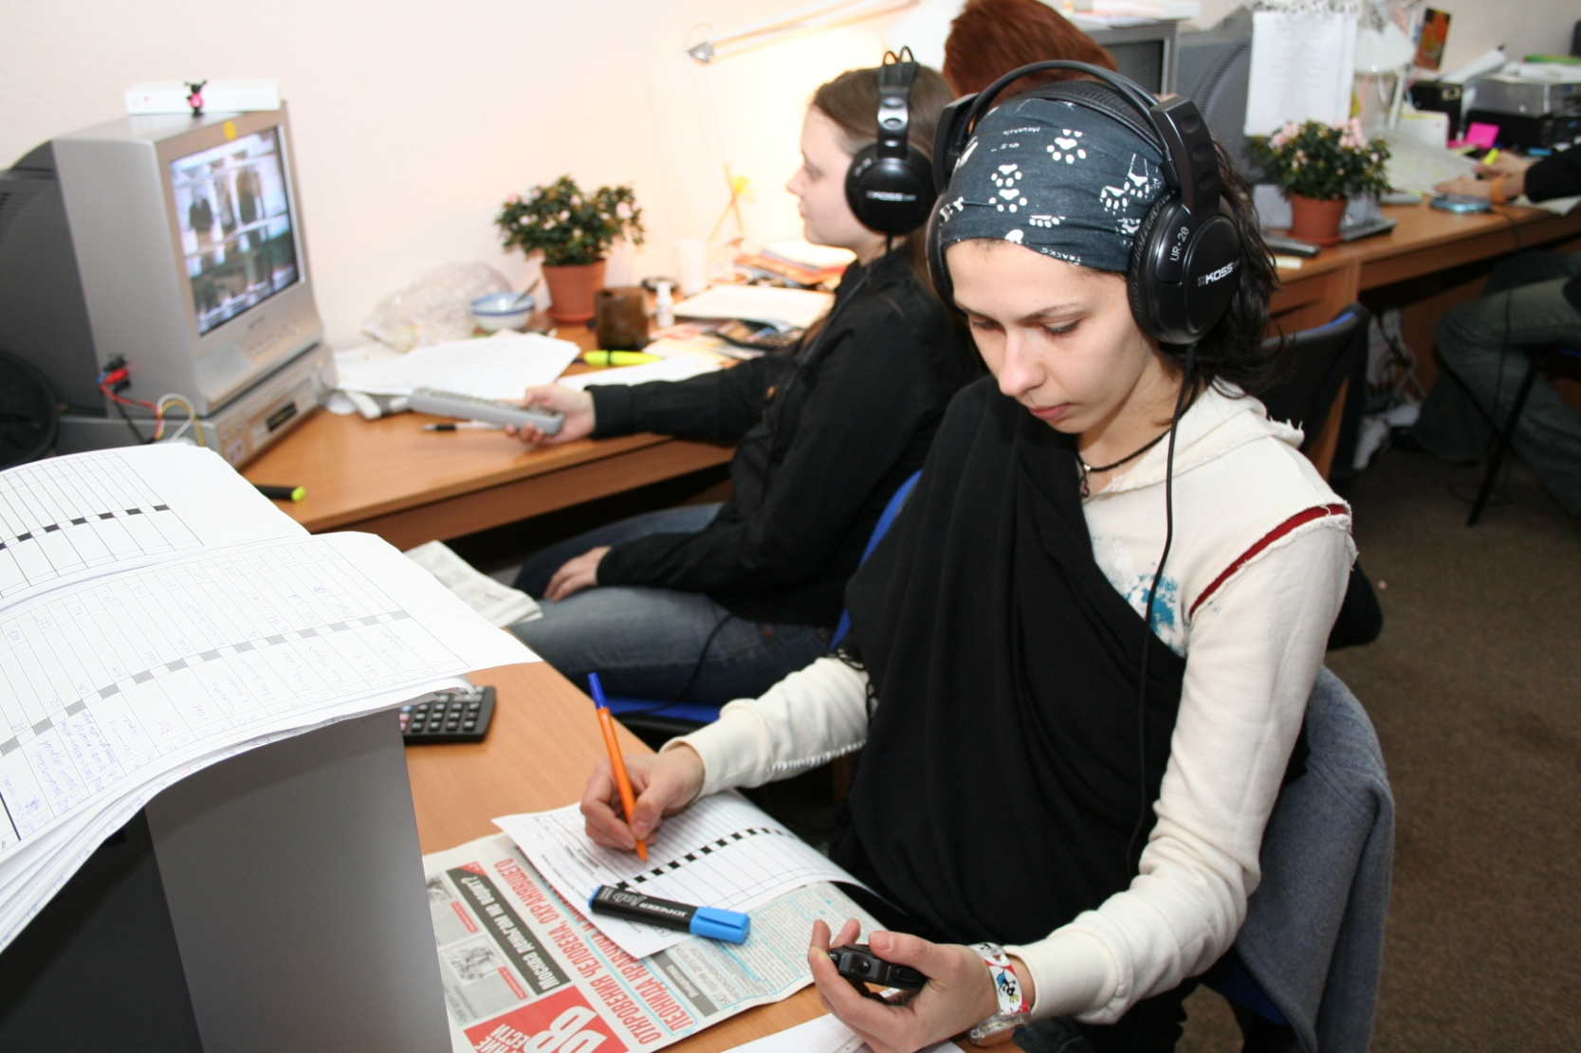
Who monitors the media?
Academics
Election observers
NGOs
Market researchers
Regulators
Media

Slide 4
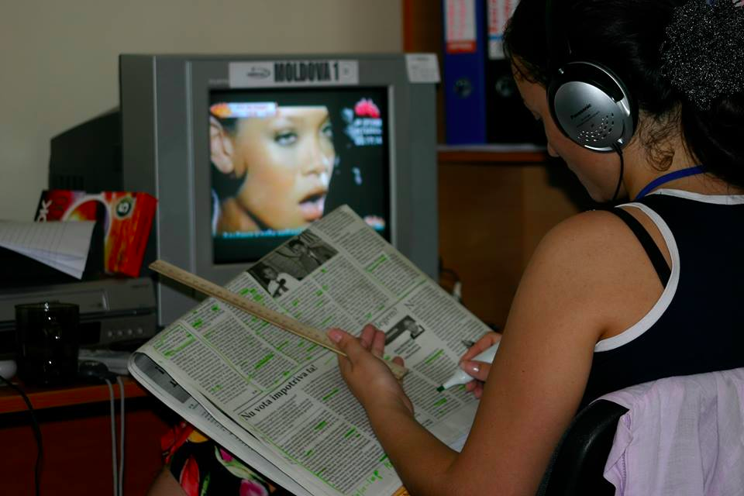
Who is best fit from among regulators to monitor media ?
Election Management Bodies?
Media regulators?
Problems of the media
coverage

Slide 5


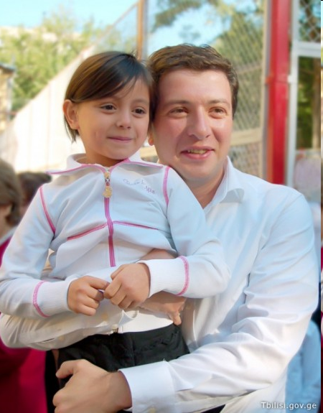
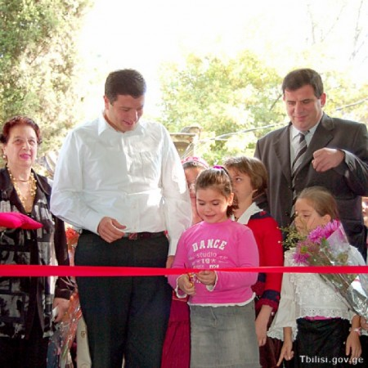

Slide 6

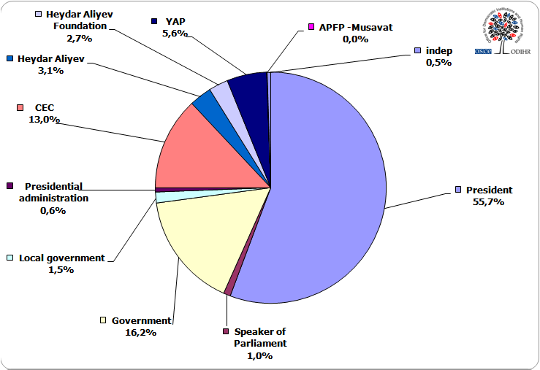
87 %
0 %

Slide 7
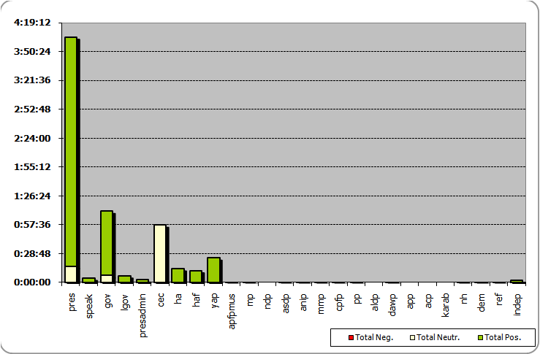
4 hours and 5 minutes
4 seconds

Slide 8
Parliamentary Elections 2010 - Azerbaijan
OSCE/ODIHR final report concluded: The CEC did not take action to address the unbalanced news coverage by state-funded media. As such, not all electoral contestants were provided with unimpeded access to the media on a non-discriminatory basis (as provided by paragraph 7.8 of the Copenhagen Document). The strikingly unbalanced coverage in the broadcast media also challenged the ability of parties and blocs to compete with each other on a basis of equal treatment.

Slide 9
Parliamentary Elections 2010 - Azerbaijan
OSCE/ODIHR recommended: The CEC, in cooperation with the National TV and Radio Council, should ensure respect for the media-related provisions of the Election Code during the campaign, including equitable news coverage of election contestants on ITV or other state-owned or financed media. Systematic media monitoring by the NTRC during an election campaign period could assist the CEC in carrying out this task.

Slide 10
BiH General Elections 2015
The Communications Regulatory Agency (CRA) is responsible for the regulation of broadcasters and is tasked with adjudicating complaints related to the activities of broadcast media in general, as well as during elections. Its sanctioning powers range from warnings to withdrawal of licenses.

Slide 11
BiH General Elections 2015
A total of 11 election-related complaints were filed with the CRA; a relatively small number when contrasted with the bias noted by civil society media monitoring in the pre-election period.
The CRA does not conduct its own systematic monitoring of the media and only acts upon complaints received. The law regulating the CRA does not set deadlines for the review of complaints and none of the complaints received in the pre-election period were decided upon before election day. Combined with the lack of a proactive approach by the CRA to identify violations, this undermined the effective enforcement of several media-related regulations.

Slide 12
BiH General Elections 2015
OSCE/ODIHR recommended:
The law should provide clear deadlines for the timely adjudication of media-related complaints. In addition, the CRA should act upon its initiative and could be mandated to conduct systematic monitoring of the broadcasters’ election coverage and their compliance with the rules and regulations.

Slide 13
Media monitoring by regulators?
Media regulators or EMBs?
The establishment of a systematic media monitoring during an election campaign would assist a media regulator in identification of any inequitable and preferential coverage of contestants and in taking prompt corrective action.
Conducting the monitoring in house or outsourcing?
Advantages & disadvantages

Slide 14
  Thank you

