Slide 1



The organisation of neutral elections: the Belgium experience
The essential elements for neutral, impartial and transparent elections

Slide 2
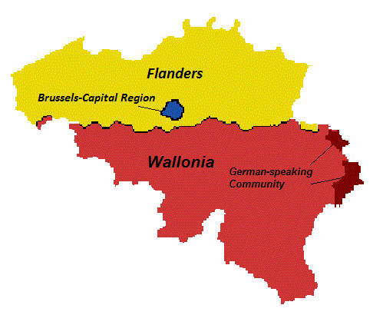
Introduction : Elections in Belgium
Federal Parliament
Region and Community Parliaments
European Parliament
  ► Federal authorities
Municipalities
Provinces
  ► Regional and
  community authorities

Slide 3
Different elements of the Belgian experience
Organizer IBZ + Municipalities
Legislation
Magistrates
Neutral, transparent and impartial elections

Slide 4
A prerequisite: the Legislation
Essential basis for all the interveners
Text must be:
  Clear
  Comprehensible to all
  Unambiguous
Essential elements:
  Provide for possibilities of appeal at the different stages of the procedure
    Candidacies
    List of voters
    Validation of the results

Slide 5
A prerequisite: the Legislation
  Authorising the attendance of witnesses
    At the different stages
    A guarantee of democracy
  Authorising the coming of observers
  Preventing modifications of the law less than one year before the elections

Slide 6
A fundamental actor: the Magistracy
Management of the main electoral offices
  Magistrates of the legal Order
Upper
main
electoral
office
Lower main electoral office
Counting station
Polling station

Slide 7
A fundamental actor: the Magistracy
  Separation of powers
  Independence
Intervention of the main electoral offices
  Designation of the members of the polling and counting stations
  Reception and validation of the candidacies
  Totalling the results
  Distribution of the seats and nomination of the elected representatives

Slide 8

A coordinator
The organising authority of the elections
  In Belgium: no independent commission
  → Ministry of Home Affairs (FPS)

Slide 9
A coordinator
IBZ
Parliament (Legislation)
Municipalities
Magistrates
Citizen / Civil society

Slide 10
A coordinator
Professionalization of the organisation
  Permanent (↔ Magistrates)
    → Essential in case of early elections
  Specialisation
Administrative values to respect
  Impartiality
  Professional integrity
  Loyalty

Slide 11
A coordinator
Our role
  Administrative and logistic frame of the elections
    Instructions and forms
    Trainings
    Other
  Editing the adaptations of the legislation in consultation with the magistrates and in answer to the requests of the citizens
  Dissemination of information → Transparency

Slide 12
An essential partner
The municipalities
  Actors « Practical mover of the organization »
  Practicalities (polling booths, ballot box, convocations, …)
  Announcement of information → Relay

Slide 13
Merci.
Pour plus d’informations:
www.elections.fgov.be
DirElec-Verk@rrn.fgov.be
Thank you.
More information:
www.elections.fgov.be
Régis Trannoy
regis.trannoy@rrn.fgov.be
+ 32 (0)2 518 20 58
DirElec-Verk@rrn.fgov.be

