Slide 1
"The use of ICTs in nation wide elections in Spain: data collection and dissemination of preliminary results."
13th EUROPEAN CONFERENCE OF ELECTORAL MANAGEMENT BODIES
“NEW TECHNOLOGIES IN ELECTIONS: PUBLIC TRUST AND CHALLENGES
FOR ELECTORAL MANAGEMENT BODIES”
14-15 April 2016Bucharest. Parliament House.
http://www.infoelectoral.interior.es/ - http://generales2015.interior.es/
© Ministerio del Interior. Subsecretaría. Dirección General de Política Interior . 2016
Contact: aclopez@interior.es Head of the Electoral Co-operation Unit. Ana Cristina López López.

Slide 2
EMB SYSTEM AND ELECTIONS.
SPAIN: EMB HYBRID SYSTEM
ELECTORAL ADMINISTRATION (EMB)
PUBLIC
ADMINISTRATION
(EMB)
+
Ministry of the Interior (MIR)
(Nation wide elections&referenda:
electoral budget and logistics,
preliminary results collection
and dissemination,
political parties´register…)
Electoral Commissions
(mainly judiciary) -candidatures,
claims, final results…)
and Electoral Boards
(They consist of 3 electors with certain education level
ramdomly chosen. Compulsory duty.
Compensation: 62 euros –paid by MIR-)
Ministry
of Foreign Affairs
and Cooperation
(Some tasks related to
Out of country voting
and OSCE visits)
Electoral
Census Office
Provincial level
Administration.
(Administración Periférica)
and Local Administration.
Embassies
and Consulates.

Slide 3
EMB SYSTEM AND ELECTIONS.
SPAIN: NATION WIDE ELECTIONS AND REFERENDA.
PARLIAMENTARY ELECTIONS: CONGRESS AND SENATE. http://generales2015.interior.es/es/las-elecciones-en-cifras/
LOCAL ELECTIONS.
http://elecciones.mir.es/locales2015/web/locales2015/home.html
3. EUROPEAN PARLIAMENT ELECTIONS.
http://elecciones.mir.es/europeas2014/web/europeas2014/home.html
4. NATION WIDE REFERENDA.
http://elecciones.mir.es/eleccanteriores/referendum2005/home.htm

Slide 4
2. MINISTRY OF THE INTERIOR (EMB).
2.1 Ministry of the Interior competences (nation wide elections and referenda):
the electoral budget (PE 2015 130 million euros);
logistics and management (I.e. The Ministry of the Interior opens several calls for tenders.)
voter education campaigns on Public Radio, TV and online (art. 50 Electoral Act 5/1985);
all tasks required to ensure that Government makes public the provisional electoral results on election day (art. 98.2 Electoral Act);
implementation of regulations related to elections and accessibility;
Political Parties Register and public funding of political parties;
the coordination of all Administrations which play a role in the managing of elections and referenda;
the design and development of strategies to innovate Electoral Management (I.e. the use of ICTs etc.);
running pilots in the field of elections (i.e. Electronically Managed Electoral Board -MAE-), with the previous authorization of the Central Electoral Commission (www.juntaelectoralcentral.es )
Security.

Slide 5
POST-ELECTORAL
PRE-ELECTORAL
1978 Constitution
Political Parties´subsidies for electoral expenses: payment.
Central Electoral Commission Doctrine.
Electoral Act 5/1985
Regulations.
Provisionary electoral results public dissemination.
Evaluation
Memorandums of Understanding.
Implementation of the electoral Management Manual&schedule.
Electoral Commissions: publication of final results.
Electoral budget: closing.
Legal framework
Decision making: National Data Dissemination Centre location, innovative goals and measures…
Polling day: incidents´ monitoring.
Electoral material quantificaction.
Planning and drafting.
Press Conferences: Ministry of the Interior and Ministry of Presidency.
Drafting of tender specifications and opening of the public tender procedures.
Polling day
The electoral cycle : the Ministry of Interior
tasks and competences.
Electoral Budget design +Ec. Admin. Instructions.
Electoral material monitoring.
Other tasks
Co-operation with other EMBs and electoral stakeholders.
Public outreach: Public media information campaing and infoelectoral@interior.es
Electoral Period
ELECTORAL
Agreement on Postal services and elections.
Electoral Board members handbook (Standard and MAE)
Accesibility: visually impaired electors special procedure, monitoring…
Calling of the elections.
R. Decree: calling for the elections.
Web site: launching.
Web site: Design.
Advanced payment: political parties’ subsidies for electoral expenses.
Sending of instructions to Provincial Level Administration: management, incidents and evaluation.
Follow up: implementation of public procurement of goods and services.
Political Parties´Register: certificates for Electoral Commissions.

Slide 6
2. MINISTRY OF THE INTERIOR (EMB).
2.2 Ministry of the Interior. Election day: electronic data collection, transmission and dissemination.
Portable electronic devices: PDAS/tablets/smartphone sand (MAES) –Electronically Managed Electoral Boards- are used to send data from the Electoral boards to the Central Data Dissemination Center (Madrid)
A Government’s representative at every polling station reports turn-out data and preliminary electoral results of one or several Electoral Boards.
Preliminary electoral results, as well as turn out data, are transmitted electronically via portable electronic devices or via MAES:
PE 2008: all municipalities over 50.000 inhabitants (46% of the electoral census).
PE 2011: all municipalities over 2.000 inhabitants (86% of the electoral census). In Madrid, Barcelona and the Canary Islands: 100% of the electoral census.
Municipalities under 2.000 inhabitants (only 14% of the electoral census) used telephones
MAE (Electronically Managed Electoral Board) 1.753 Electoral Boards in the city of Madrid used MAEs.
c) PE 2015:
Portable electronic devices: 21. 400 (90,96% of the electoral census)
Telephones: 4.169 Electoral Boards.
MAE (E-managed Electoral Board) : 3.305 (All Electoral Boards in the municipality of Madrid)

Slide 7
2. MINISTRY OF THE INTERIOR (EMB).
MININT ICTs approach:
Intensive ICTs use. *
*(N.B. The electoral law does not regulate e-voting)
Streamlining: rationalization, cost cutting measures and technology updates.
Increasing competitive concurrence.

Slide 8
2. MINISTRY OF THE INTERIOR (EMB).
2.3 The electoral budget. MINISTRY OF THE INTERIOR.
Electoral Budget | Parliamentary Elections 2011 | Parliamentary Elections 2015
Total | 124.838.130 euros | 130.244.505 euros
Preliminary results ‘dissemination and ICTs | 18.925.000 euros | 12.839.000 euros
Electoral Budget | European Parliament Elections 2009 | European Parliament Elections 2014
Total | 136.480.000 euros | 120.584.914 euros
Preliminary results‘ dissemination and ICTs | 14.630.000 euros | 14.676.618 euros
Electoral Budget | Local Elections 2011 | Local Elections 2015
Total | 112.781.550 euros | 127.990.000 euros
Preliminary results ‘dissemination and ICTs | 17.000.000 euros | 15.970.258 euros

Slide 9
3. DATA COLLECTION AND DISSEMINATION OF ELECTORAL RESULTS.
Preliminary tally/counting of the votes: Electoral Boards.
(57.486 EBs )
Final/definitive tally:
50 Province Electoral Commissions
50 PECS
On site voting.
Postal voting:
+ in country postal voting.
+ temporarily out of country postal voting (Voto ERTA).
Permanently out of country voting (Voto CERA).
- Preliminary counting protocols issued by the Electoral Boards + claims + invalid votes/ballots
Election day: preliminary results dissemination Ministry of the Interior I.e. PE 2015 http://resultadosgenerales2015.interior.es/#/
Final/definitive results published in the Official Gazette www.boe.es by the Central Electoral Commission www.juntaelectoralcentral.es
http://www.infoelectoral.interior.es/min/

Slide 10
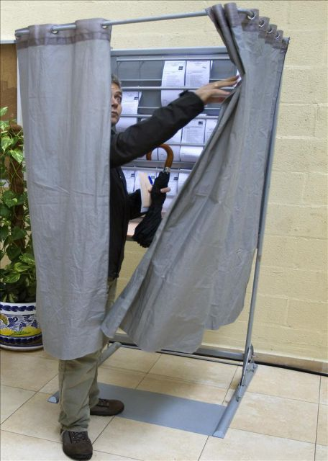
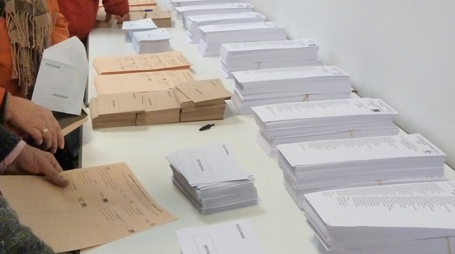
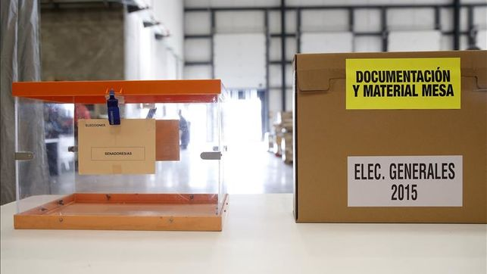

Slide 11
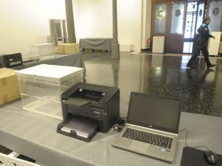
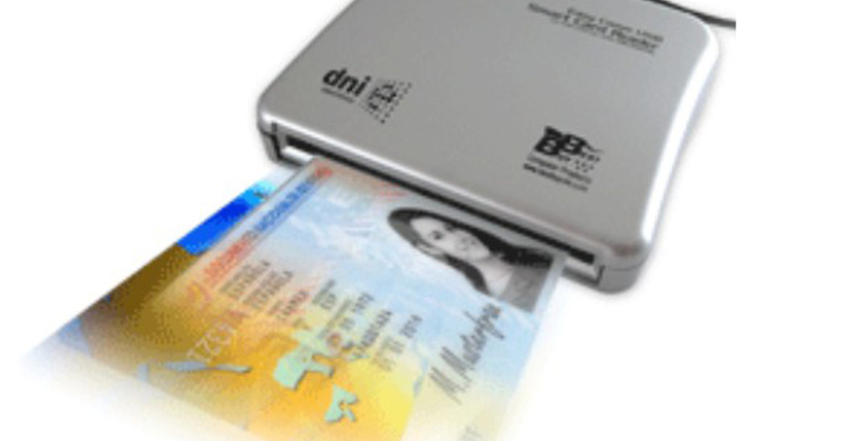
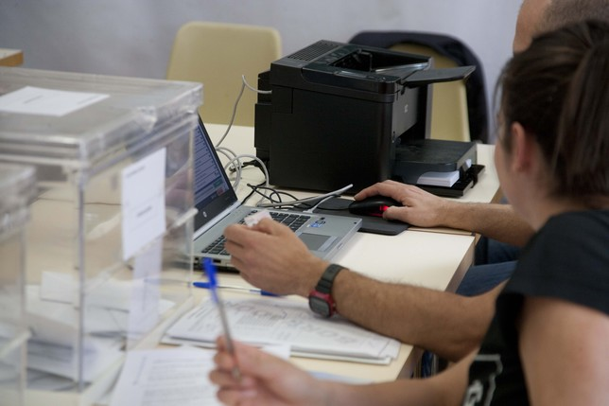

Slide 12
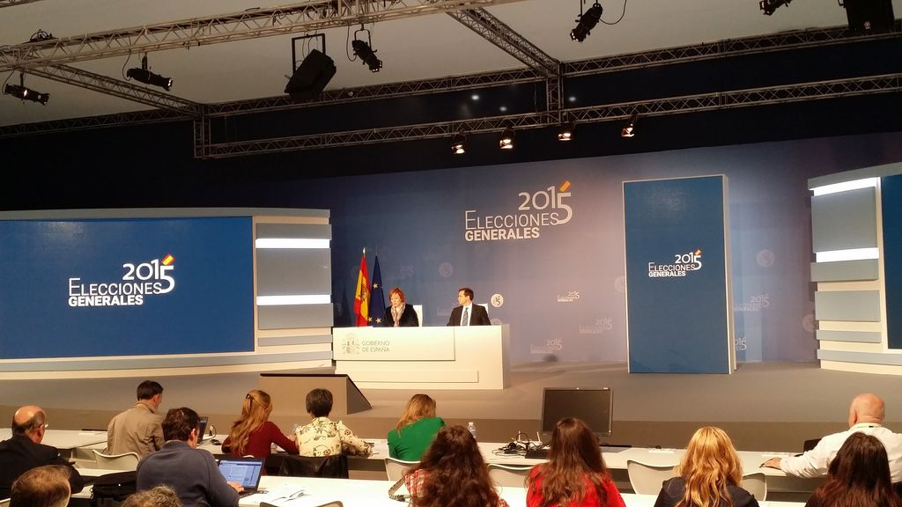

Slide 13
The MAE IS NOT AN E VOTING TOOL and consists of:
A tablet with a keyboard + a software application+ an e-car reader + a laser printer + Internet conection
MAE Esencial feature: Helpful e-tools for the Electoral Board members
Only on a second level: a data-sending device.
http://generales2015.interior.es/es/visitas-virtuales/mae/

Slide 14
Mesa Administrada Electrónicamente. (MAE) 2008 *-2015
E-managed Electoral Board.
1.Lleida, 2.Pontevedra 3.Salamanca.
461 MAES
1.Castellón
2.Ceuta
3.Huesca
5. Mérida
452 MAES
1.Madrid. 1.763 MAES
1.Barcelona.
2.Córdoba.
3.Valladolid. 1.746 MAES
21 MUNICIPALITIES*
3.194 MAES
1.MADRID.
3.305 MAES
MAE. First pilot: Parliamentary Electionra 2008 The Central Electoral Commission authorized the MININT to run the first pilot in several Ebs: Alcobendas, Toledo and Valladolid.
Local Elections 2015 MAE 21 municipalities . N.B. As it also had happened in 2011 Local Elections, there was a co-operation agreement with Autonomous Communities EMBs to use MAEs simultaneously in local and Autonomous Communities´ elections. Alcobendas(Madrid), Avilés (Asturias), Badalona (Barcelona), Burgos, Candelaria (SantaCruz de Tenerife), Ceuta, A Coruña, Huesca, Ingenio (Las Palmas de Gran Canaria), Jaén, Marratxí (Illes Balears), Melilla, Mérida (Badajoz), Molina de Segura (Murcia), Pamplona, Santander, Sevilla, Talavera de la Reina (Toledo), Tarragona, Torrent (Valencia) y Vitoria-Gasteiz.

Slide 15
4. LINKS.
1.Ministry of the Interior: http://www.interior.gob.es/
1.1 Parliamentary Elections 2015 http://generales2015.interior.es/
1.2 Electoral results data base: http://www.infoelectoral.interior.es/min/
1.3 Electoral information permanent web site: http://www.infoelectoral.interior.es/
2. Junta Electoral Central (Central Electoral Commission)
http://www.juntaelectoralcentral.es/
3. Oficina del Censo Electoral/Electoral Census Office
(Ministry of Economy and Competitiveness) http://www.ine.es/oficina_censo/presentacion.htm
4. Ministry of Foreign Affairs and Cooperation
http://www.exteriores.gob.es/Portal/es/ServiciosAlCiudadano/SiEstasEnElExtranjero/Paginas/ParticipaEnLasElecciones.aspx

Slide 16
www.interior.gob.es

