Slide 1
Use of Electronic Voting Devices An Overview of the Latin American Situation
Carlos Navarro
April 2016

Slide 2
Use of Electronic Voting Devices An Overview of the Latin American Situation
Common Features

Slide 3
Common features:
Geographical contiguity
Historical and cultural background
Language (except Brazil)
Deep rooted socio-economic inequities
Presidential form of government
Restored or emerging democracies
Multiparty systems
Highly competitive elections
Lack of confidence in politics and elections

Slide 4
Two broad categories:
Pessimistic approach
Optimistic approach
Lack of confidence in electoral institutions, proceedings and results
Distrust in electronic devices (digital division) +
Illiteracy in rural areas =
Adverse conditions and low prospects for introducing EVD
This is the era of ICT
ICT options and solutions are everywhere
Voting and counting are no exceptions
Conducive conditions for introducing EVD and making the voting and counting processes easier, quicker, safer and more cost-effective.

Slide 5
Use of Electronic Voting Devices An Overview of the Latin American Situation
What’s the evidence?

Slide 6
What’s the evidence?
Two countries introduced electronic voting machines (DRE) for binding elections in the late 1990´s: Brazil in 1996 and Venezuela in 1998.
Since then, both have used them in every single election that they have held.

Slide 7
Major differences
Brazil
Venezuela
The Brazilian device:
Designed and developed according to requirements and specifications established by the national EMB
Introduced on a gradual basis
The Venezuelan model:
Relies on products available in the market.
Since 2004, the DRE voting system is able to produce a paper trail
In 2012, the system integrated a biometric device for authentication of voters.

Slide 8
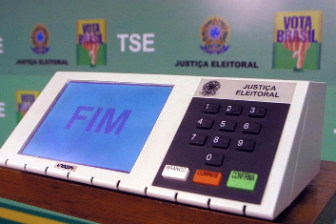
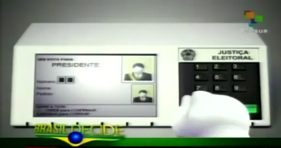
Major differences
Brazil
The Brazilian device:
Designed and developed according to requirements and specifications established by the national EMB
Introduced on a gradual basis

Slide 9
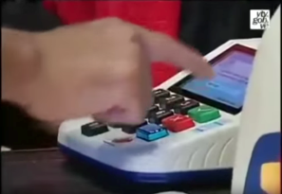
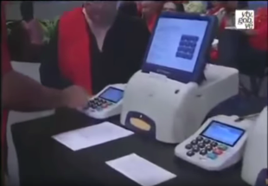
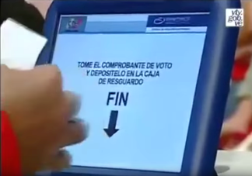
Major differences
Venezuela
The Venezuelan model:
Relies on products available in the market.
Since 2004, the DRE voting system is able to produce a paper trail
In 2012, the system integrated a biometric device for authentication of voters.

Slide 10
What’s the evidence?
Paraguay
Only other country in the region that has used electronic voting devices at national level with binding effects: during three electoral processes held between 2001 and 2006
After new complaints and allegations came up, the project was dropped in 2007.

Slide 11
What’s the evidence?
Peru
New rising star in the regions´ electronic voting horizon
Following a similar path to the Brazilians:
designed and developed their own DRE voting system
included a paper trail like the Venezuelan one
Introduction has been gradual, used for binding elections since 2011
In the general elections held last Sunday, the DRE voting system covered major areas in the capital city: nearly 3 out of 23 million voters registered

Slide 12
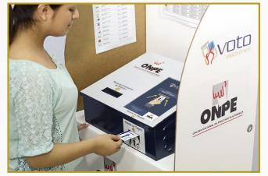
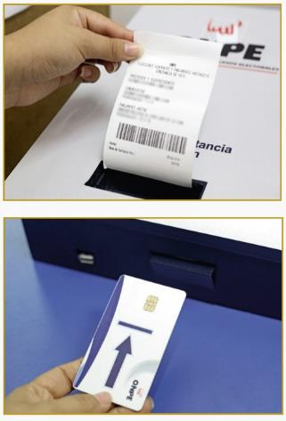
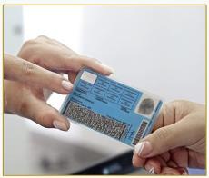
Peru

Slide 13
What’s the evidence?
Ecuador
Has also made intensive efforts to promote e-voting alternatives
In 2014, tested three different models with binding purposes at designated local elections
Despite high expectations for a more extensive usage in the 2017 national elections, project has been postponed until 2019.

Slide 14
Federal States: Two interesting case studies:
Argentina
Decentralized system
No legal provisions or initiatives at national level.
23 provinces have the power to enact their own electoral laws and proceedings.
A few (starting with Buenos Aires in 2003) have adopted legal provisions on the subject matter, and tested EVD.
Most relevant case: the province of Salta. A very sui generis semi electronic device has been used for binding elections since 2011.

Slide 15
Federal States: Two interesting case studies:
Mexico
New legal and institutional arrangements in distribution of electoral powers between federation and the 32 states has put on hold initiatives of e- voting at state (local) level
E-voting initiatives developed by six states, including three that have used them with binding effects (Coahuila, Jalisco and Mexico City).
All devices designed and developed in house, and provide paper trails.
INE has also designed and developed its own DRE voting system; however, no legal provisions for e-voting at national level

Slide 16
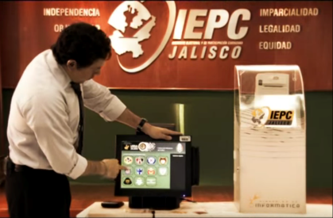
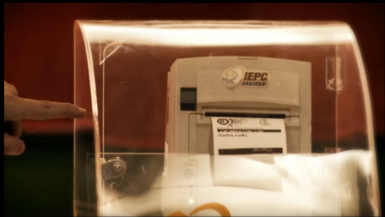

Slide 17
What’s the evidence?
Mexico (two states for local elections, 2012 and 2015), and Panama (for national elections in 2014)
have adopted remote i-voting with binding effects only for OCV purposes.
Figures for both voters registered and votes cast have been somehow disappointing.

Slide 18
Use of Electronic Voting Devices An Overview of the Latin American Situation
What does this tell us?

Slide 19
What does the evidence tell us?
One of the main motivations for the introduction of e-voting devices in the region is its potential for deterring fraud and bolstering confidence in the elections
The anecdotal evidence suggests that the confidence “issue” is at the same time a driving force and an obstacle for the introduction of e-voting.
The success of failure of an initiative is highly contextual and depends on different factors, but efforts displayed for building confidence and political consensus play a critical role.

Slide 20
What does the evidence tell us?
Some research has started to be done in the region examining to what extent voters are familiar with e-voting devices, and what are their perceptions or concerns in terms of the security and reliability of those devices.
National Survey on E-Voting in Mexico (2014)
Only 26% of the 1,400 surveyed knew what e-voting is
Only 20% of the total regarded e-voting as reliable, 65% did not.
65% thought that DRE devices in designated kiosks are more reliable than remote i-voting.
Only 15% preferred any other type of remote voting.
40% considered that e voting is less reliable than the actual manual and paper based voting.

Slide 21
Use of Electronic Voting Devices An Overview of the Latin American Situation
Final Remarks

Slide 22
Final remarks
Feasibility is highly contextual
Comprehensive and careful needs assessment: what problems need to be solved and their level of priority
In-house solutions relying on gradual approaches that involve and build confidence among key stakeholders seem to be the benchmark in the region
Awareness of and committment to international standards.

Slide 23
Final remarks
Systems that integrate paper audit trail can substantially increase the confidence in e-voting.
Impact of an e-voting solution in the trustworthiness of the electoral processes and its results are still open to debate
No evidence of increasing voter turnout
No doubt, from a logistical and operational point of view, an e-voting solution can greatly facilitates the management of the voting and counting proceedings.

