Slide 1

Technicalities of voting,
Belgium case
David Van Kerckhoven

Slide 2
Agenda
Time history
Concept
How to secure?
Conclusion

Slide 3
Time History
1991
  Experiment in 2 municipalities
1994
  Introduction of an electronic voting system
1999
  Extension
2012 and 2014
  Introduction of the new voting system Smartmatic
Next elections:
  2018 and 2019

Slide 4
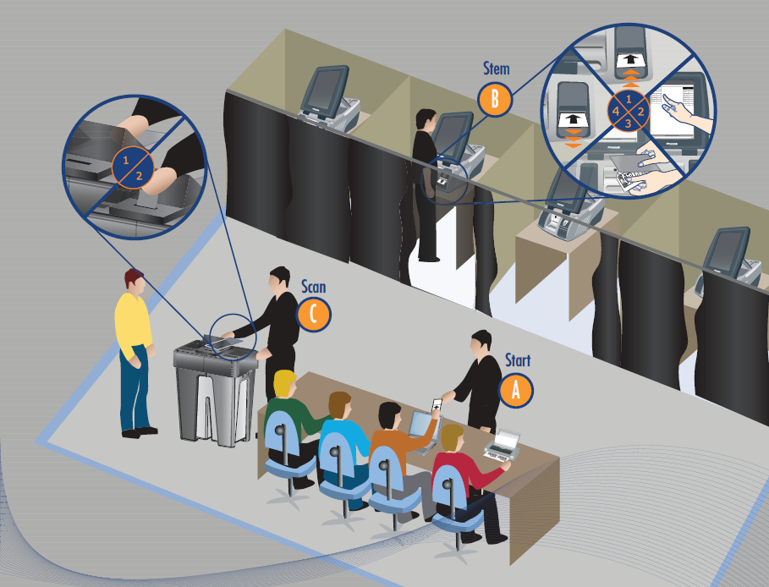
Bar code reader
Voting computer
Presidents Computer
Ballot box

Slide 5







Concept: Collecting the results

Slide 6
How to secure?
3 principles
IT security
Procedures
Transparency

Slide 7

How to secure: IT security
IT Security Team ←→ Hackers
Supplier
Authority
Counselling body
College of Experts
Technological evolutions

Slide 8
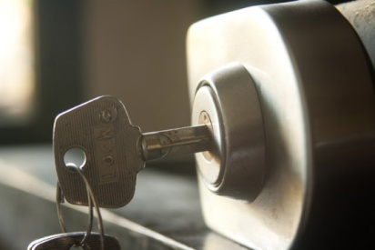
How to secure: Procedures
Protection
Security zone
Secure transport
Preventing a battle
“A battle that you don’t need to fight is always won!”

Slide 9


How to secure: Transparency
Openness to citizens
Website
Helpdesk
Publication software
Improvement
IT security
Procedures

Slide 10
Conclusion
Electronic voting system since 1991
New voting system since 2012
3 Security principles:
IT Security
Procedures
Transparency

Slide 11

Questions?
More information
DirElec-Verk@rrn.fgov.be
http://www.elections.fgov.be

Slide 12
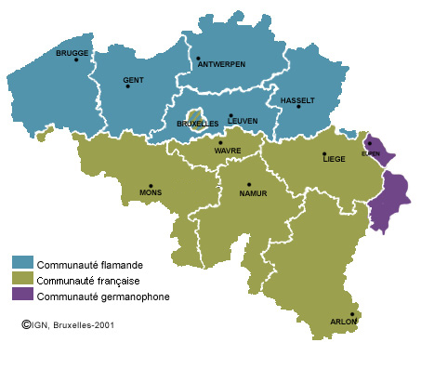
Who is Belgium?
Federal State
  ± 11.000.000 inhabitants
  ± 8.000.000 electors
  ± 50% electronic vote
4 different language-speaking regions
  Flanders →Dutch
  Walloon provinces → French
  Brussels → bilingual
  German-speaking region

Slide 13
Current situation
Flanders
  Continuation: 60%
Walloon provinces
  Stopping: 0%
Brussels
  ?
Next elections:
  2018 and 2019

Slide 14
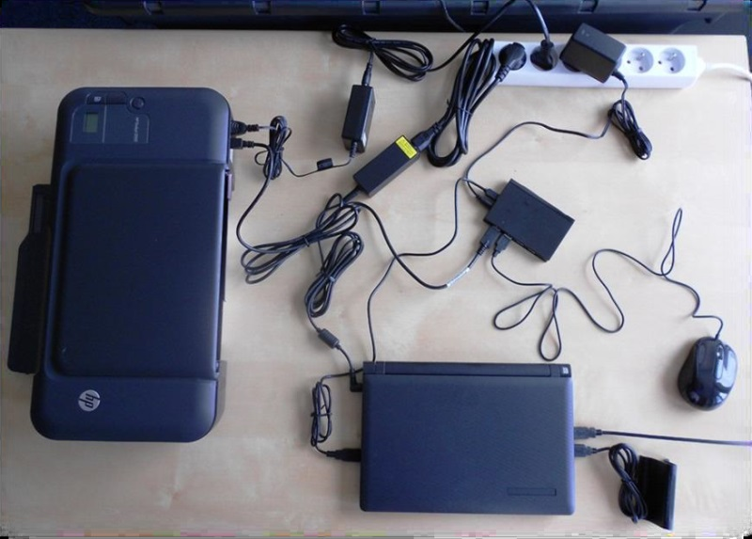
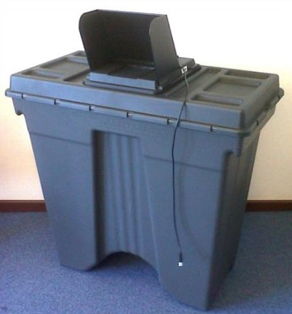
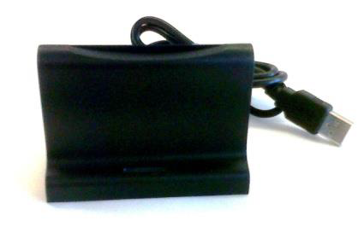
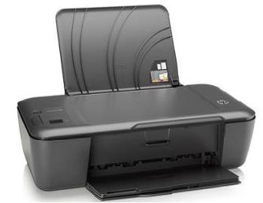
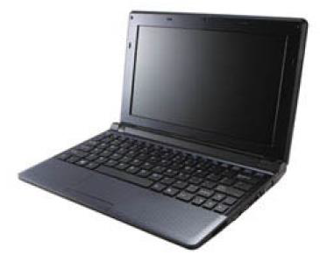
Concept: Polling station - President
Ballot
box
Presidents computer and accessories
Presidents
computer
Card reader
Printer

Slide 15
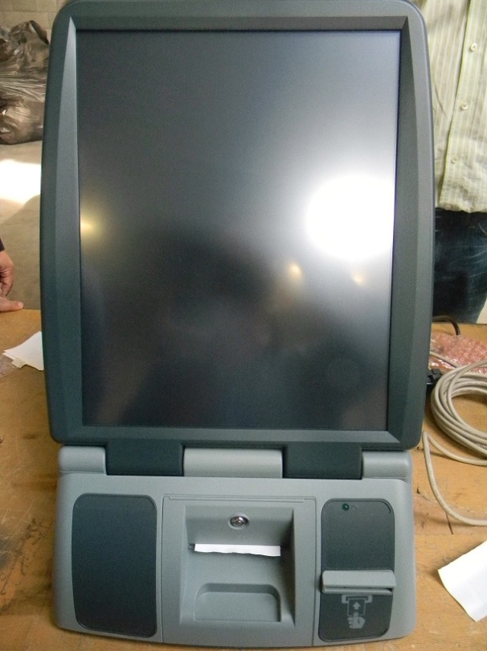
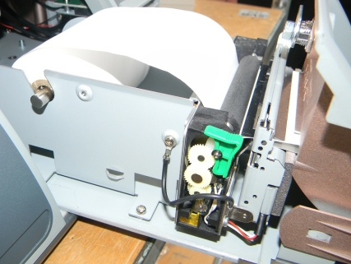
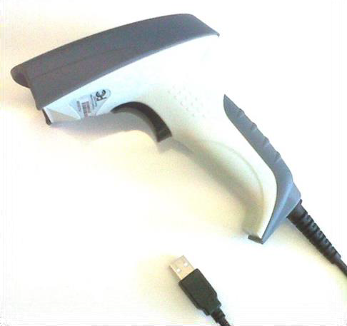
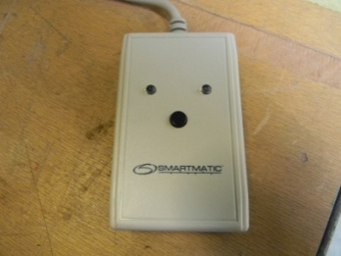
Concept: Polling Station - Elector
Paper
trail
printer
Voting computer
Bar code
reader
Alarm box

Slide 16
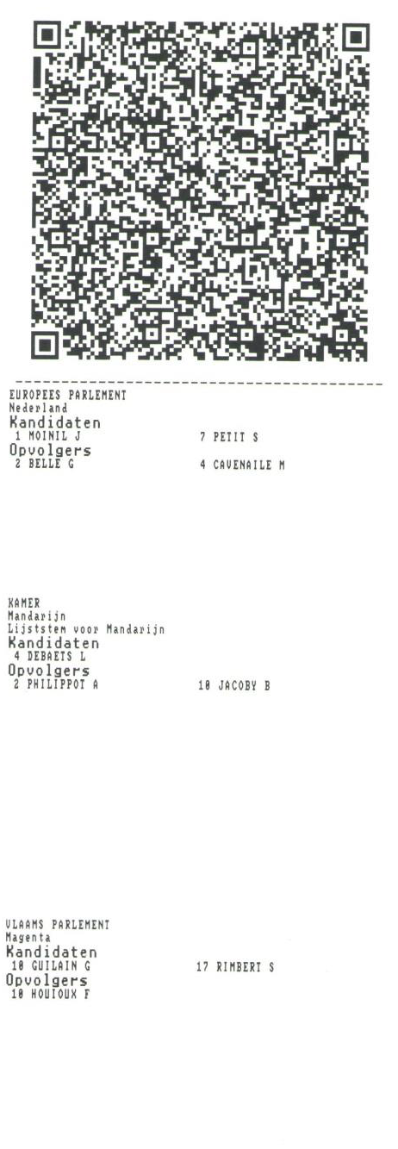
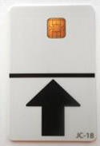
Concept: Polling station - Elector
Voting card:
Activates the
voting process
Votes cast:
Bar code + text

Slide 17
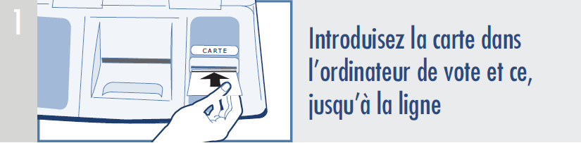
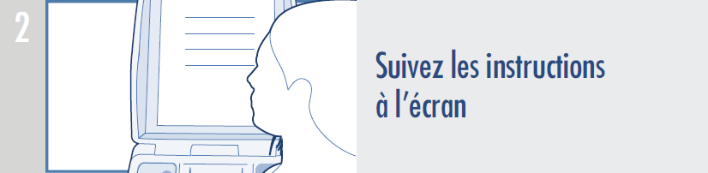
How to vote?

Slide 18
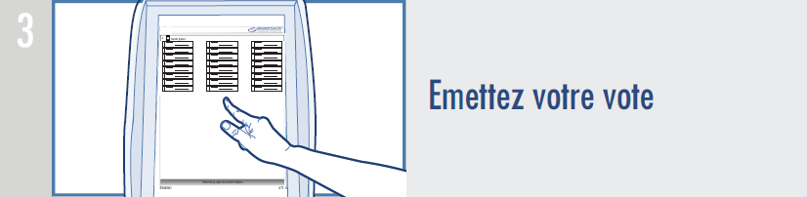
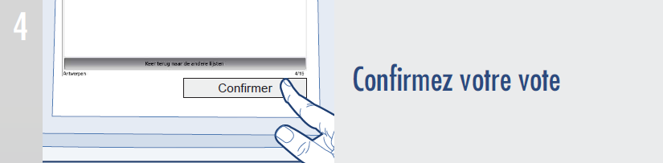
How to vote?

Slide 19
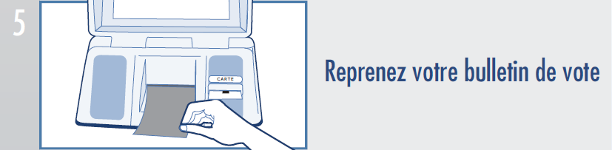
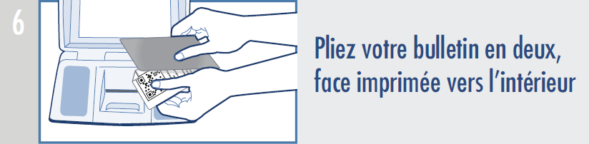
How to vote?

Slide 20
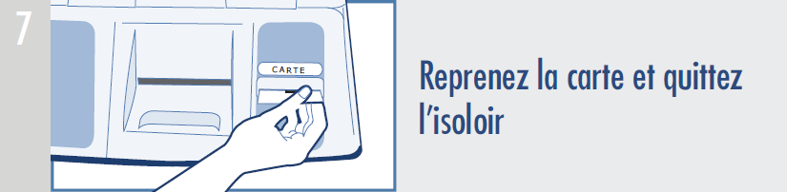
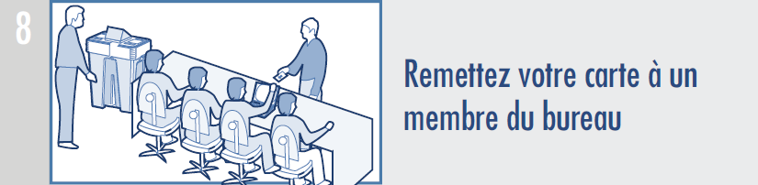
How to vote?

Slide 21
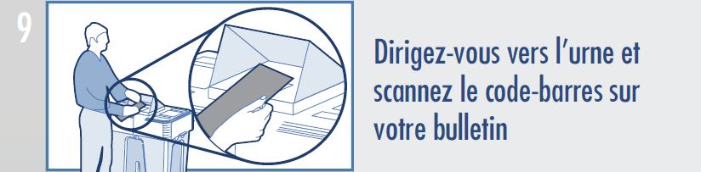
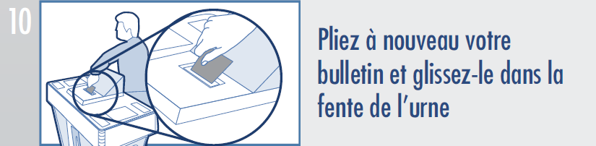
How to vote?

