Slide 1
BRAZILIAN 20-YEARS EXPERIENCE IN E-VOTING
13th European Conference of Electoral Management Bodies
Bucharest, 15th April, 2016

Slide 2
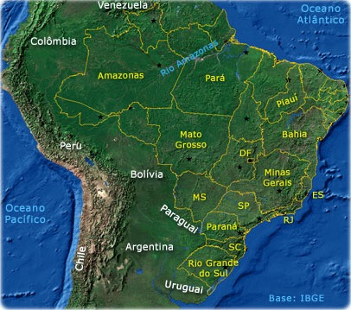
About the Brazilian Electoral Justice
2014 Elections
Registered voters 142,822,046
Cities 5,570
Electoral Zones 3,038
Electoral Sections 451,877
Electronic Voting Machines 532,705
Political Parties 32
Staff for the Election 2,435,303
As of 13/MAR/2014
Candidates 26,172
Information – 2014 Elections
Population 202,2768,562
* WWW.IBGE.GOV.BR OCT/2014

Slide 3
Electoral Court System
Created in 1932 (suspended between 37 and 45).
Judiciary Branch
FUNCTIONS
Administrative - Prepares and organizes elections.
Jurisdictional - Election-related judicial processes.
Regulatory - Issues binding instructions.
Composition of the Electoral Court System
The Superior Electoral Court (TSE)
27 Regional Electoral Courts (TRE)
3,033 Electoral Zones (Electoral Judges)
451,501 Polling Stations
96,146 Polling Places

Slide 4
About the Brazilian Electoral Justice
The Electoral System
Majority-based election, with the possibility of two rounds for President, Governors and Mayors, in cities with more than 200.000 inhabitants;
Majority-based election for Senator (three representatives from each State and from the Federal District), 81 (total);
Proportional representation with open list for the Federal Chamber of Deputies, the State Legislative Assemblies and the City Councils. For the Federal Chamber, minimum of 8 and maximum of 70 Deputies per state. 513 (total)

Slide 5
History of Computerized Vote
Computerization began in 1986;
About 70 million voters were registered into one single database;
The work to implement the electronic voting system began in 1995;
The IT committee, composed by TSE's technicians and consultants, presented a prototype of an electronic voting machine.

Slide 6
Parameters for the electronic voting system:
Standardization
Compliance with Brazilian legislation
User-friendly process
Cost reduction
Durability
Security
Logistical Advantage
Autonomy

Slide 7
Implementation Premises
The Electoral Justice is fully familiarized with the electronic voting process;
The electronic voting process is not limited to the electronic voting machine;
The national voting system depends on the:
Constitution;
Culture and history of the democratic process;
Financial capacity;
Legislation.

Slide 8
Implementation Premises
Requirements of any voting system solution:
To be complete: All possibilities must be identified and worked out;
Operate anywhere:
Indigenous village;
Large urban center;
Serve everyone:
Visually impaired;
Illiterates;
Elders, etc.

Slide 9
Vote Counting – Elections 2014
1st round – 100% of vote counting at
11h11m01s on 6.OCT.2014
2nd round – 100% of vote counting at
00h17m08s on 27.OCT.2014
50.47 BU’s per second is the average speed during vote counting.
Maximum of 3,813 BU’s per second.
At 8 p.m. on the election day, 93.9% of votes were already counted.
Notes:
fue la elección más rápida y con mejores indicadores de calidad electoral en la historia

Slide 10
Biometric Identification
EXPECTED BENEFITS
Improvements in the voter identification process;
Refinement of Electoral Registration process;
Reduction of identification fraud.
SCOPE
Classification of cities by population, infrastructure, distance from the capital, logistical feasibility, state support, and others.

Slide 11
Thank You

