Slide 1
IFES Covid-Related Responses in Elections in Serbia, North Macedonia, Kyrgyzstan, Ukraine and Georgia
Dr. Beata Martin-Rozumiłowicz, Director for Europe and Eurasia, International Foundation for Electoral Systems (IFES)

Slide 2
Background
COVID-19 pandemic necessitated rapid response in many elections
The swiftness of spread in Feb/March 2020 meant that many countries in region postponed initially scheduled elections
This presented certain legal difficulties – mostly dealt with by various ‘states of emergency’ (echoing Oliver, context important)
But also specificities, such as N. Macedonia where parliament had been disbanded and political agreement needed to be reached
Notes:
N.Mac - A state of emergency declared on 18 March in response to COVID-19;
On 21 March, a government decree suspended all election activities;
A health protocol for elections issued by the Ministry of Health on 22 June with recommendations for voting, handling election material;
Political parties agreed for 15 July as the new election date

Slide 3
Background
IFES was asked by a number of state authorities to help assist them in their COVID-19 responses in planning for postponed elections
Will present overview of assistance in chronological order:
21 June: Serbia (parliamentary)
15 July: N. Macedonia (parliamentary)
4 Oct: Kyrgyzstan (parliamentary)
25 Oct: Ukraine (locals)
31 Oct: Georgia (parliamentary)
Also draw some lessons learned for future elections
Notes:
Serbia initially called for 26 April
N.Mac initially called for 12 April

Slide 4
IFES Serbia
First national election in the European space after pandemic
Based on IFES’ Safeguarding Health and Elections white paper, IFES produced a comprehensive document with contextualized recommendations for EMB to consider in preparation of elections
A risk assessment exercise identified potential vulnerabilities and brainstormed feasible solutions, including:
Voter education and information
Protective health supplies
Poll worker training and instructions, including mobile teams
Polling station procedures and vote count and tabulation processes

Slide 5
Voter Information / Outreach
TV and Radio PSAs to highlight protective e-day measures
TV PSA aired frequently in days prior to the elections
Radio PSA was aired on a network of 160 radio stations nationwide
Instructional video and poster image were also promoted on EMBs Instagram account and reached 800,000 Instagram users

Slide 6
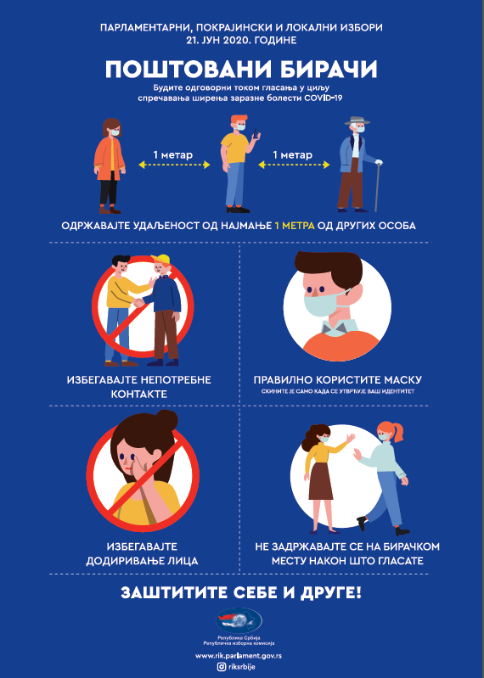
Voter Information / Outreach
Posters developed and disseminated
at all polling stations in the country
"Keep distance" poster, five copies per polling station
Informational poster for voters, one copy per polling station
Instructional poster for poll workers, one copy per polling station
Notes:
Around June 15, the government task force on COVID-19 issued special guidelines for election day, with the following key measures:
Voters were recommended to wear protective masks (some were provided at polling stations) and keep at least 1-meter distance from others
Voter interactions with others limited to 15 minutes at polling stations
Poll workers were mandated to wear protective masks and gloves, keep 1-meter distance from others

Slide 7
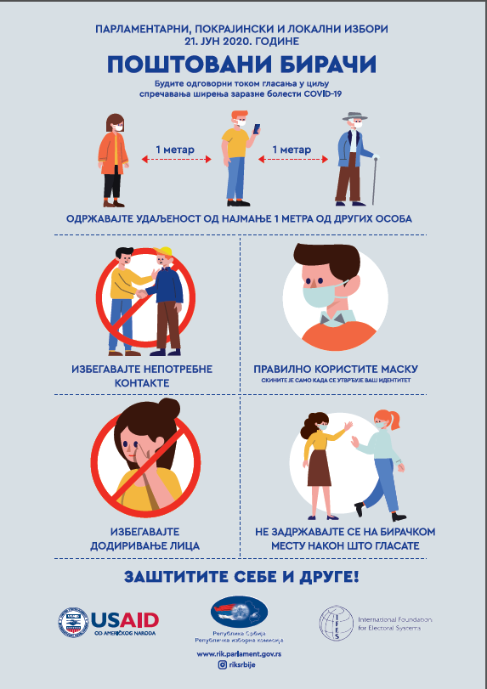
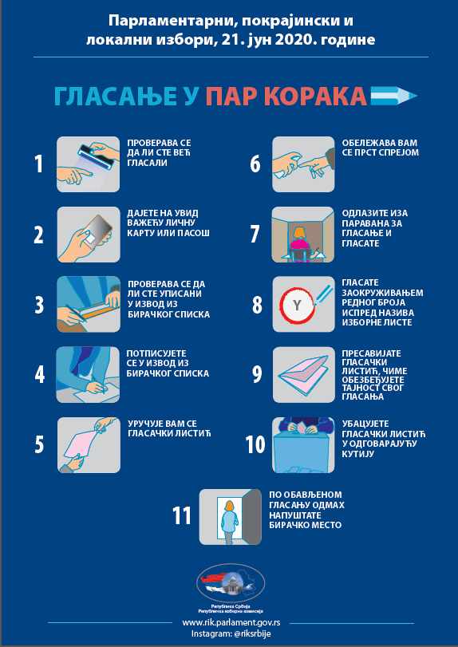
Voter Information and Outreach
564,000 informational leaflets were included in nine daily newspapers (Alo, Blic, Kurir, Informer, Večernje Novosti, Politika, Dnevnik, Danas, Srpski Telegraf)
Side 1: Safety measures on election day
Side 2: Updated procedures on election day
Notes:
Continued:
Poll worker mobile teams were mandated to wear protective masks and gloves at all times, as well as to provide a protective mask to visited voters
Polling stations were to be cleaned 24 hours before they open and remain well-ventilated throughout election day.
Desks, chairs, and polling booths were mandated to be arranged in compliance with 1-meter distance.
- These mitigation measures follow recommendations made by IFES during the risk assessment exercise.
- Given the very short timeline for implementation and dissemination of preventive measures for election day, IFES worked with RIK to revise original recommendations and prioritized those that could be realistically achieved and addressed higher-risk concerns.

Slide 8
IFES North Macedonia
IFES helped establish key measures introduced related to COVID-19:
Voters to wear protective masks and keep at least 1.5-2m distance from others
PEC members to wear masks and gloves, keep distance from other members
Special PEC members to wear protective coats, masks gloves, visors
Mandatory use of hand sanitizer before and after voting
Number of voters inside polling station (PS) not to exceed number of booths
Windows to be open for proper ventilation;
PSs to be disinfected before and after voting

Slide 9
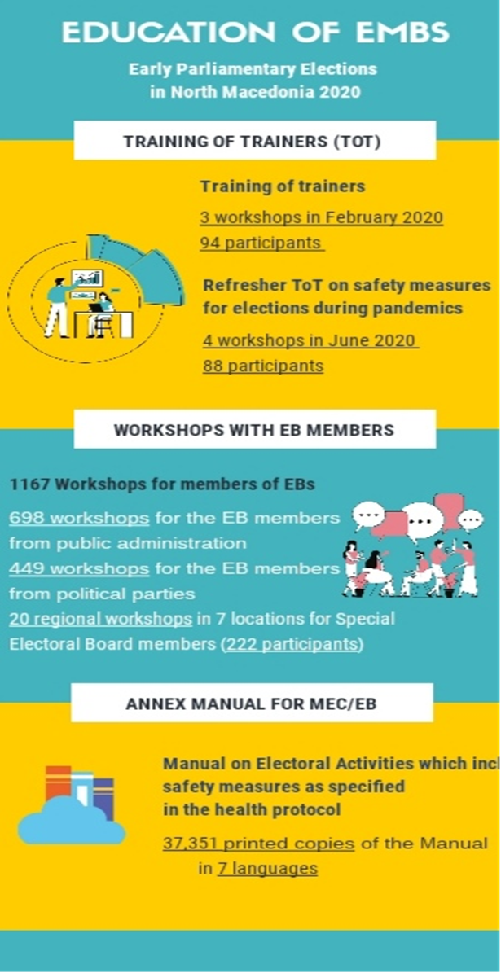
EMB Training
Training undertaken in February/March, resumed in June
2nd round of trainings included education on protective measures
Education materials created based on health protocol and reflected changes in voting procedures

Slide 10
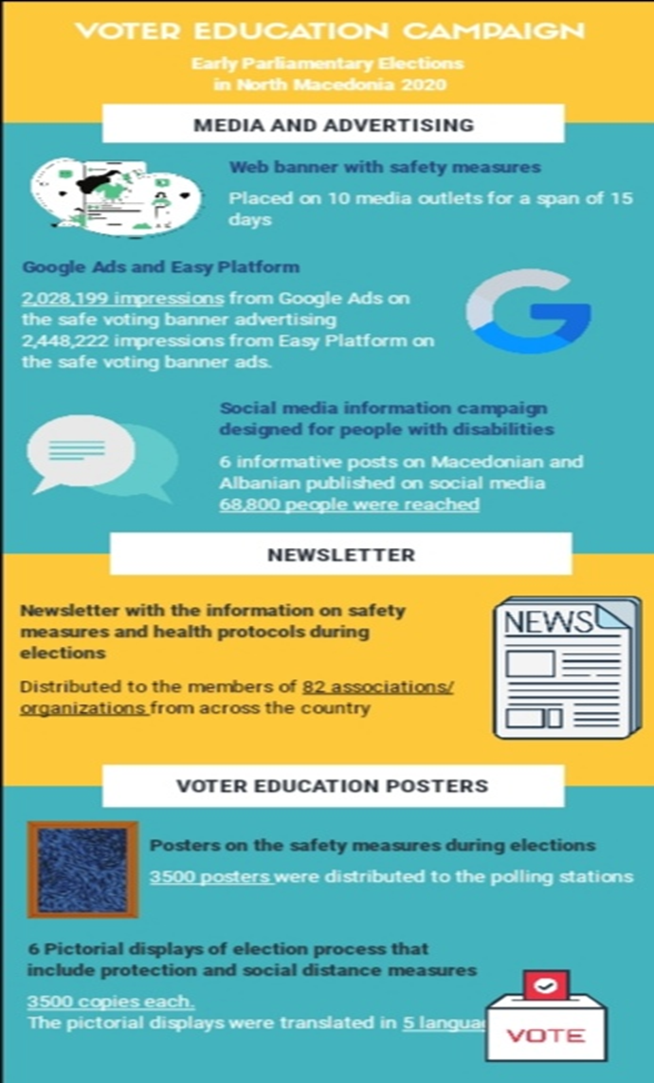
Voter Information / Outreach
Notes:
IFES supported the SEC with voter information and outreach campaign assistance to inform voters of the protective measures which should be followed
The campaign included videos, radio messaging, brochures, leaflets, social media adds, posters for election day in all PSs
These were supplemented by targeted campaigns for people with disabilities, remote and vulnerable communities, including Roma voters
These efforts were designed to build public confidence in safety during voting, on election day as well as in the ability of the SEC to administer elections in a COVID-19 environment

Slide 11
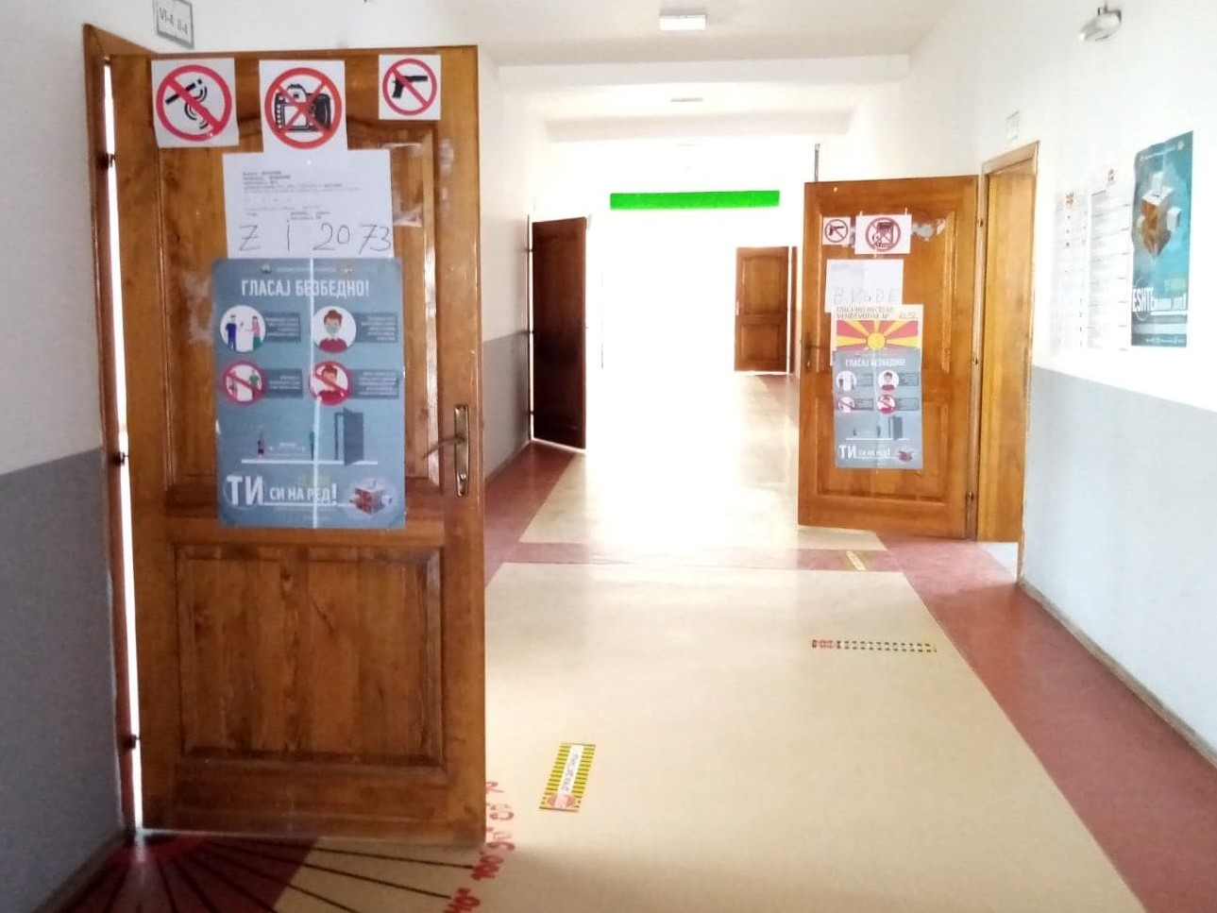
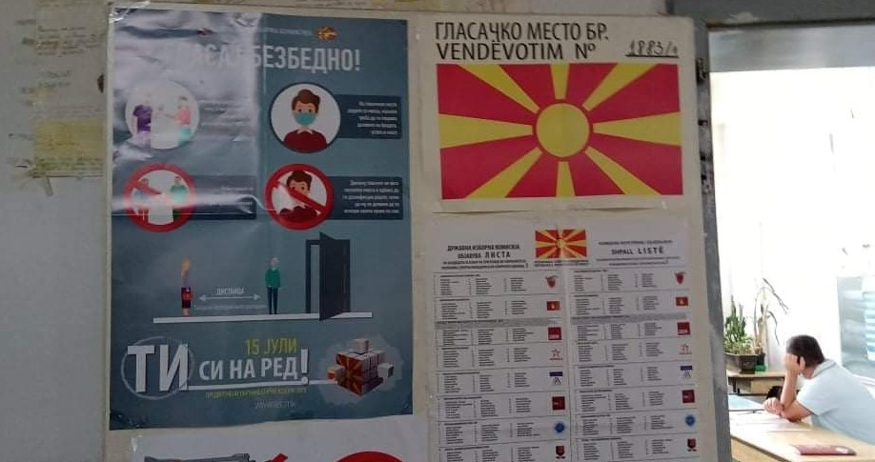
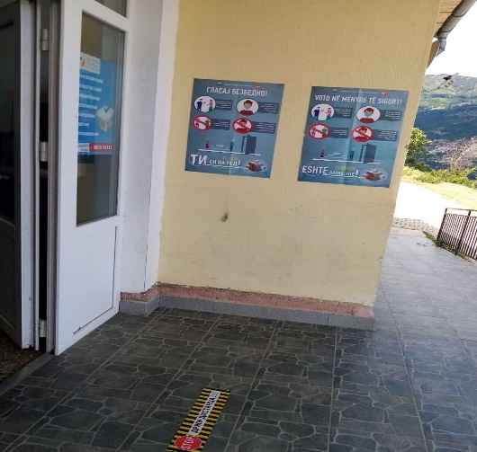
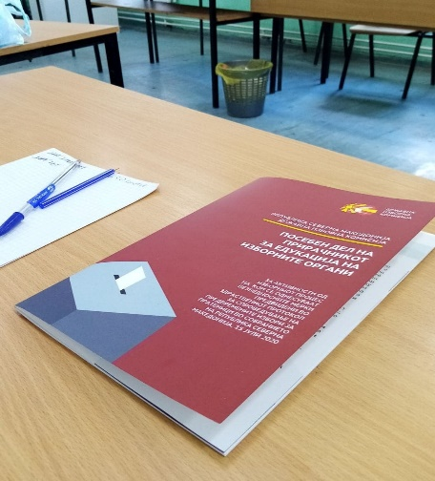
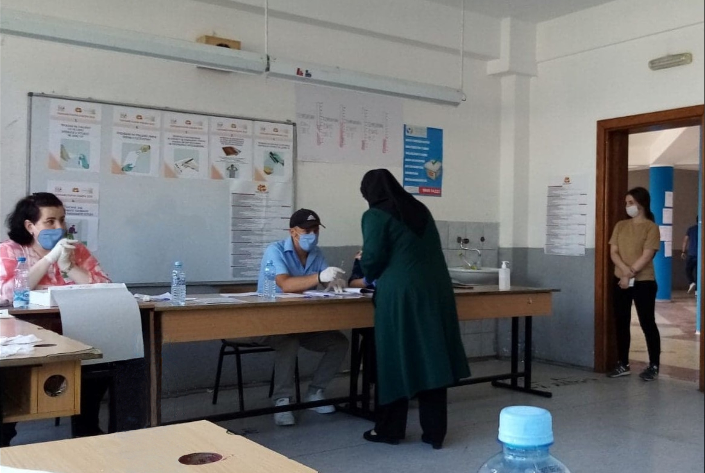
N. Macedonia Election Day

Slide 12
IFES Kyrgyzstan
IFES provided support in three key areas:
Organization and conduct of elections
Civic and voter education
Promoting enfranchisement of youth, persons with disabilities and gender equality
Notes:
I. E-modules for the CEC
To ensure preparation for October 4 Parliamentary elections amid the pandemic, IFES has developed 6 e-modules in Russian and Kyrgyz languages for training of election commissioners on the basis of existing electronic platform for E-learning trainings.
IFES COVID-19 Guidelines on safeguarding health and elections
IFES has developed a set of guidelines dedicated to conducting elections under special conditions. The primary goal of the guidelines was to combine the experience of foreign countries in conducting elections under special conditions. Recommendations and requirements of international health organizations were included in the guide. IFES Kyrgyzstan has translated into Russian and Kyrgyz languages the guidelines on safeguarding health and elections. These guidelines were disseminated among the CEC, Parliament, Government, the State Registry Service (SRS) and observer groups. The CEC chairwoman noted that these guidelines were utilized as a unique set of rules to follow amid the pandemic. The recommendations have been considered and incorporated into the CEC instructions on certain electoral activities and in sanitary-hygienic requirements for the electoral process and E-day.
PPEs
IFES procured PPEs for the preparation of Parliamentary elections both for voters and members of election commissions to ensure health and safety at the 2,462 polling stations. At the request of the CEC, IFES provided disposable face masks, sanitizers, alcohol injection wipes to disinfect fingers and fingerprint scanners, antibacterial wet wipes and adhesive tape to indicate social distance at polling stations:
- disposable masks – 260,000 pcs
- sanitizers - 5900 pcs
- alcohol injection wipes – 3 million pcs for disinfection of fingers and scanners of finger-print
- adhesive tape (for marking social distance) – 4924 pcs
- antibacterial wet wipes – 9000 pcs
II. International expert club
Ongoing COVID-19 pandemic made it possible to move the International Experts Club online (the IEC was initiated by IFES Kyrgyzstan in 2011). On IFES Kyrgyzstan’s Facebook page well-known experts with solid background in electoral leadership from USA, Israel, Ukraine, Moldova, Latvia, Bulgaria and Kyrgyzstan are discussing twice per month and analyzing election-related issues in the context of elections in Kyrgyzstan and other countries with an aim to share and exchange their experience in organizing elections in challenging conditions and overcoming different obstacles that may appear during election process. Live discussions are followed and commented by the election management representatives and serve as best practice recommendations while ensuring exchange of experience among peers and other electoral stakeholders such as national observer groups, civil society etc.
Expert dialogue on elections
In order to provide wider audience with information on election organization in different countries, election process and innovations, IFES organized a series of LIVE dialogues with distinguished experts (in a user-friendly language for followers) on Instagram and Facebook ahead of the Parliamentary elections on October 4. IFES held eight events with experts to discuss international best practices and topical issues related to the upcoming elections and election process amid the pandemic with a wider audience including first-time voters, observers, youth etc. For instance, IFES facilitated a conversation on holding elections during a pandemic by looking at the 2020 Presidential election in Poland with Vasil Vashchanka, an independent expert in the field of elections and rule of law and former Deputy Chief of Rule of Law at OSCE/ODIHR. Other events highlighted how the pandemic affected international observation, including consequences of absent observation missions, e-voting, out-of-country voting as well as the challenges and difficulties of election campaigning and voter education.
III.
Online Democracy Camp, online Election Schools and online youth Forum
IFES Kyrgyzstan, having more than 20 years of experience in conducting offline Democracy Camps for youth, as well as experience in conducting Election Schools in all regions of the country, has built an extensive portfolio of results and accumulated sufficient tested material and methodology to create online youth Civic Engagement platform. The most qualified trainers developed and conducted first-ever online Democracy camps. To ensure continuous work with youth and due to COVID-19, the traditional ten-day Democracy Camp programme was transformed into online programme that combined theoretical and practical approaches with involvement of creative studios. The programme highlighted key topics, including human rights, state and good governance, elections, gender equality, media literacy and project management. The interactive studio time provided with an opportunity for participants to utilize what they learned to create multimedia, social media marketing materials and speak publicly. The Camps were well-received by both participants and trainers, who recognized the significant accomplishment of holding the landmark activity during the COVID-19 pandemic. The camps were held on IFES’ educational platform http://demcamp.ifes.kg. IFES also utilized the platform for conducting 3-day online Elections Schools and an Online Forum for Youth equally involving regional and gender strata.

Slide 13
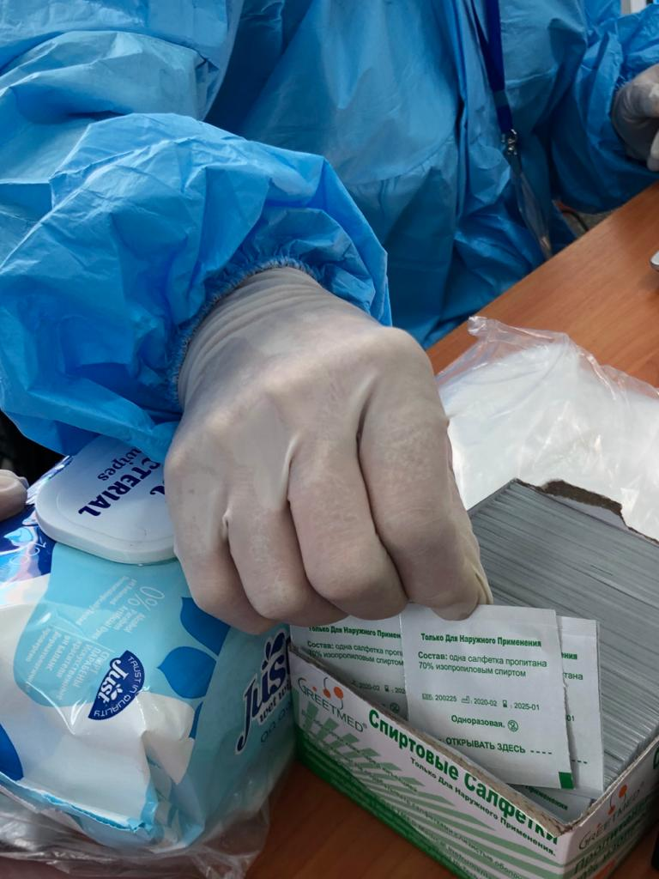
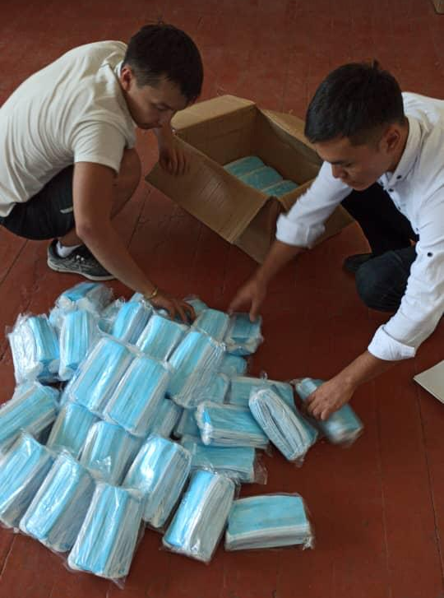
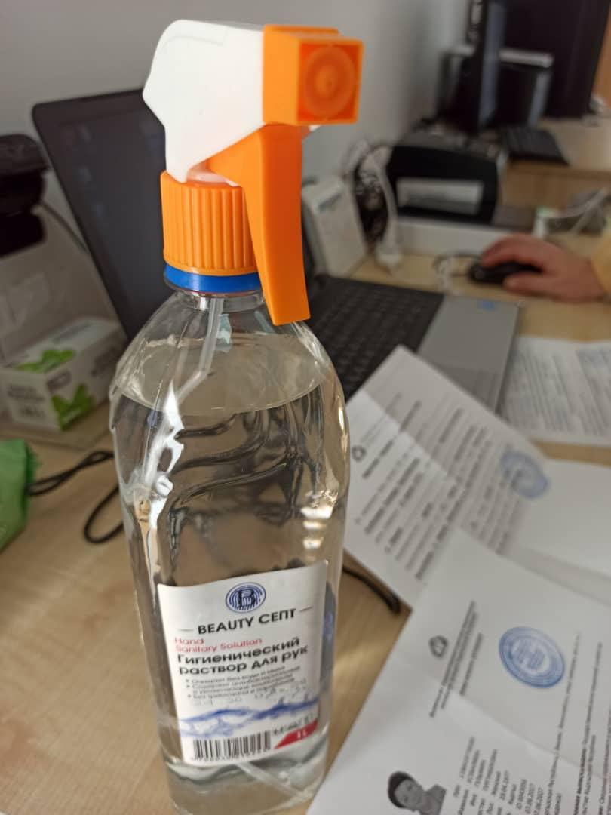
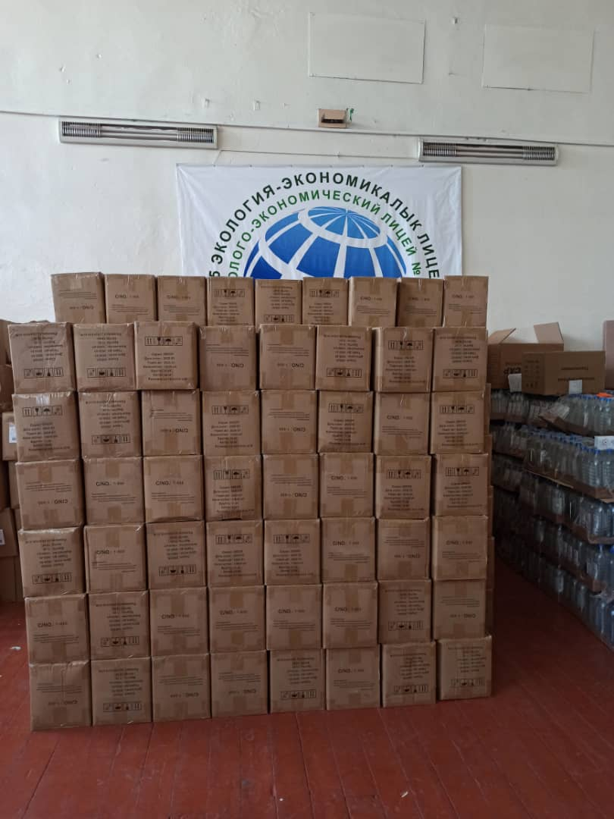
IFES Kyrgyzstan
Personal Protective Equipment
Alcohol injection wipes for disinfection of fingers and scanners
Face masks
Hand sanitizers
Antibacterial wet wipes

Slide 14
IFES Ukraine
IFES supported key stakeholders in planning, procedural support, training, education, assessment
Supported CEC to set up inter-ministerial working group to address COVID-19 ahead of local elections
Provided training and informational materials to all TEC/PECs on mitigating risks (manuals, video tutorials, online training, posters at each PEC)
Launched nationwide voter education campaign with CEC focused on safety measures in place to encourage participation as well as voter protection, such as mask wearing

Slide 15
IFES Ukraine
Worked with civil society organizations to target groups facing discrimination (people with disabilities, the internally displaced, women, young people, and the Roma community) to provide information on how to vote safely and encourage participation.
Together with IFES, the CEC released a training video for members of local election commissions on voting in times of COVID-19
Together with IFES, the CEC produced 30,000 posters on safe voting in times of COVID-19 before local elections for each precinct election commission with QRL codes for sign language and audio interpretation.

Slide 16
IFES Ukraine
Conducted an online pre-election survey, is analyzing the impact of COVID-19 mitigation measures through an assessment and will launch a national online post-election survey. At this time, while cases continue to rise across the country, there has not been evidence of a significant post-election spike in cases
Worked with journalists and media to discourage the spread of dis/misinformation

Slide 17
IFES Georgia
Covid-19 Risk Assessment Team
Team formed to assist CEC / government with preparations, readiness, safeguards, PEC training and improved voting procedures
Buttressed by pre- and post-election surveys, as well as focus groups in eight target locations
Data gathered aligned with the information collected during in-person and remote meetings with various electoral stakeholders (EMB representatives, CSOs, political parties, government agencies) for more comprehensive overview
Number of recommendations taken into account and incorporated in different sections of the CEC regulation on electoral activities and health requirements for Election Day

Slide 18
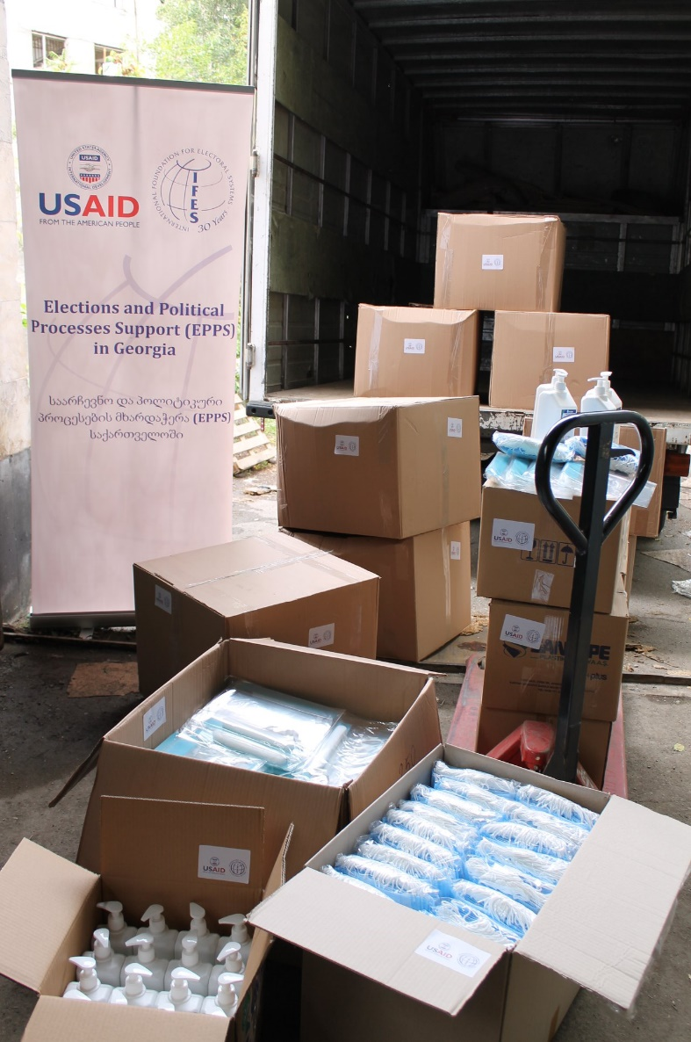
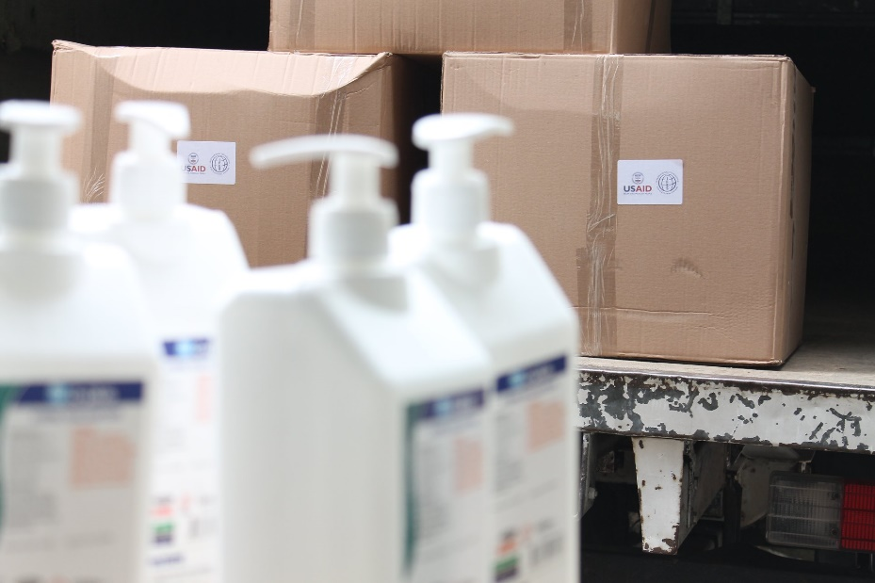
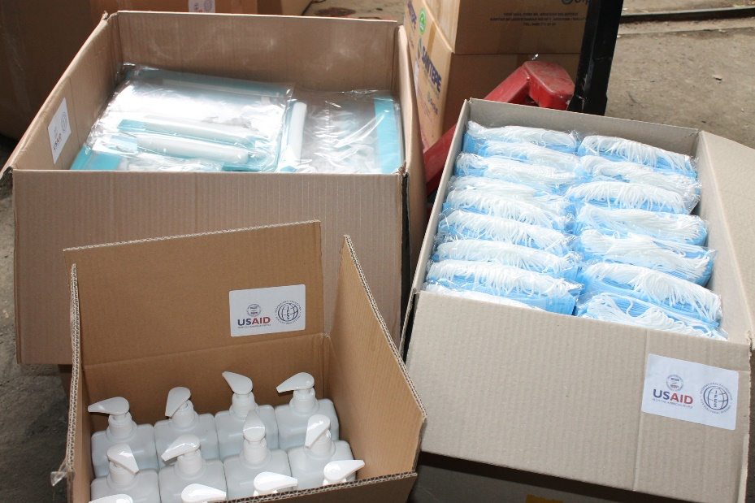
IFES Georgia
Personal Protection Equipment
In order to ensure safe election and to adhere to the safety requirements set forth by the CEC, IFES has procured and delivered the Personal Protection Equipment (PPEs) for elections in amount of the 2.5 million face masks, 48,100 face shields and 6,750 liters of sanitizing liquids. Thus, each and every polling station was equipped with all necessary items for COVID-19 Safe Electoral Environment.

Slide 19
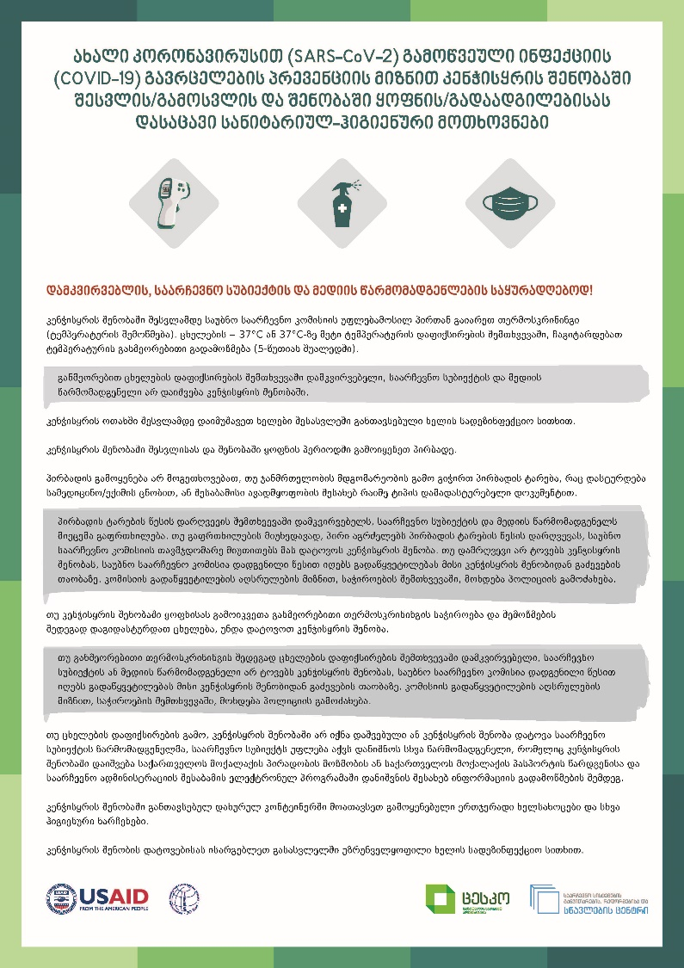
IFES Georgia
Voter Education Efforts
IFES has engaged with the CEC to create voter education materials such as posters, PSAs, among others (including in ethnic minority languages). These items have covered safety measures of the election in regard to Covid-19 and regulations necessary for voters and poll workers on election day to be aware of:
- Rights of Persons with Disabilities during and beyond COVID-19
- Sanitary and hygienic procedures on E-day
Links to PSA: https://fb.watch/1G2op8F0Lz/
https://fb.watch/1G35fojOMl/

Slide 20
Key Lessons Learned
Above cases gives rise to a number of important conclusions for countries seeking to hold elections during the COVID-19 pandemic:
In each case, targeted assistance was predicated on a deep risk analysis
This ensures that assistance gets to the heart of a countries contextualized problems and that the targeted interventions are more impactful
Political dialogue is key to addressing many of the crucial issues that emerge and such dialogue should happen as soon as possible in an inclusive format
Longer time periods need to be built-in to such assistance to ensure proper risk-based analysis planning, rather than an ad hoc approach and to have human resources and capacity in place
Long-term partnerships crucial to move quickly with interlocutors based on trust

Slide 21
Questions
Dr. Beata Martin-Rozumiłowicz
Director for Europe and Eurasia, IFES
2011 Crystal Drive, Arlington, VA 22202
bmartinrozumilowicz@ifes.org | www.IFES.org

